Slide 1


CALIFORNIA LODGING
FORECAST UPDATE
Prepared for:
Visit California
April 2022
WWW.TOURISMECONOMICS.COM

Slide 2
CONTEXT
Visit California engaged Tourism Economics to prepare a custom forecast of key lodging sector indictors for twelve California regions (consistent with the market as defined by STR). The analysis relies on:
Data provided by Visit California, such as historical guest hotel metrics;
Tourism Economics’ prior research on California’s tourism economy;
STR hotel data through February 2022;
Economic forecasts prepared by Oxford Economics, parent company of Tourism Economics; and,
Assumptions on the future path of tourism sector recovery.
The US economy faces shifting headwinds. The Omicron wave has now been largely contained but higher inflation and greater uncertainty triggered by Russia’s invasion of Ukraine have emerged as key risks. We anticipate real GDP will grow 3.4% this year and slow to 2.1% in 2023, but risks are tilted to the downside given the intensifying inflation shock, a growing fiscal drag, and a more hawkish Fed.
The worsening inflation outlook stemming from the Russia-Ukraine war will weigh on consumer spending in the coming quarters, though we expect excess savings and robust wage growth will soften the blow. Overall, we still see robust consumer spending growth of 3.4% this year, which will continue to support robust domestic US travel including California’s lodging sector.
California’s lodging sector continued to outperform our expectations in the first two months of the year. Current forecast anticipates close to 2,100 more daily rooms in demand this year compared to our forecast in December. Recent performance coupled with inflationary pressures resulted in an ADR upgrade to $174 from $167 this year. Risks are skewed to the downside.

Slide 3
NATIONAL ASSUMPTIONS

Slide 4
ECONOMIC OUTLOOK
Changing headwinds driven by inflation and war
The Omicron wave contained by greater uncertainty triggered by Russia-Ukraine war
Economic output
Labor market
The US economy faces shifting headwinds. The Omicron wave has now been largely contained but higher inflation and greater uncertainty triggered by Russia’s invasion of Ukraine have emerged as key risks. We anticipate real GDP will grow 3.4% this year and slow to 2.1% next year, but risks are tilted to the downside given the intensifying inflation shock, a growing fiscal grad, and a more hawkish Fed.
Inflation continues to run hot. In January, headline CPI surged to 7.5% y/y from 7%. Our modelling of the energy shock shows a higher near-term peak in CPI inflation and a slower decline through 2022. Consumer prices now look likely to rise 6.3% in 2022. Excess savings and wage growth will soften the inflation blow and consumer spending will grow 3.4% this year.
The February employment report indicated that the labor market ended the Omicron wave on strong footing. Job creation gained further momentum, with payrolls up by stronger-than-expected 678,000, and the unemployment rate fell to 3.8% even as the labor force participation rate edged up to a new post-pandemic high. Incomes have been supported by compensation growth this year, after fiscal transfers were the driver in 2022. We expect robust economic momentum will help close the remaining 2.1mn jobs shortfall in H2 2022.
The need to expand productive capacity to meet demand and replenish inventories should support robust business investment of 5.3% this year, but disruptions from the Russia-Ukraine war could dampen business spending plans.
Consumers
Business sector

Slide 5
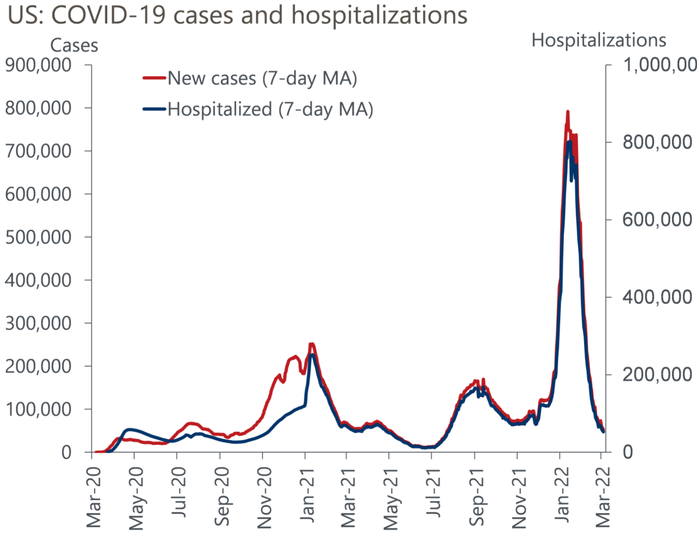
US: COVID-19 CASES AND HOSPITALIZATIONS
New virus cases have fallen sharply
Covid cases have reached their lowest levels since last summer

Slide 6
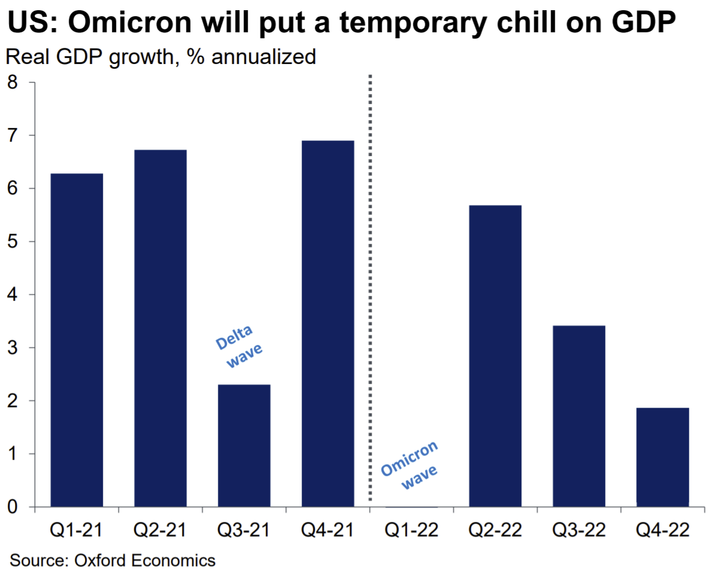
US GDP GROWTH
Omicron will put a temporary chill in GDP

Slide 7
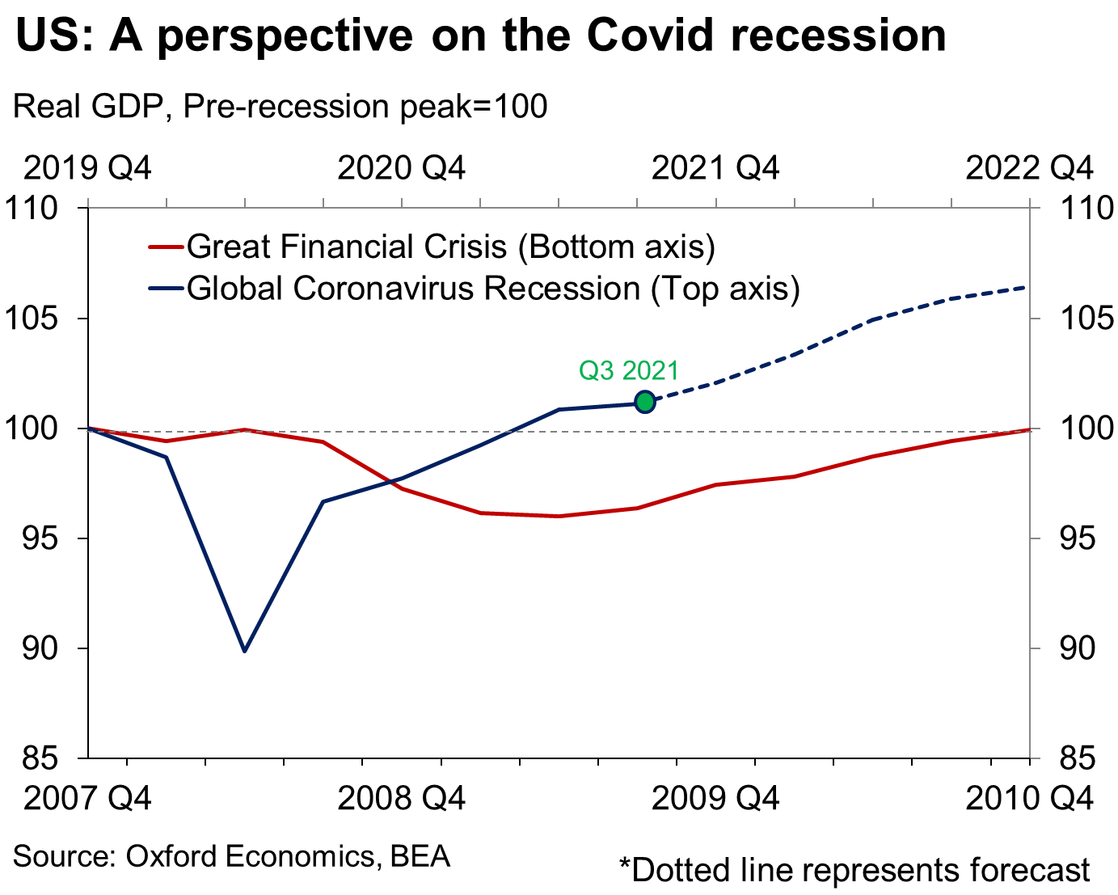
US: A PERSPECTIVE ON THE COVID RECESSION
A historically brisk economic recovery
GDP growth:
2020: -3.4%
2021: 5.7%
2022: 3.5%

Slide 8
US: EMPLOYMENT RECOVERY CONTINUES
Labor market ends the Omicron wave on strong footing
Job creation gained further momentum with payrolls up by 678,000 in February, stronger-than-expected.

Slide 9
US NON-FARM PAYROLL EMPLOYMENT
An uninspiring jobs report in November
The shortfall of jobs relative to pre-Covid levels has shrunk to just 2.1 million

Slide 10
US: UNEMPLOYMENT RATE
Unemployment rate from 15% to 4% in record time

Slide 11
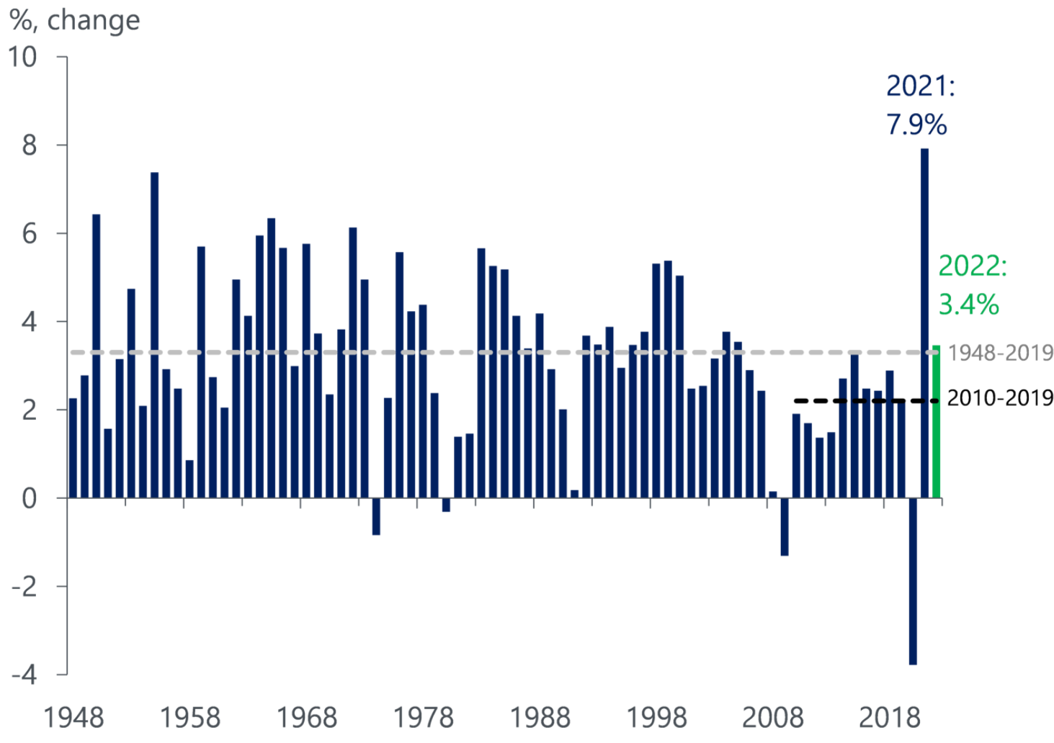
US: CONSUMER SPENDING
Above-trend consumer spending growth in 2022
Russia-Ukraine war will weigh on consumer spending, but excess savings and robust wage growth will soften the blow. Consumer spending will grow 3.4%.

Slide 12
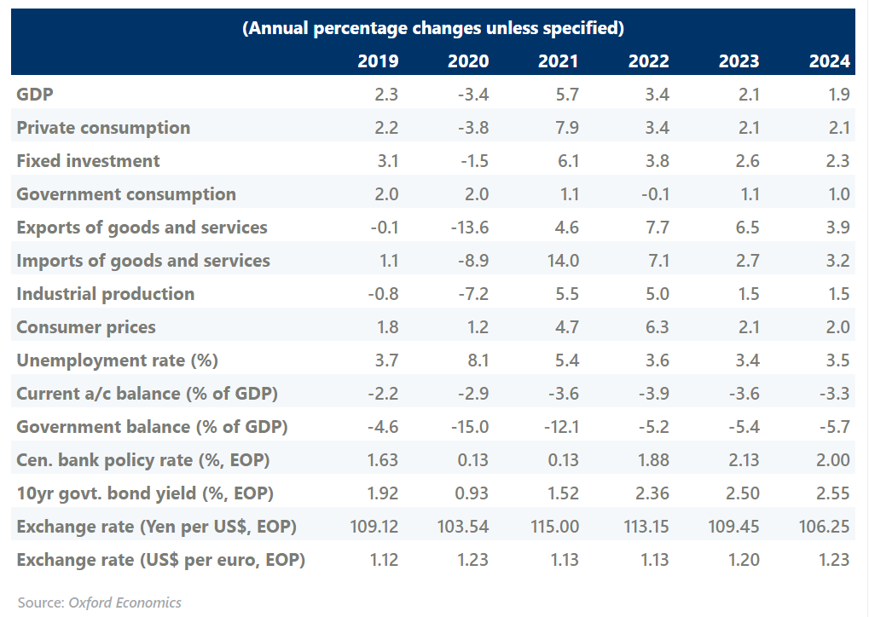
US OUTLOOK TABLE
Five-year forecast

Slide 13
US: COVID-19 DEVELOPMENTS
Covid is a factor, but situation is rapidly improving

Slide 14
HOTEL PERFORMANCE
SUMMARY
Room demand
Room demand in California increased 39.5% through February compared to the same period last year, ahead of the 29.3% increase in US room demand and behind the 41.4% increase in Pacific US room demand.
Occupancy
California remained on its steady recovery path toward pre-pandemic February 2019 occupancy of 73.9%. Occupancy in California stood at 63.0% in February compared to 48.2% last year.
ADR & RevPAR
February ADR stood at $173 surpassing the $169 pre-pandemic February 2019 ADR. In the first two months of the year, California RevPAR grew 92.5% compared to the same time period last year, significantly outperforming the US RevPAR growth of 70.9%.
Source: STR

Slide 15
CALIFORNIA FORECAST

Slide 16
SUMMARY TABLE
Annual forecast: California

Slide 17
SUMMARY TABLE
Annual forecast: California gateway regions

Slide 18
SUMMARY TABLE
Annual forecast: California non-gateway regions

Slide 19
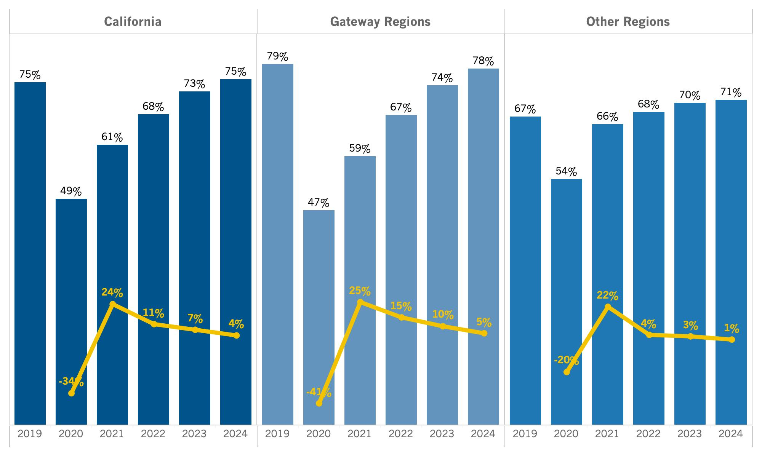
California Summary: Occupancy
Source: Tourism Economics

Slide 20
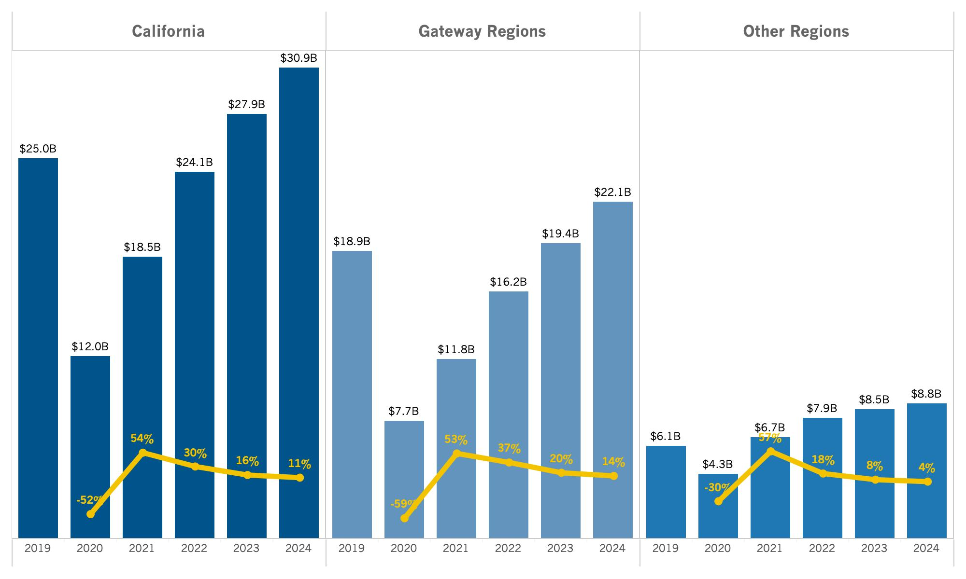
California Summary: Revenue
Source: Tourism Economics

Slide 21
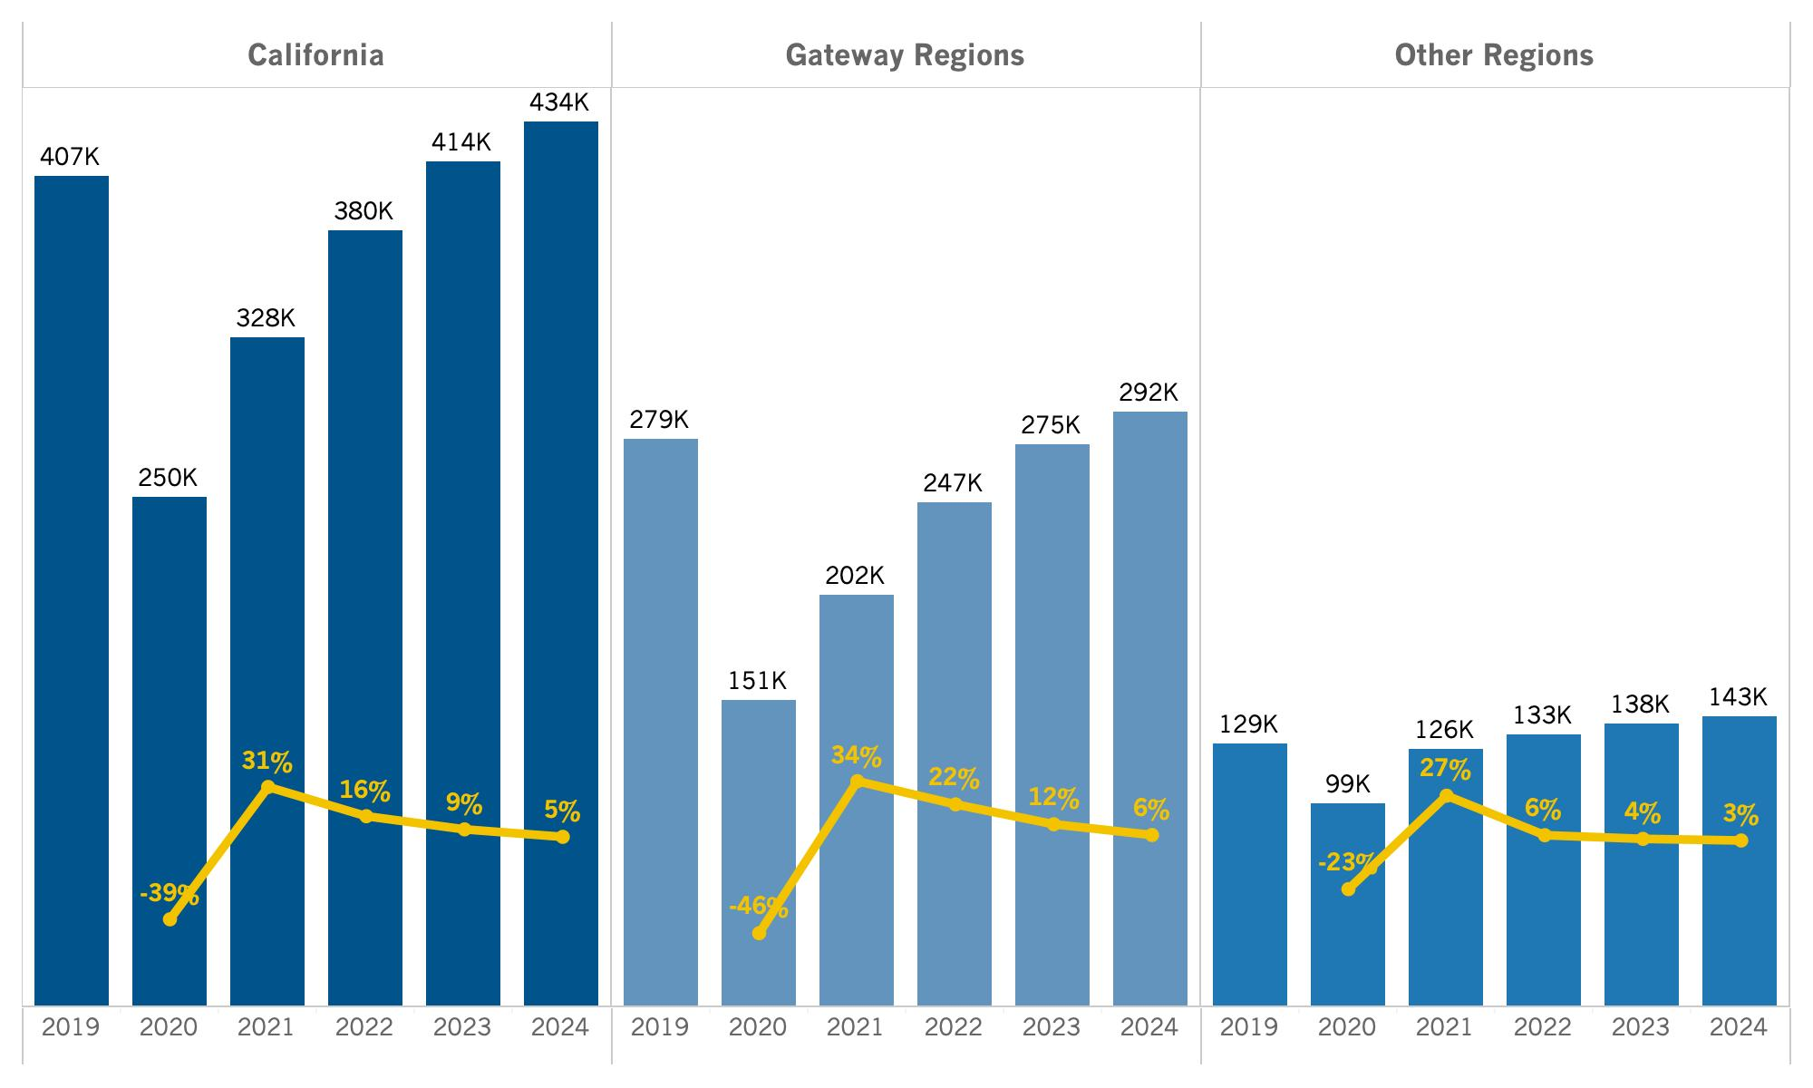
California Summary: Room Demand (Daily)
Source: Tourism Economics

Slide 22
CALIFORNIA REGIONAL FORECAST
Central Coast
Central Valley
Deserts
Gold Country
High Sierra
Inland Empire
Los Angeles County
North Coast
Orange County
San Diego County
San Francisco Bay Area
Shasta Cascade

Slide 23
Lodging Forecast
(Central Coast)

Slide 24
SUMMARY TABLE
Annual forecast: Central Coast

Slide 25
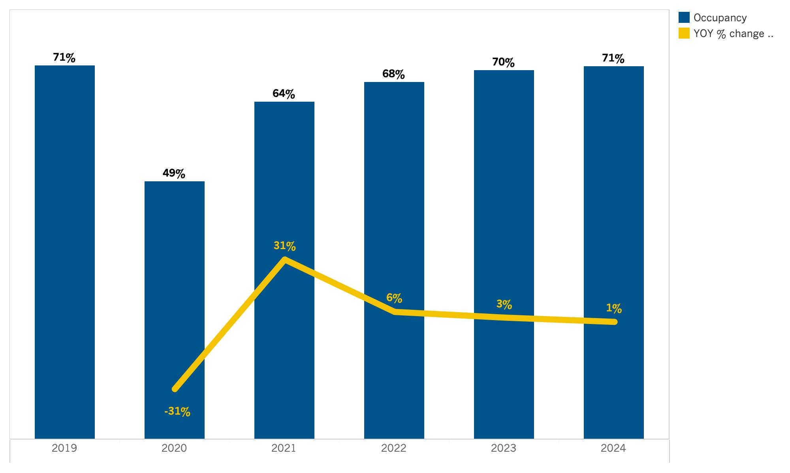
Central Coast: Occupancy
Source: Tourism Economics

Slide 26
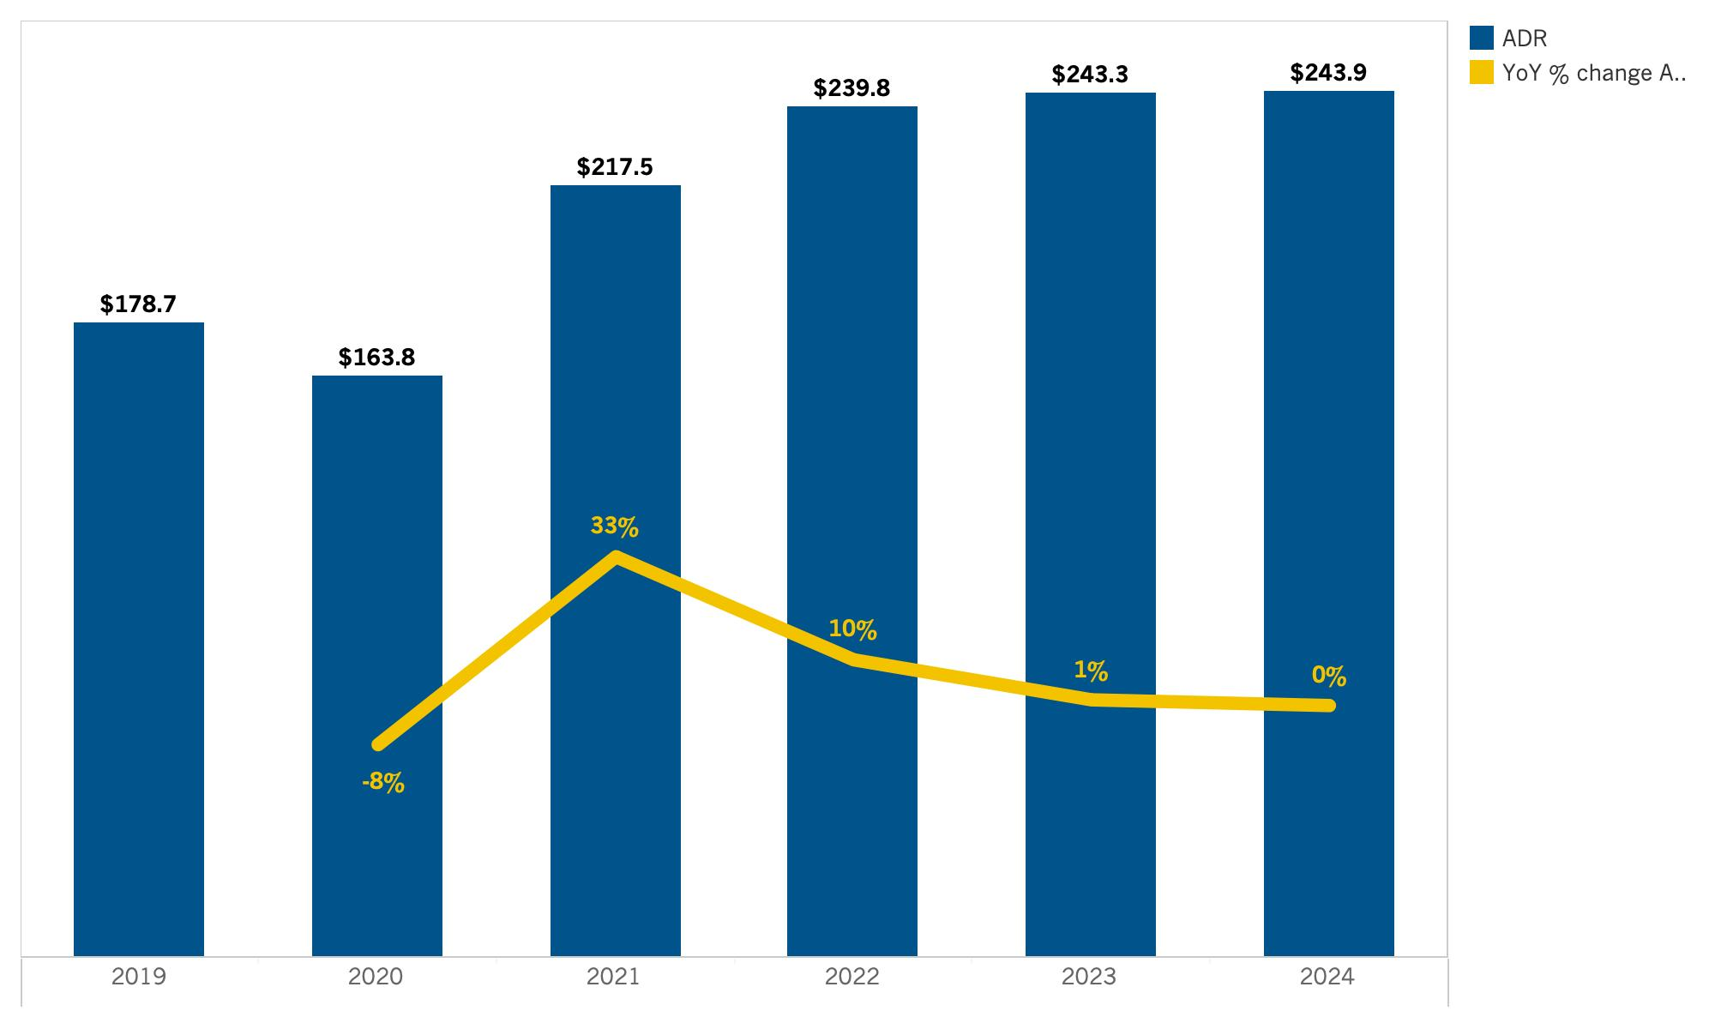
Central Coast: ADR
Source: Tourism Economics

Slide 27
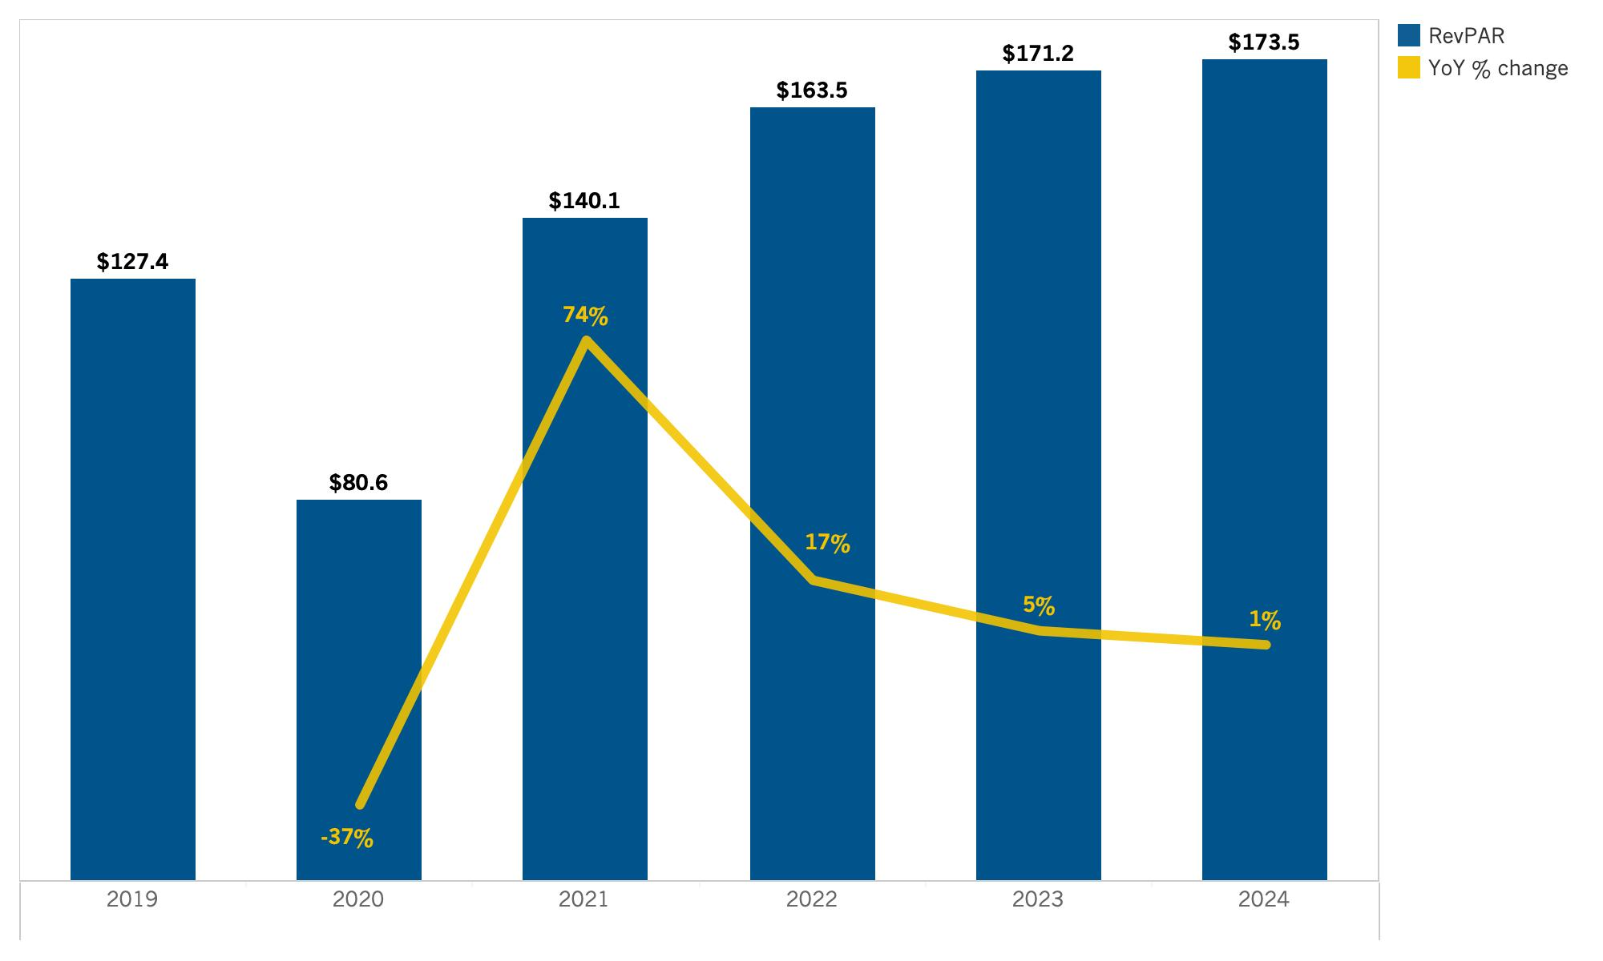
Central Coast: RevPAR
Source: Tourism Economics

Slide 28
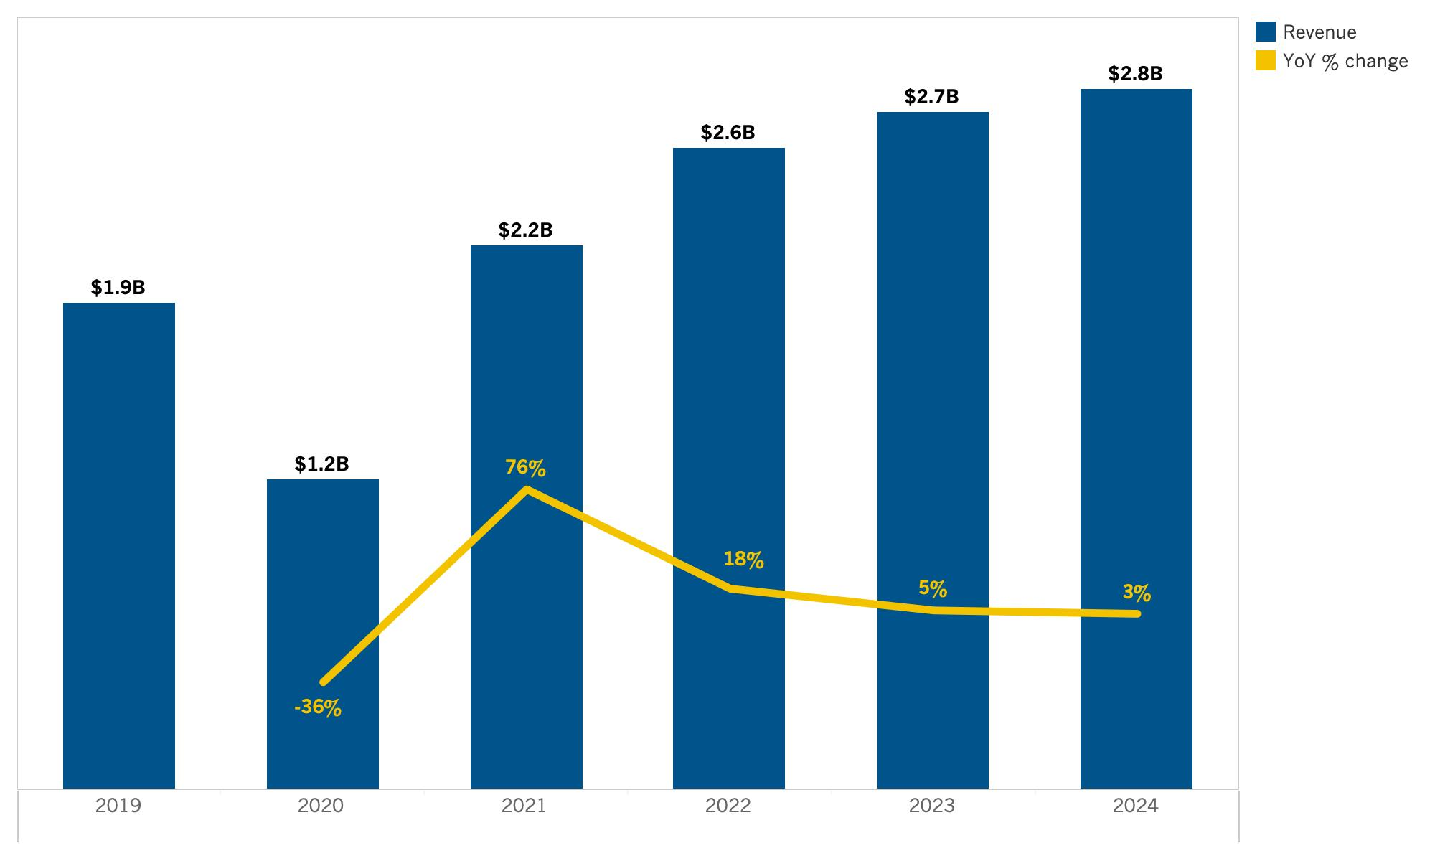
Central Coast: Room Revenue
Source: Tourism Economics

Slide 29
Lodging Forecast
(Central Valley)

Slide 30
SUMMARY TABLE
Annual forecast: Central Valley

Slide 31
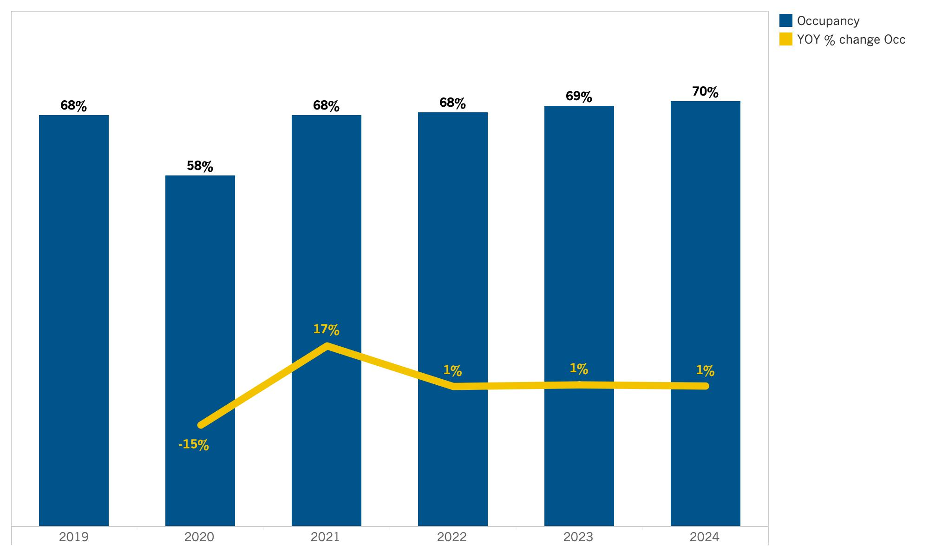
Central Valley: Occupancy
Source: Tourism Economics

Slide 32
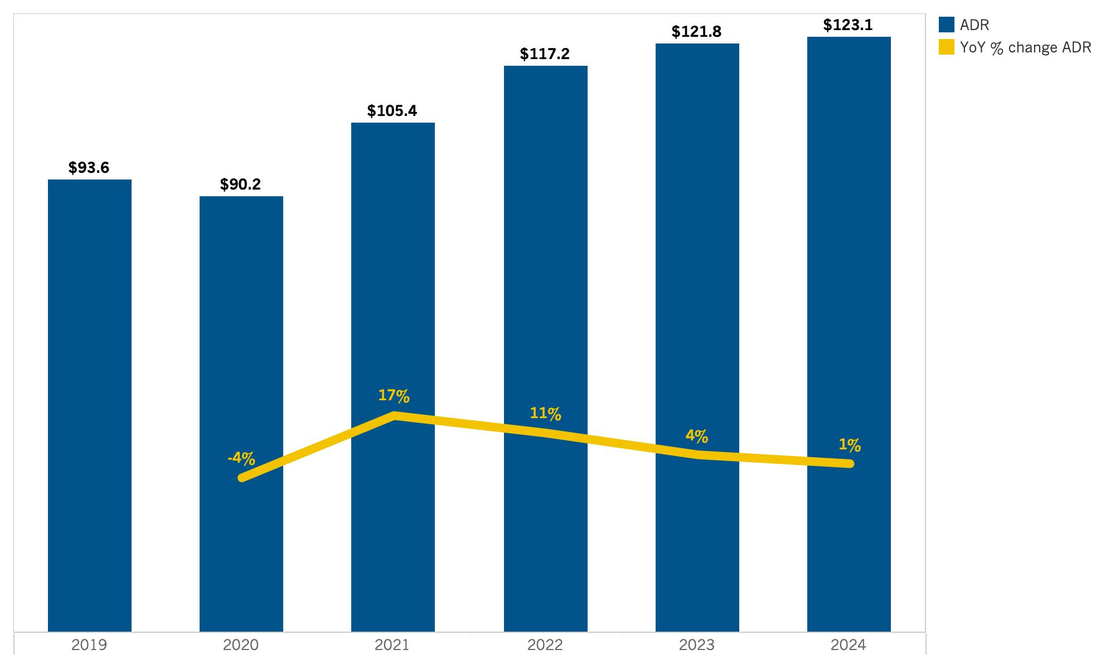
Central Valley: ADR
Source: Tourism Economics

Slide 33
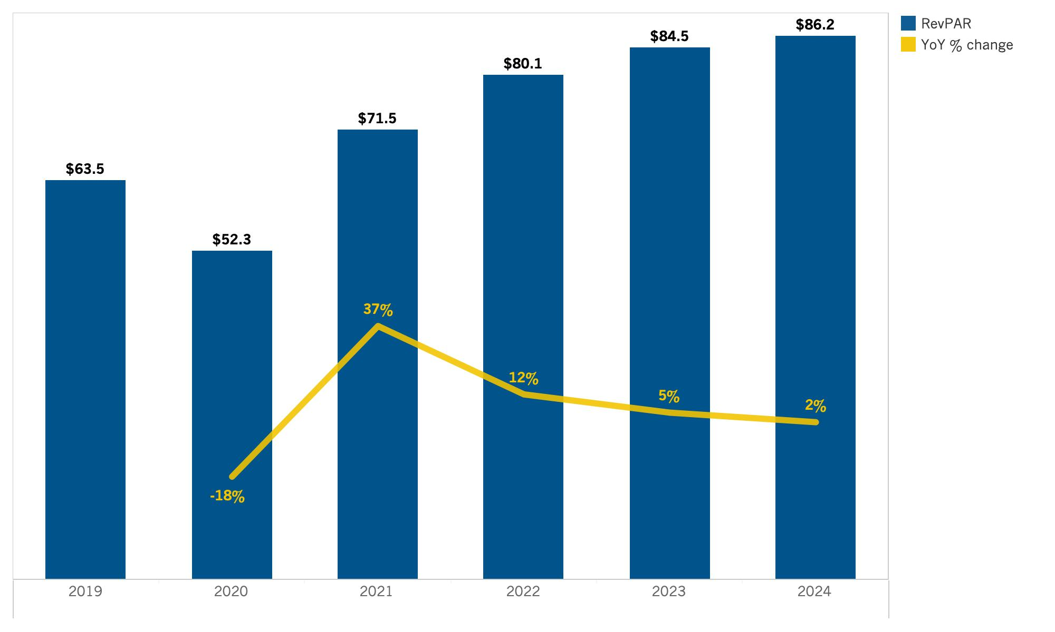
Central Valley: RevPAR
Source: Tourism Economics

Slide 34
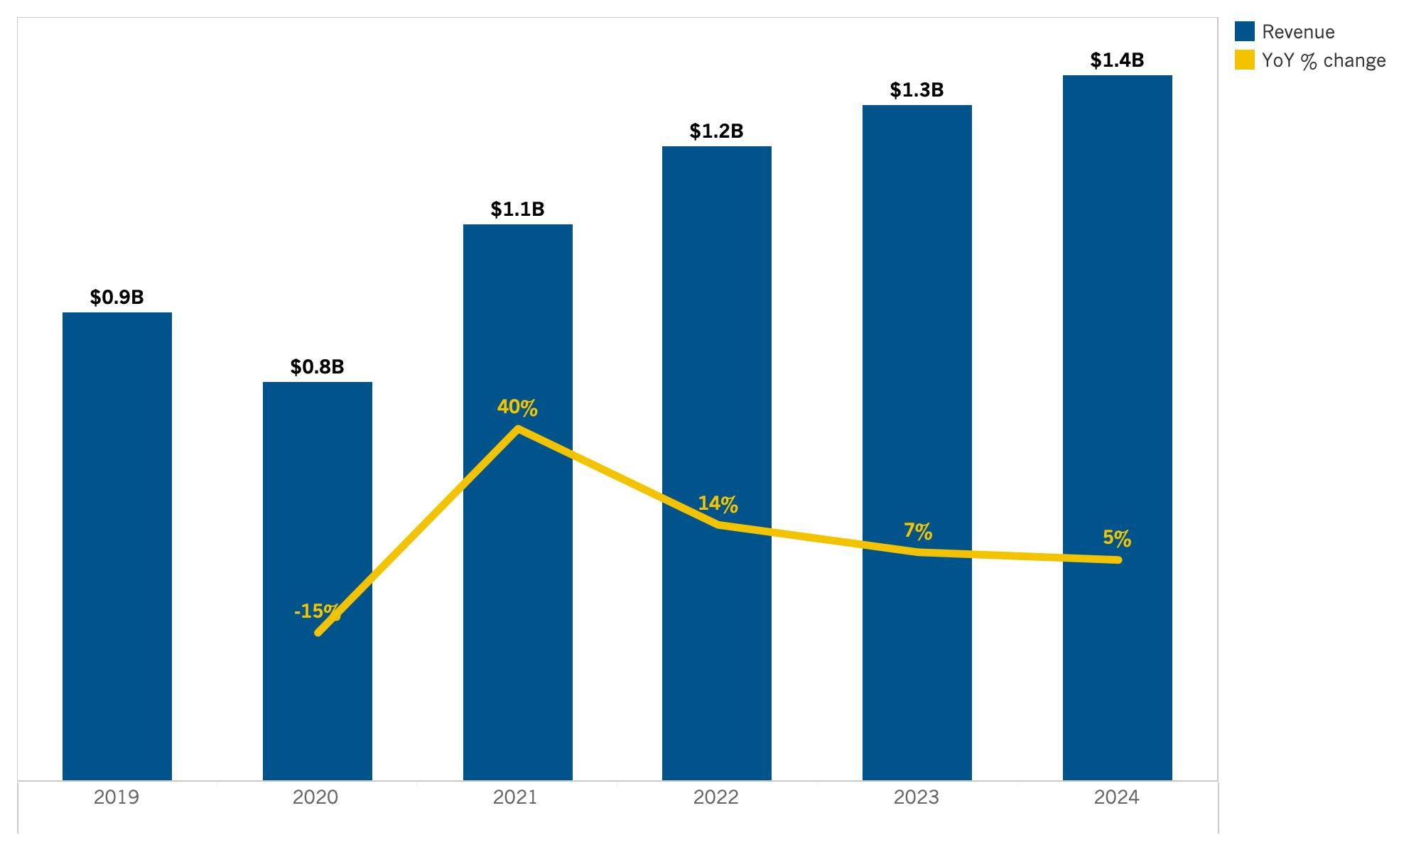
Central Valley: Room Revenue
Source: Tourism Economics

Slide 35
Lodging Forecast
(Deserts)

Slide 36
SUMMARY TABLE
Annual forecast: Deserts

Slide 37
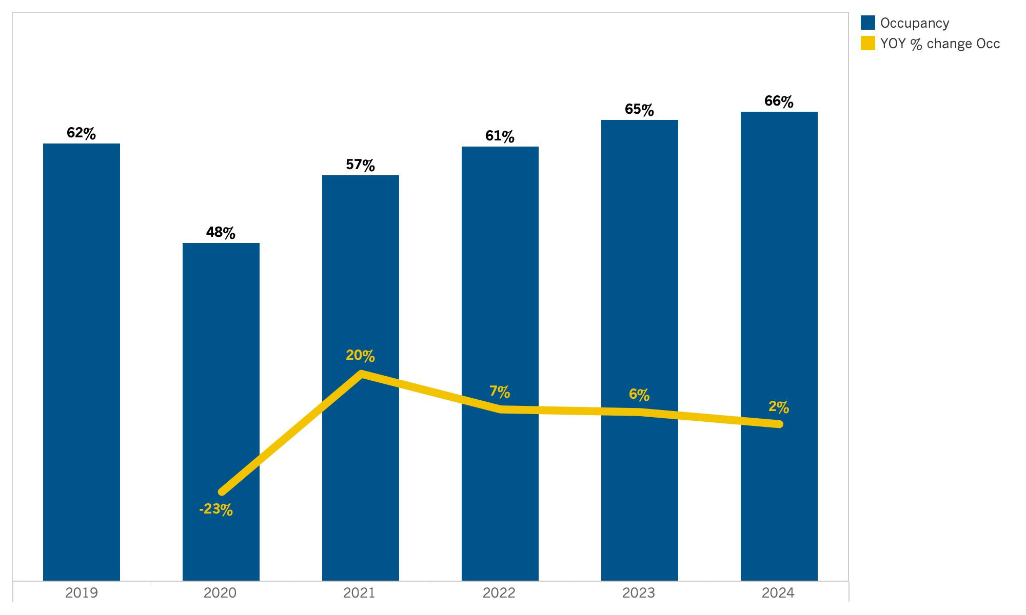
Deserts: Occupancy
Source: Tourism Economics

Slide 38
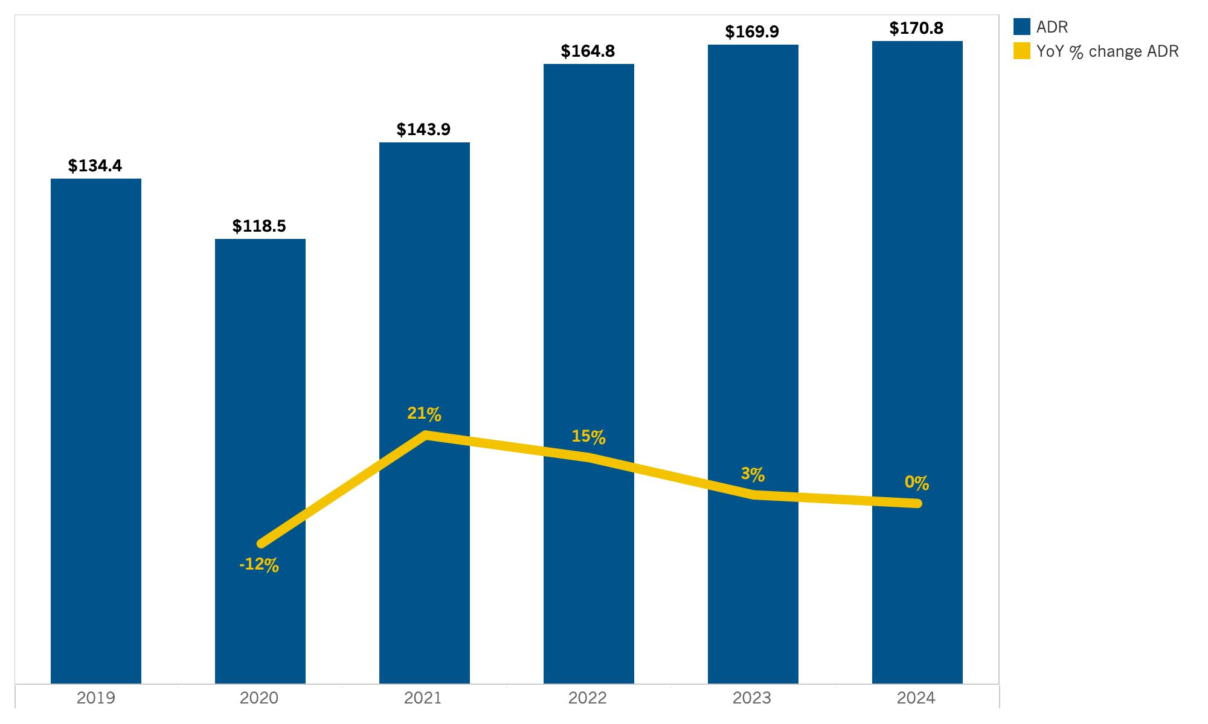
Deserts: ADR
Source: Tourism Economics

Slide 39
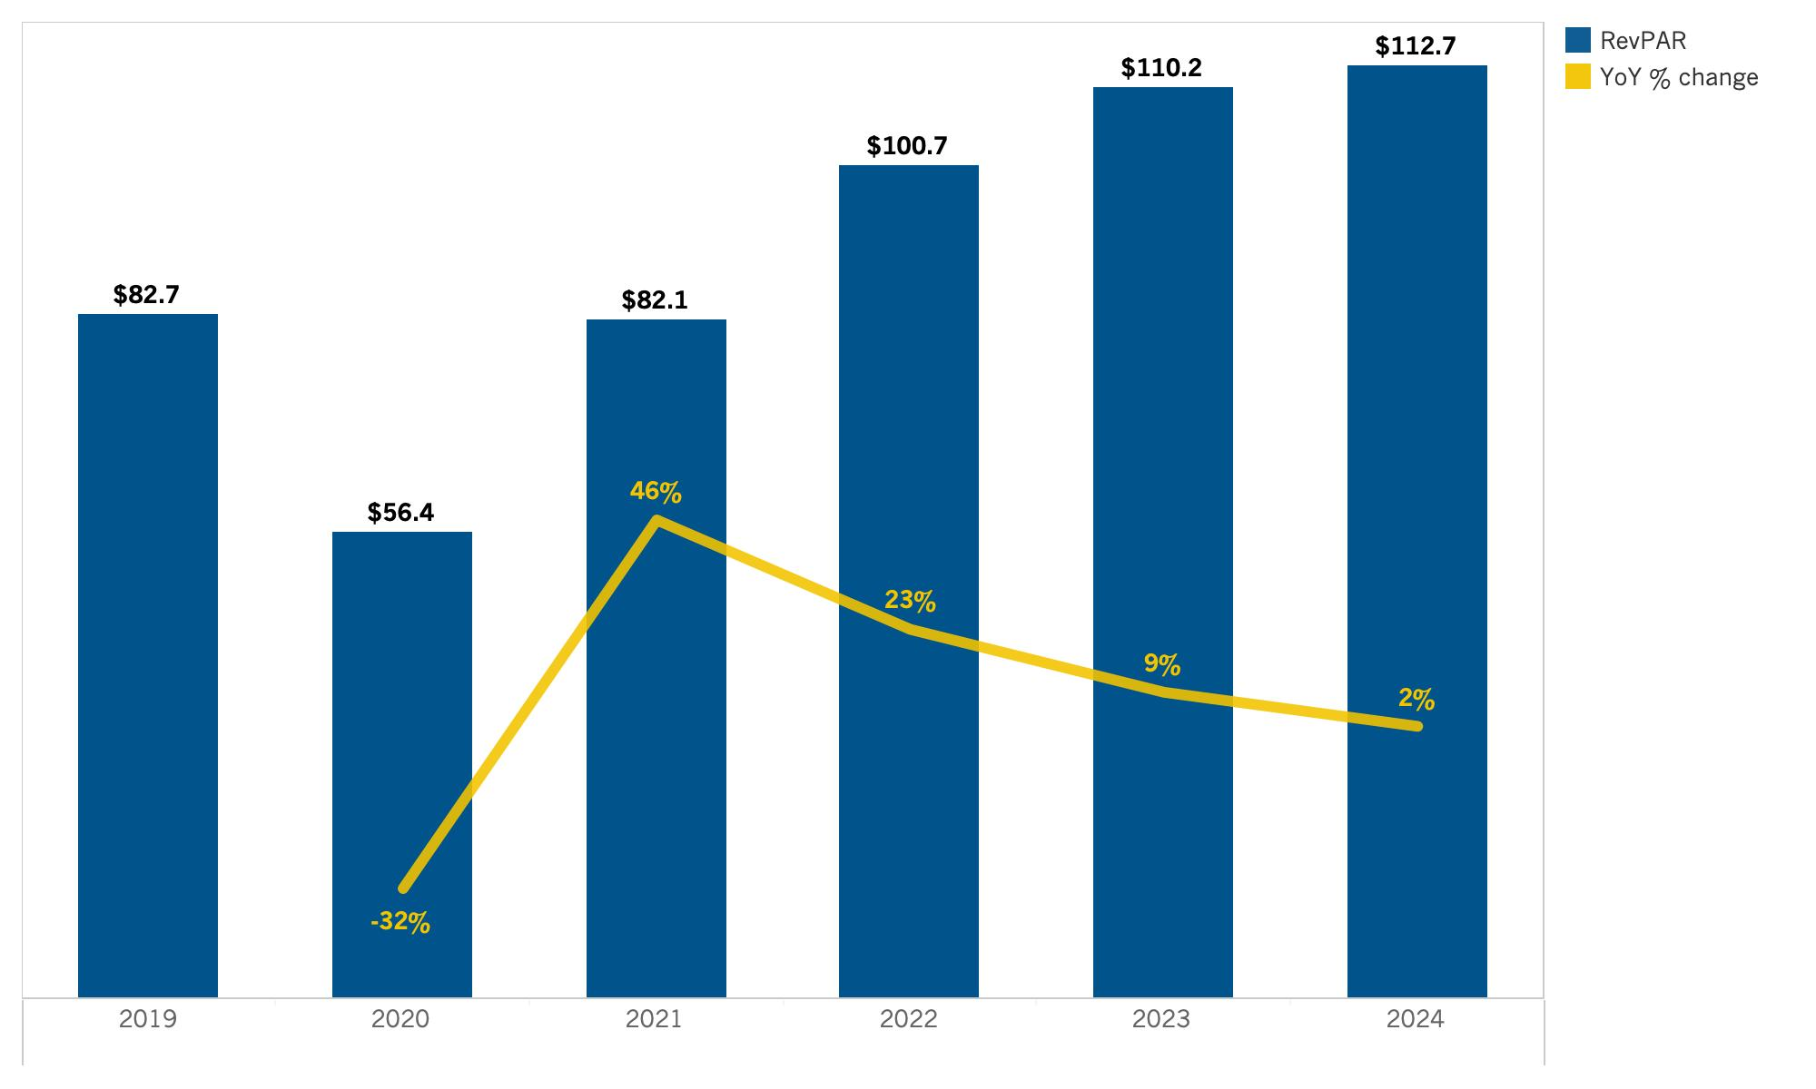
Deserts: RevPAR
Source: Tourism Economics

Slide 40
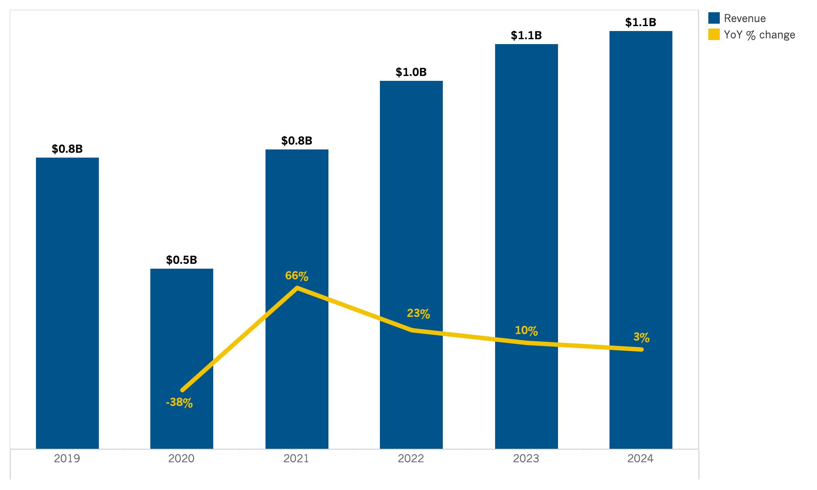
Deserts: Room Revenue
Source: Tourism Economics

Slide 41
Lodging Forecast
(Gold Country)

Slide 42
SUMMARY TABLE
Annual forecast: Gold Country

Slide 43
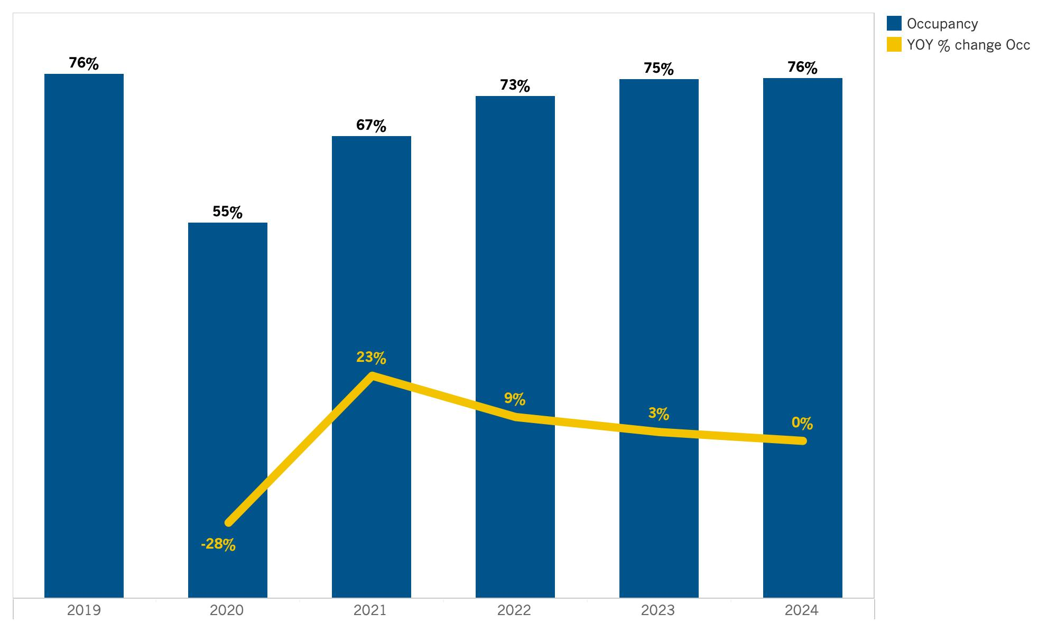
Gold Country: Occupancy
Source: Tourism Economics

Slide 44
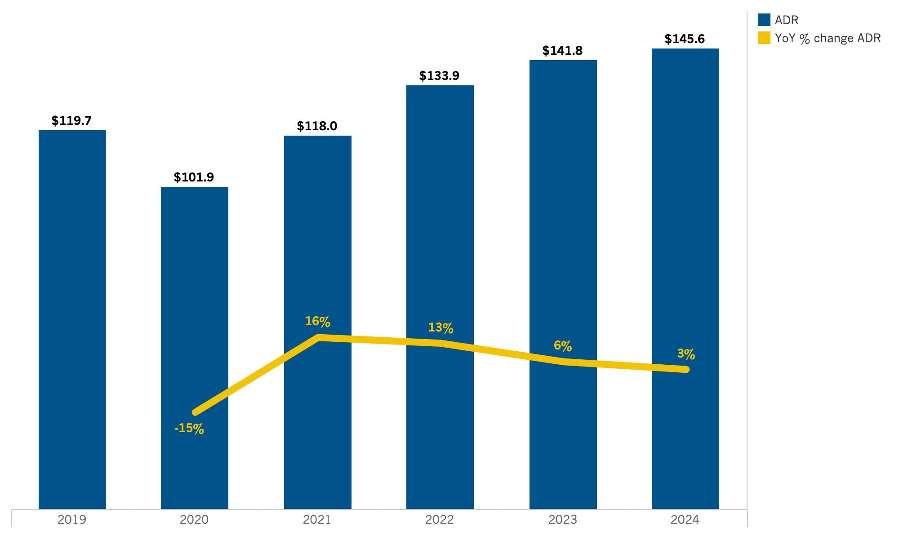
Gold Country: ADR
Source: Tourism Economics

Slide 45
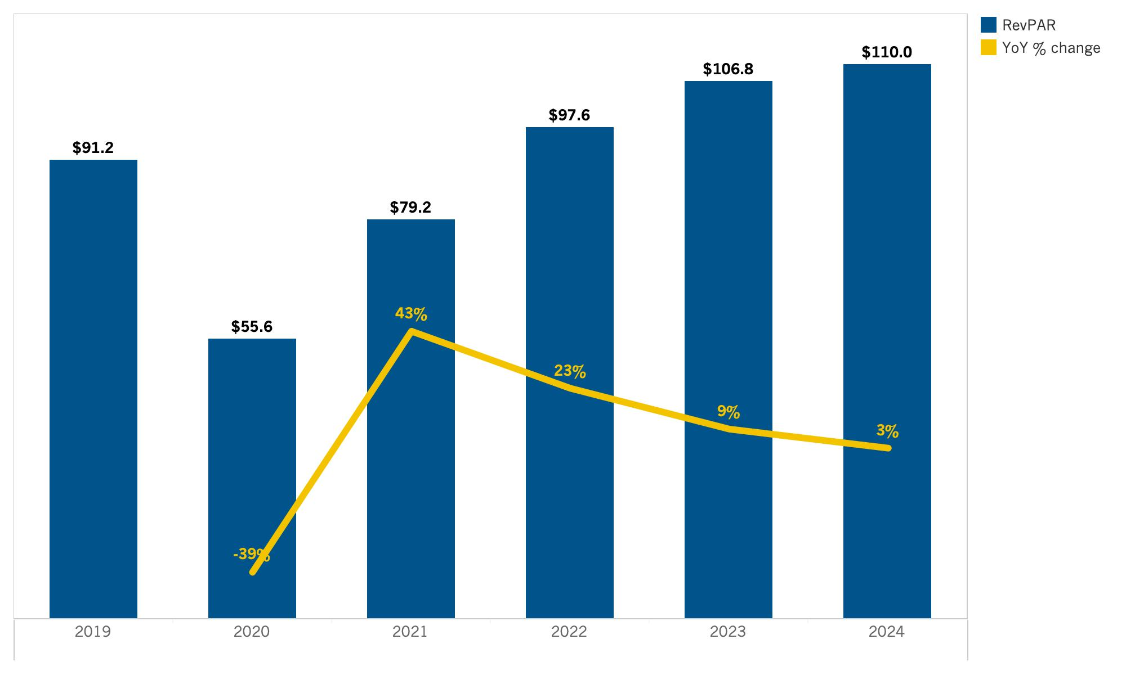
Gold Country: RevPAR
Source: Tourism Economics

Slide 46
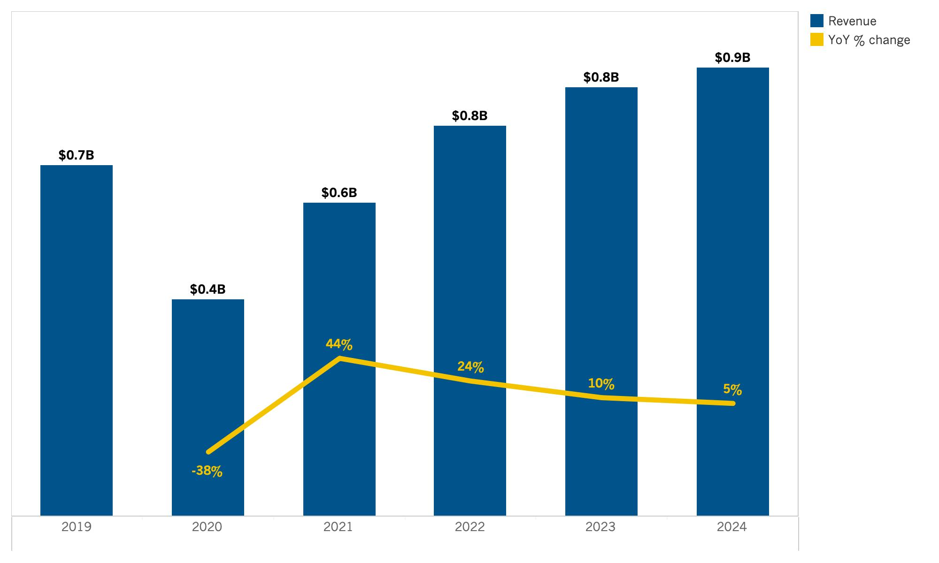
Gold Country: Room Revenue
Source: Tourism Economics

Slide 47
Lodging Forecast
(High Sierra)

Slide 48
SUMMARY TABLE
Annual forecast: High Sierra

Slide 49
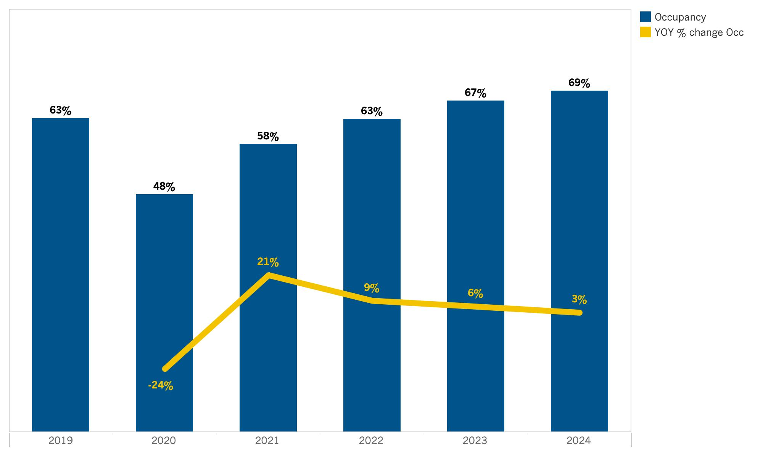
High Sierra: Occupancy
Source: Tourism Economics

Slide 50
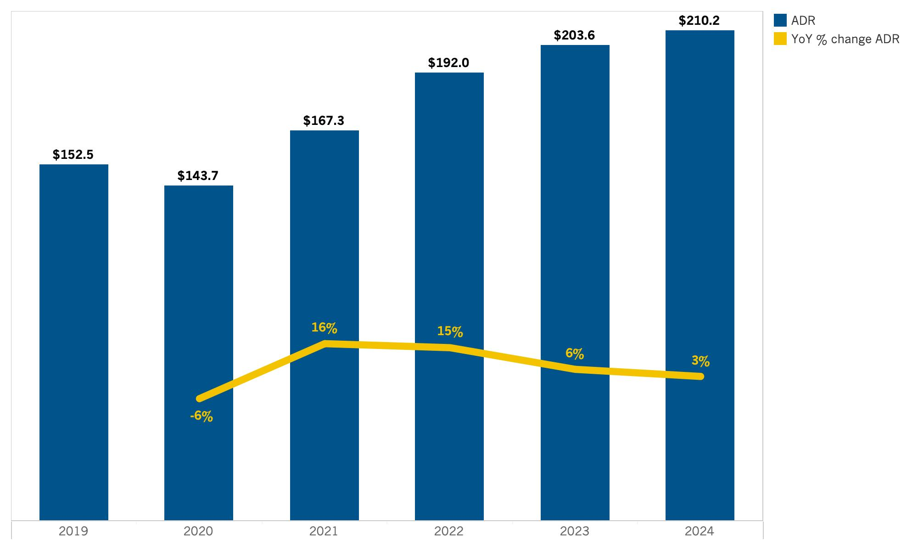
High Sierra: ADR
Source: Tourism Economics

Slide 51
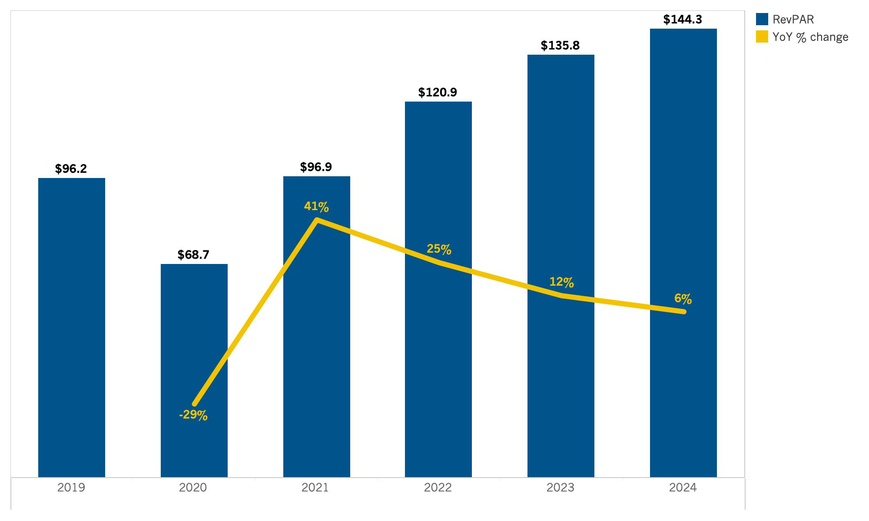
High Sierra: RevPAR
Source: Tourism Economics

Slide 52
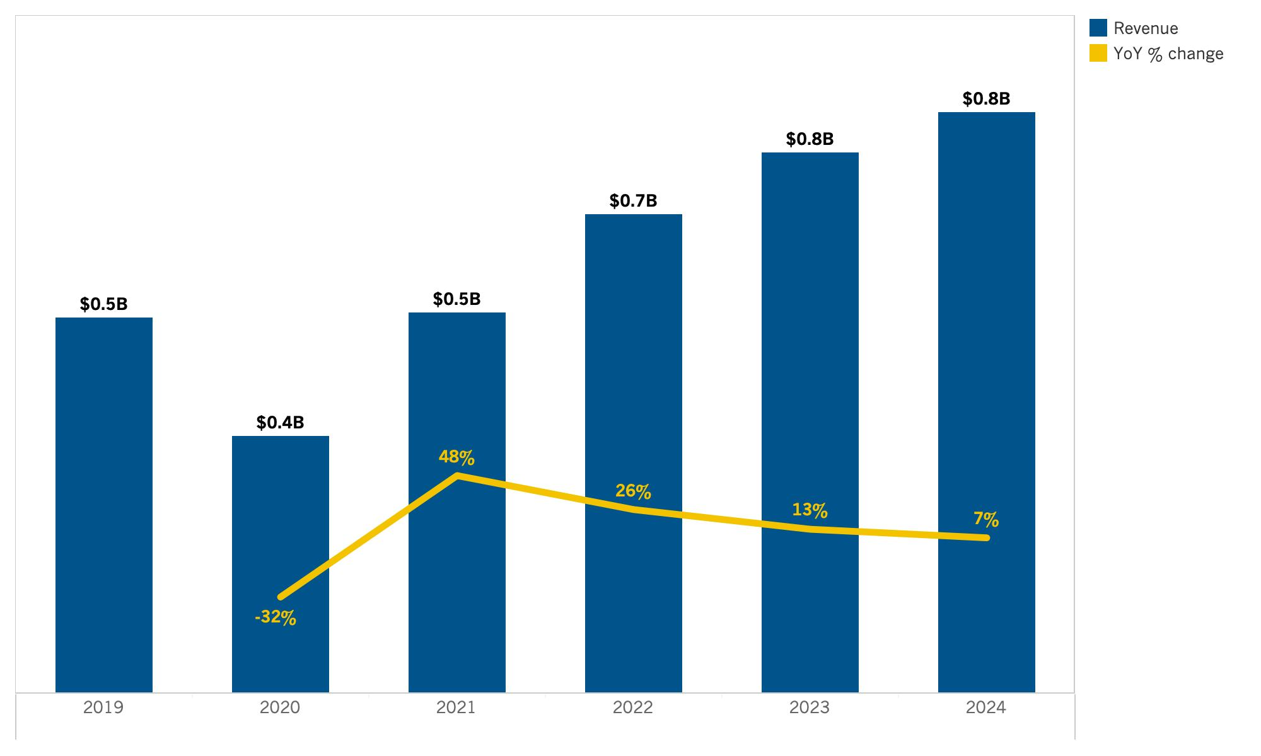
High Sierra: Room Revenue
Source: Tourism Economics

Slide 53
Lodging Forecast
(Inland Empire)

Slide 54
SUMMARY TABLE
Annual forecast: Inland Empire

Slide 55
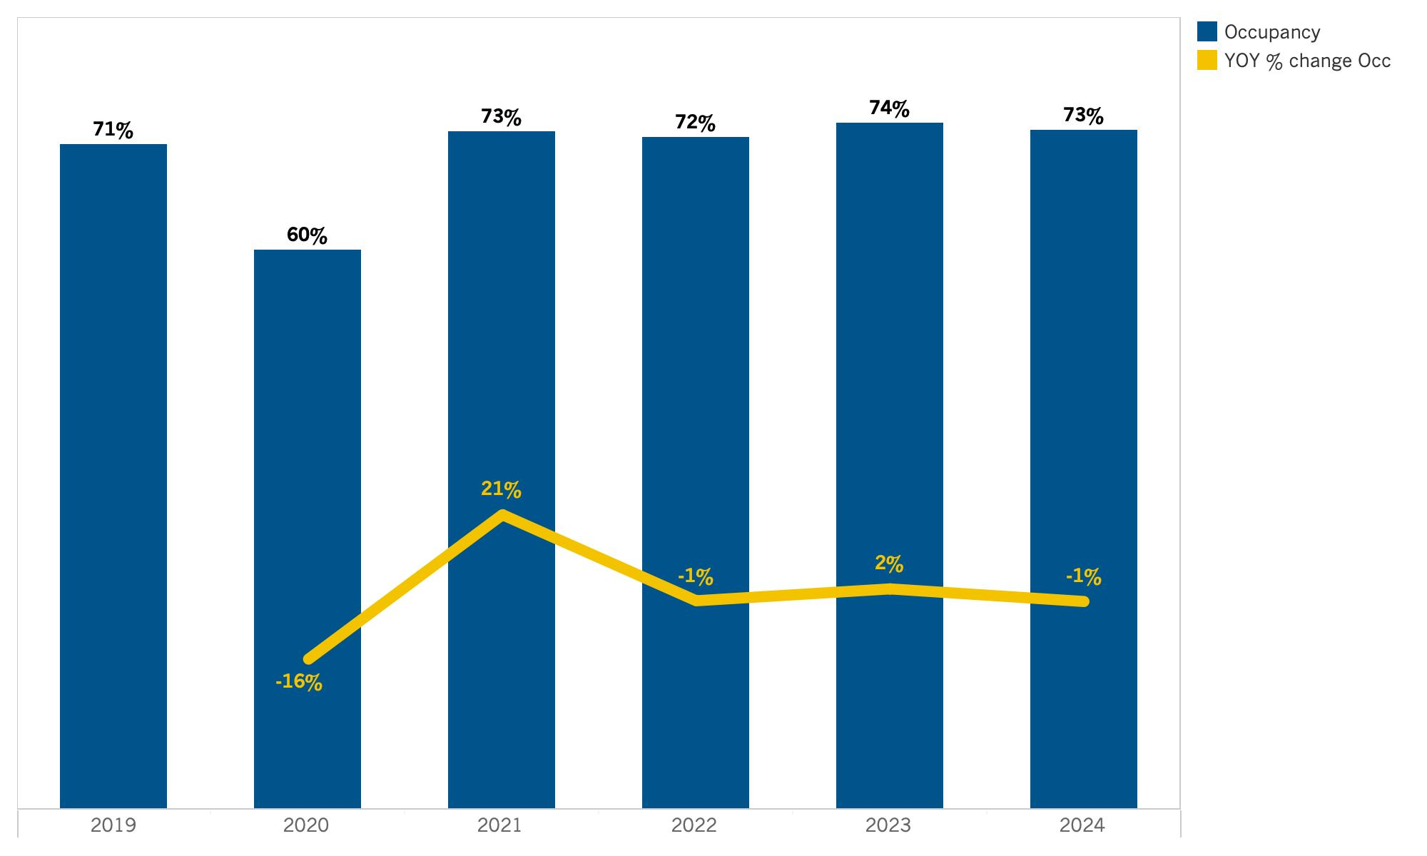
Inland Empire: Occupancy
Source: Tourism Economics

Slide 56
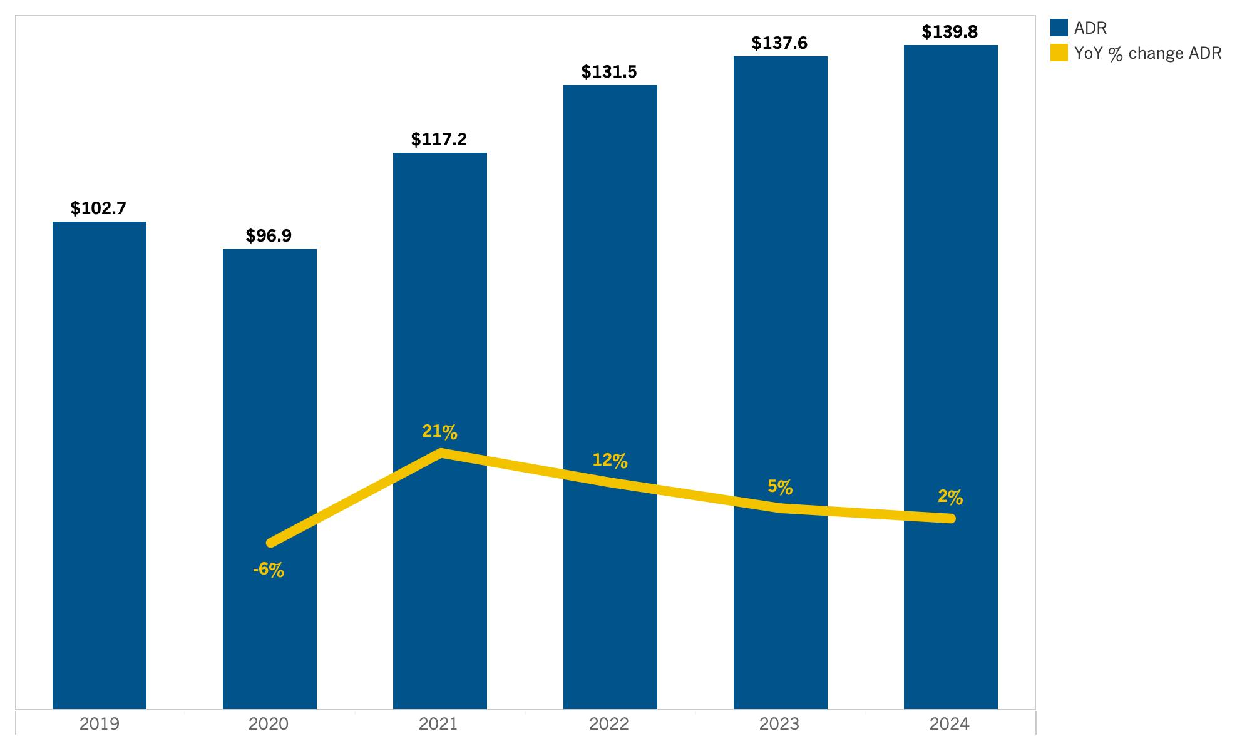
Inland Empire: ADR
Source: Tourism Economics

Slide 57
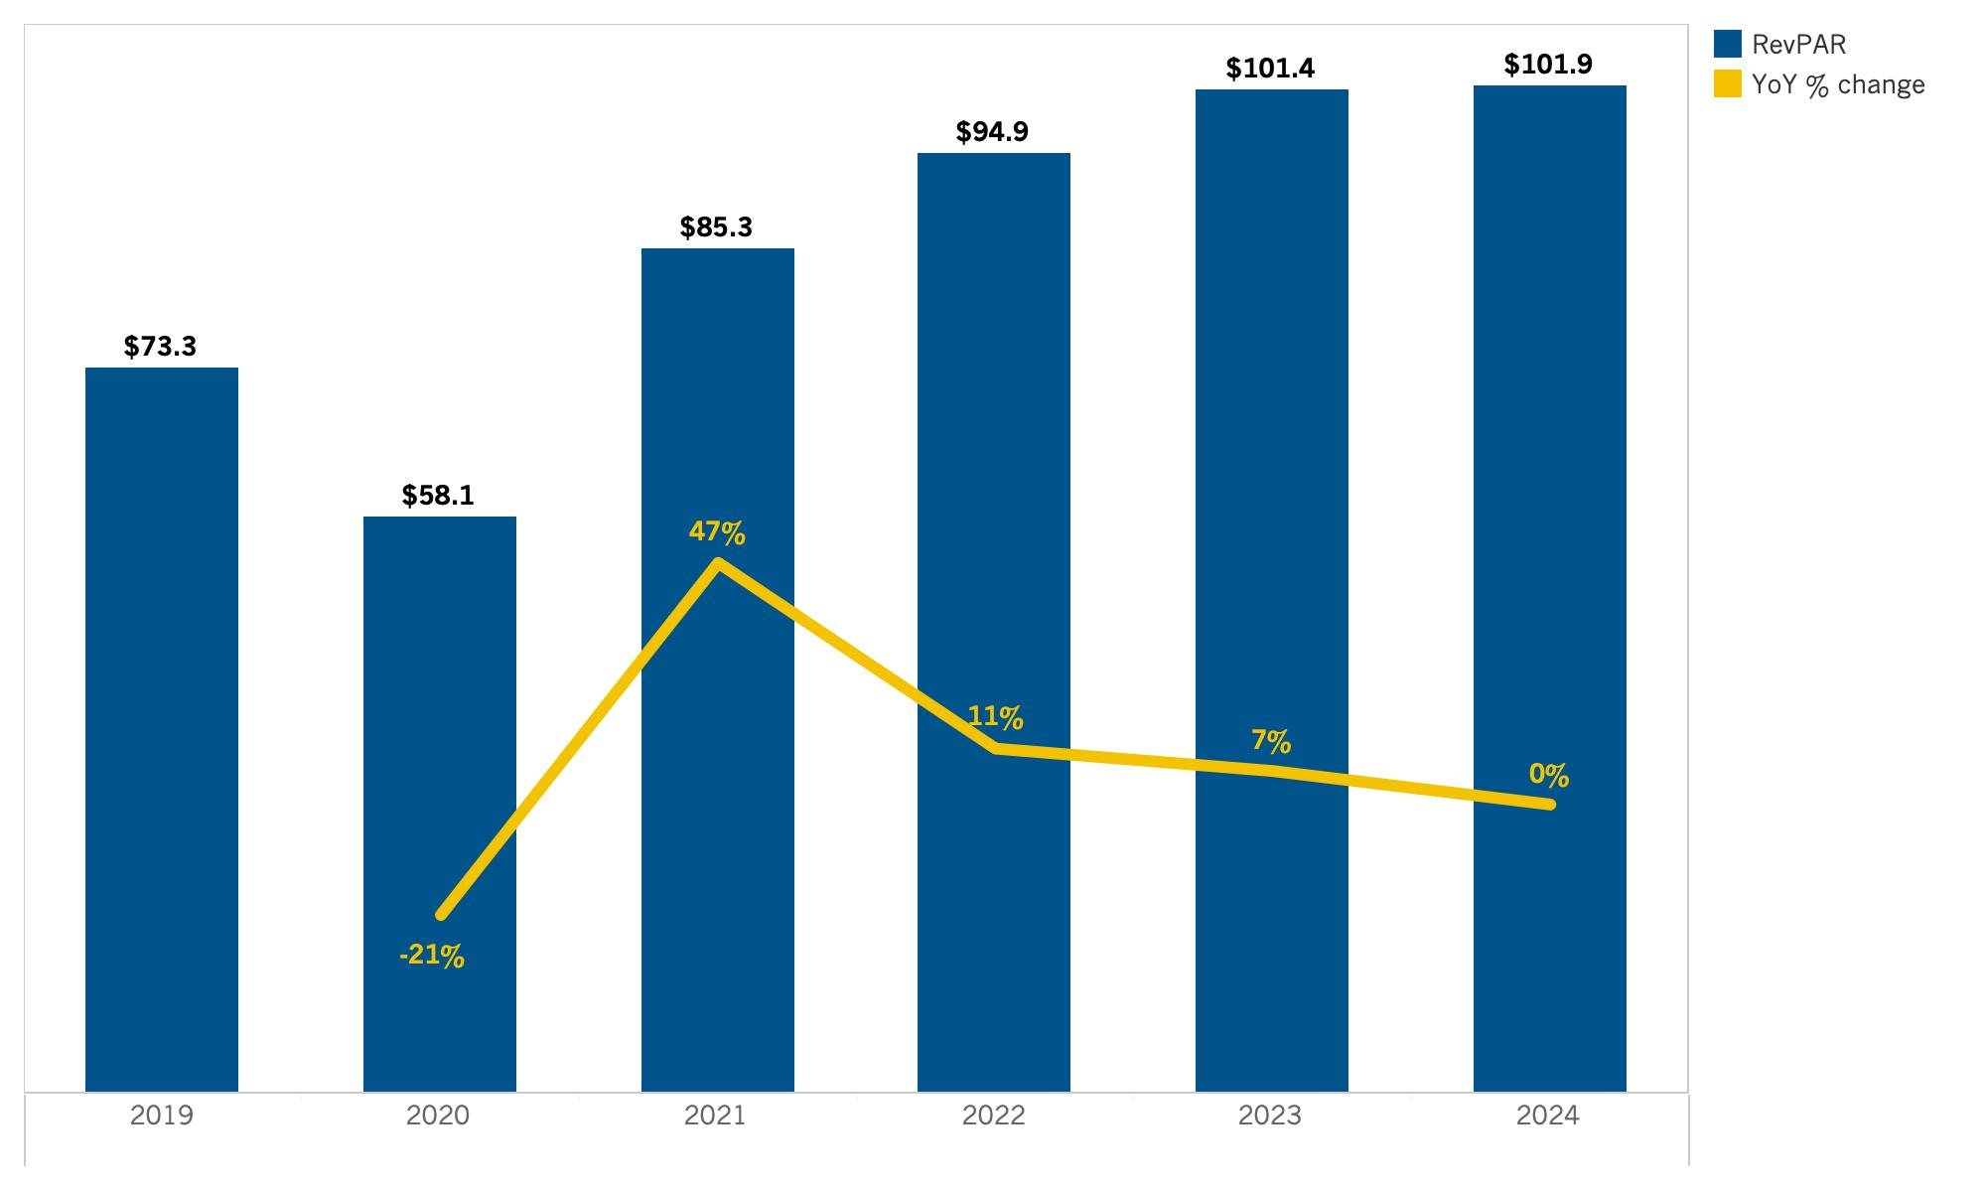
Inland Empire: RevPAR
Source: Tourism Economics

Slide 58
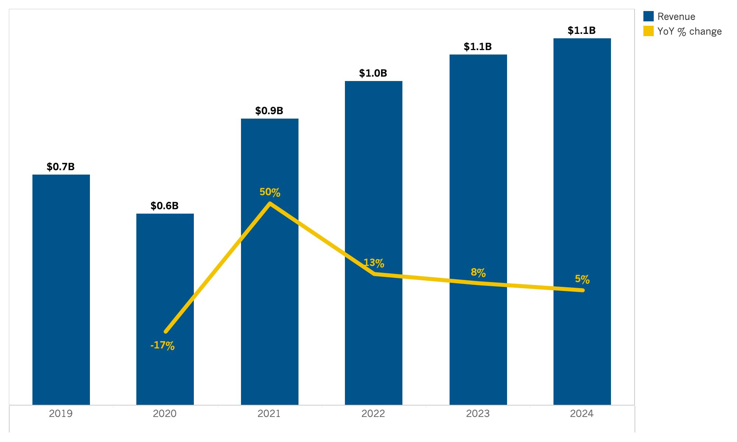
Inland Empire: Room Revenue
Source: Tourism Economics

Slide 59
Lodging Forecast
(Los Angeles County)

Slide 60
SUMMARY TABLE
Annual forecast: Los Angeles County

Slide 61
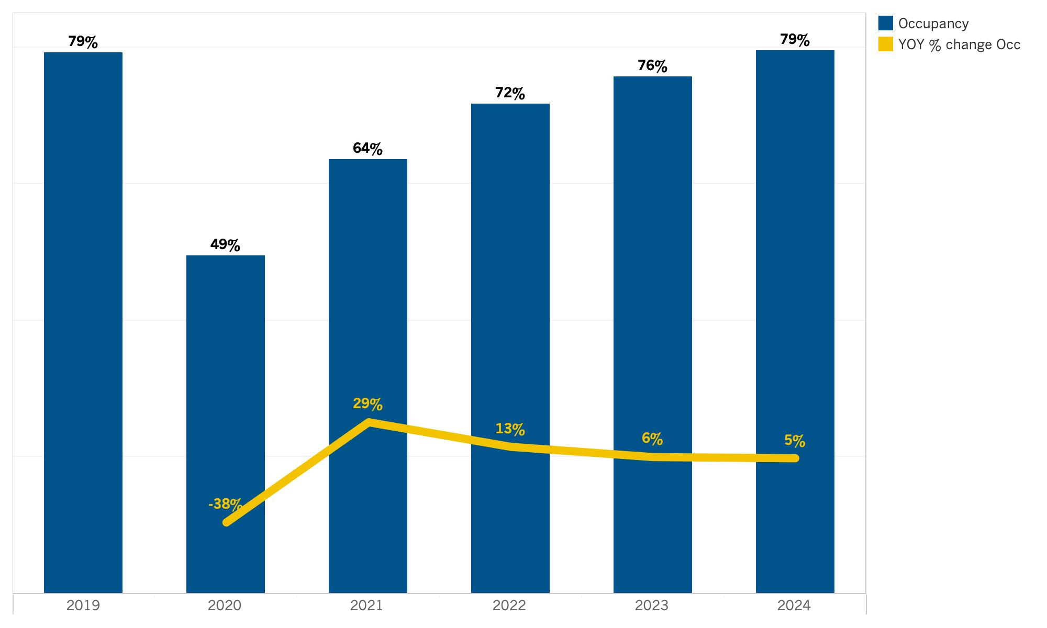
Los Angeles County: Occupancy
Source: Tourism Economics

Slide 62
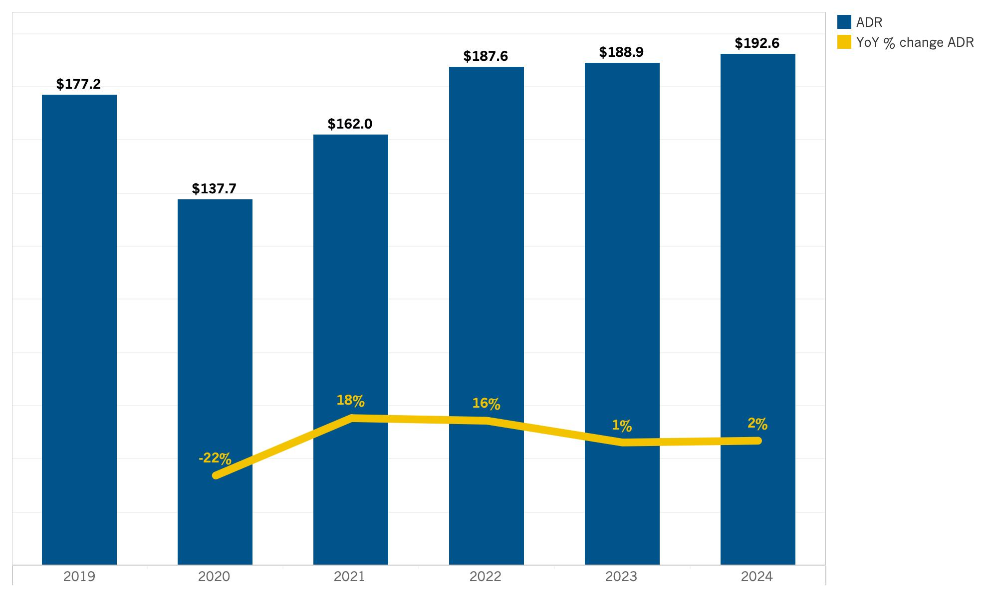
Los Angeles County: ADR
Source: Tourism Economics

Slide 63
Los Angeles County: RevPAR
Source: Tourism Economics

Slide 64
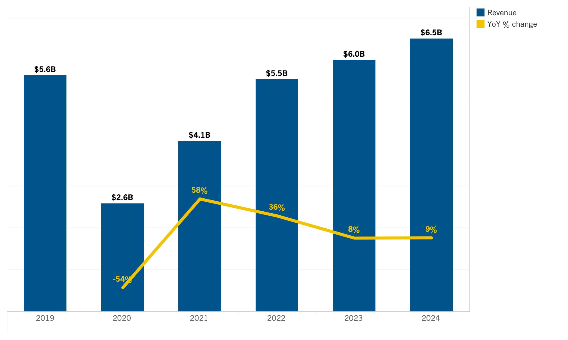
Los Angeles County: Room Revenue
Source: Tourism Economics

Slide 65
Lodging Forecast
(North Coast)

Slide 66
SUMMARY TABLE
Annual forecast: North Coast

Slide 67
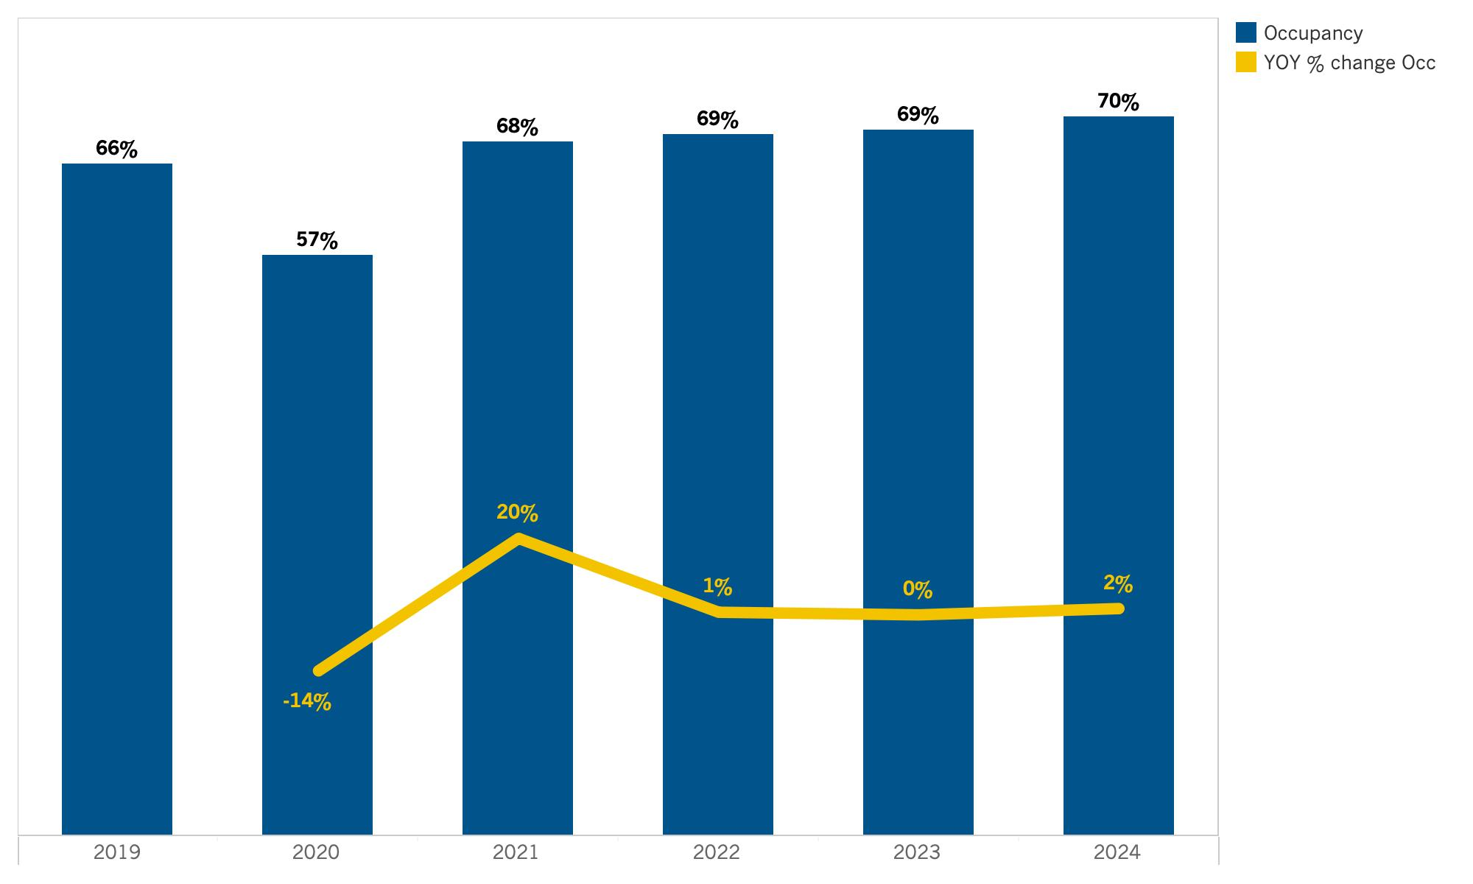
North Coast: Occupancy
Source: Tourism Economics

Slide 68
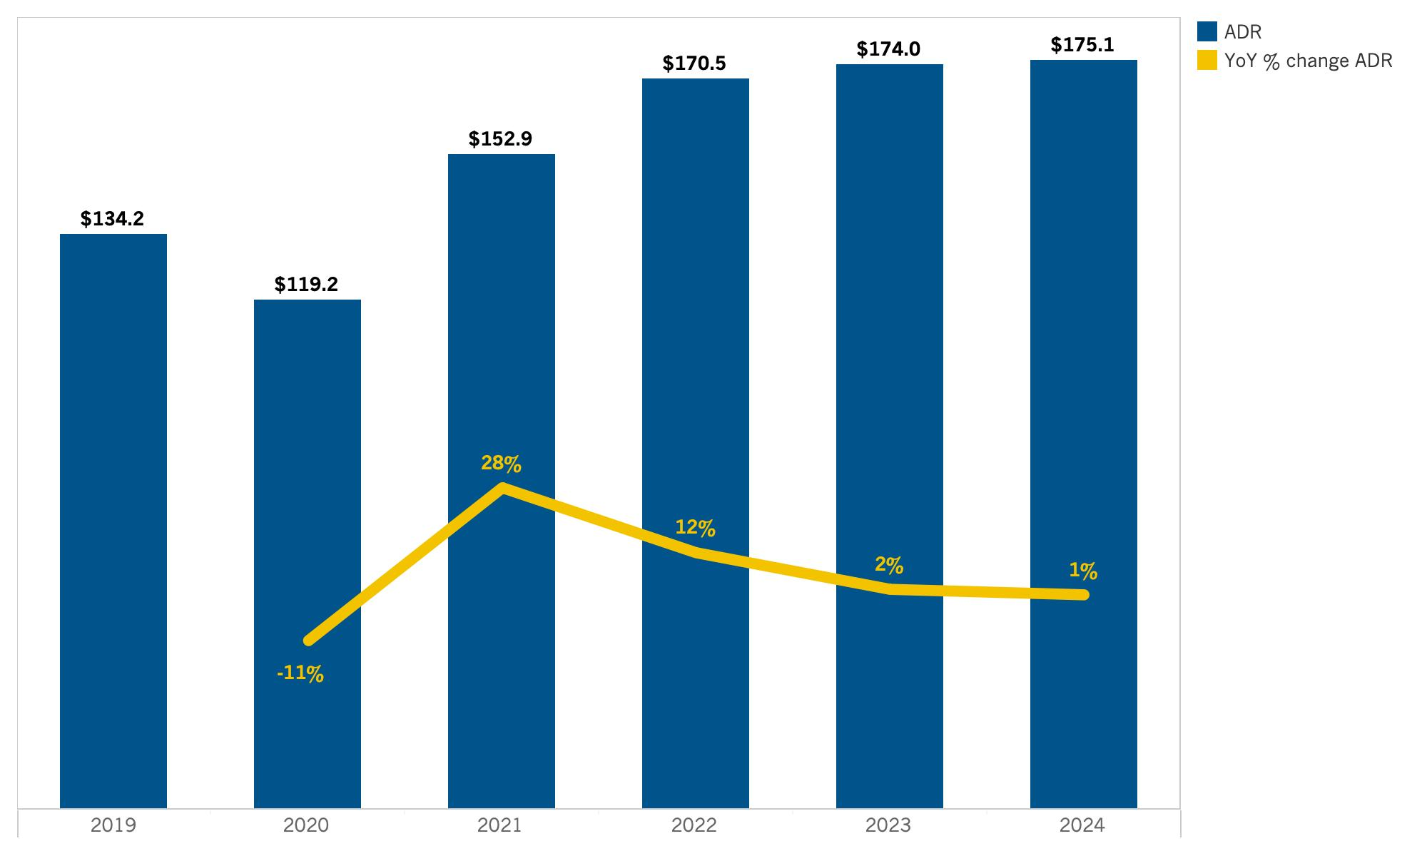
North Coast: ADR
Source: Tourism Economics

Slide 69
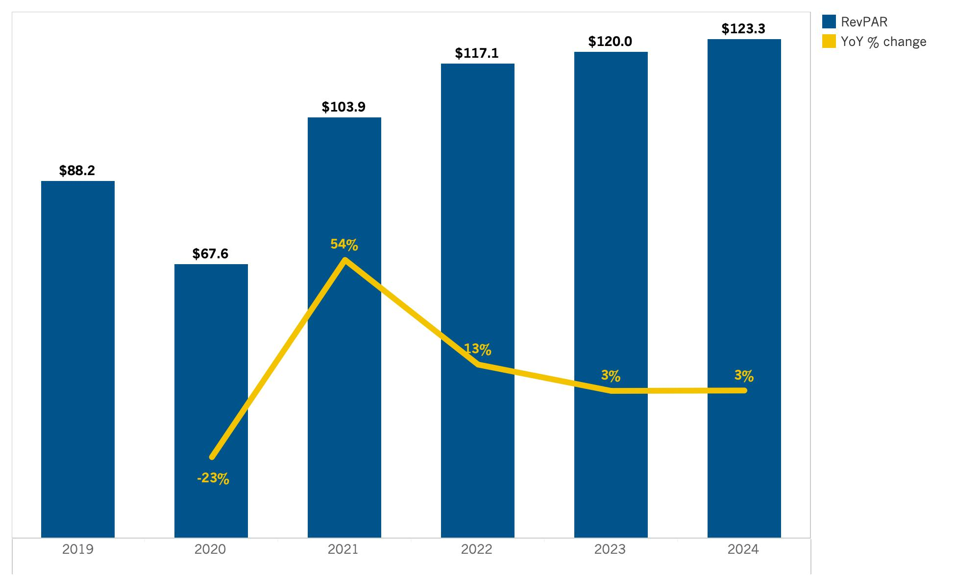
North Coast: RevPAR
Source: Tourism Economics

Slide 70
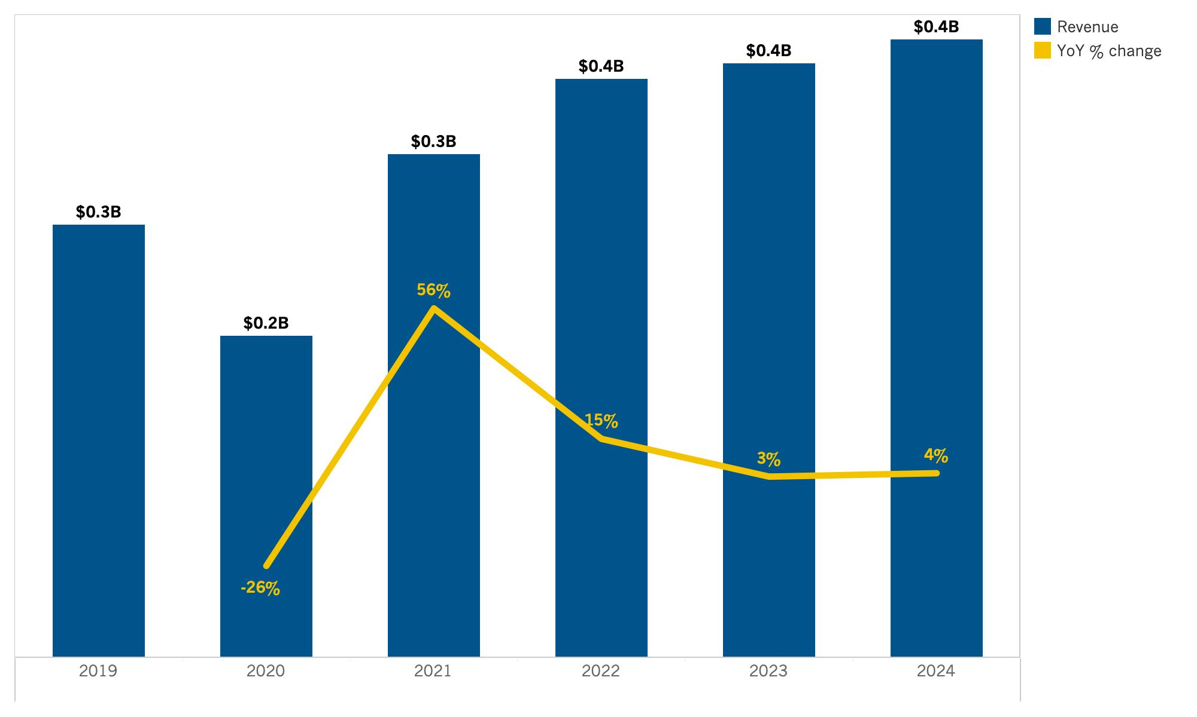
North Coast: Room Revenue
Source: Tourism Economics

Slide 71
Lodging Forecast
(Orange County)

Slide 72
SUMMARY TABLE
Annual forecast: Orange County

Slide 73
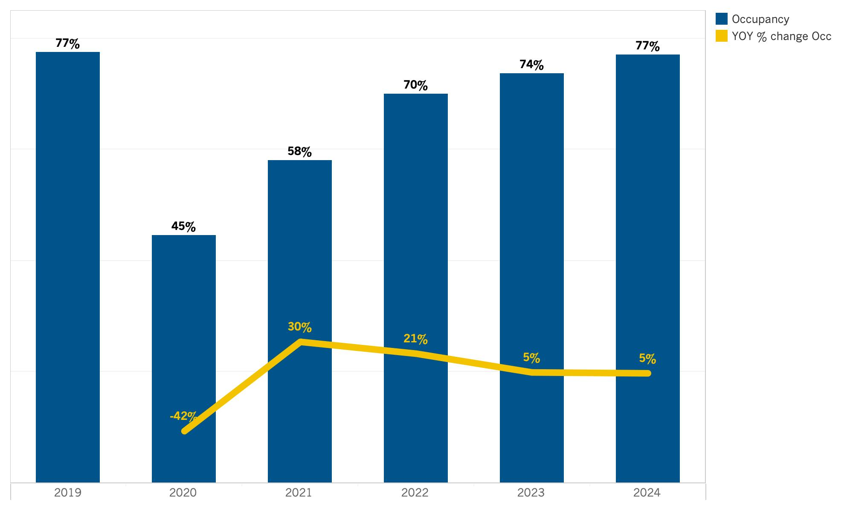
Orange County: Occupancy
Source: Tourism Economics

Slide 74
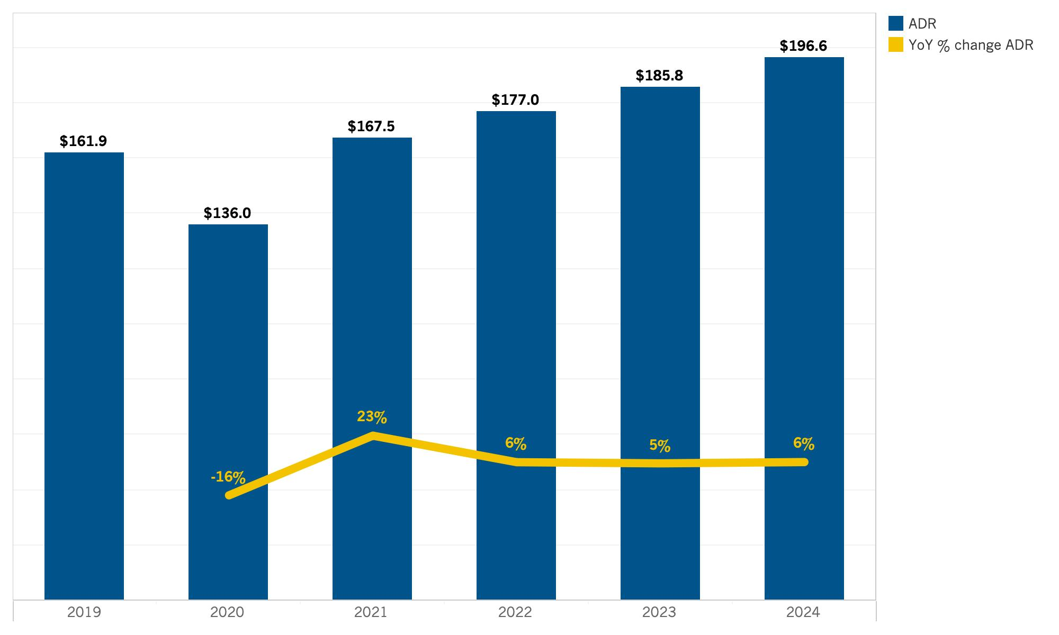
Orange County: ADR
Source: Tourism Economics

Slide 75
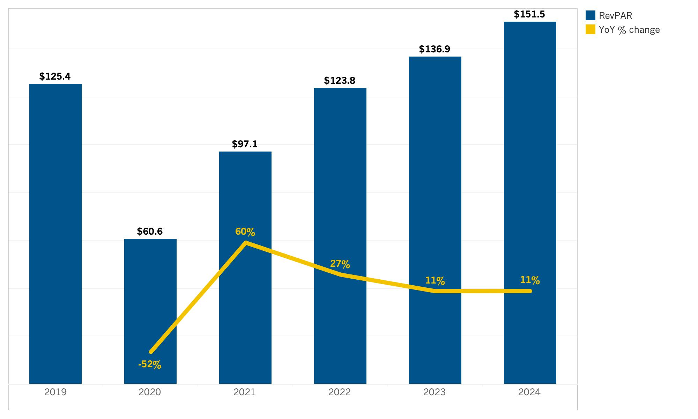
Orange County: RevPAR
Source: Tourism Economics

Slide 76
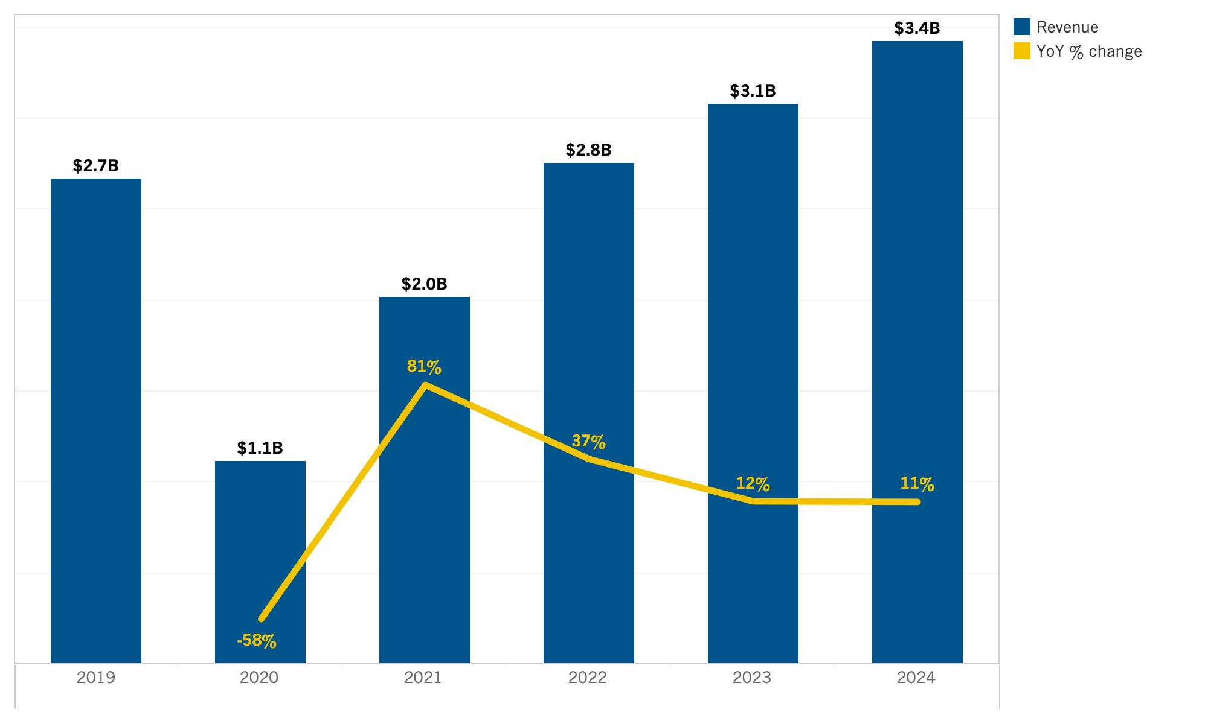
Orange County: Room Revenue
Source: Tourism Economics

Slide 77
SUMMARY TABLE
Annual forecast: Shasta Cascade

Slide 78
Lodging Forecast
(San Diego County)

Slide 79
SUMMARY TABLE
Annual forecast: San Diego County

Slide 80
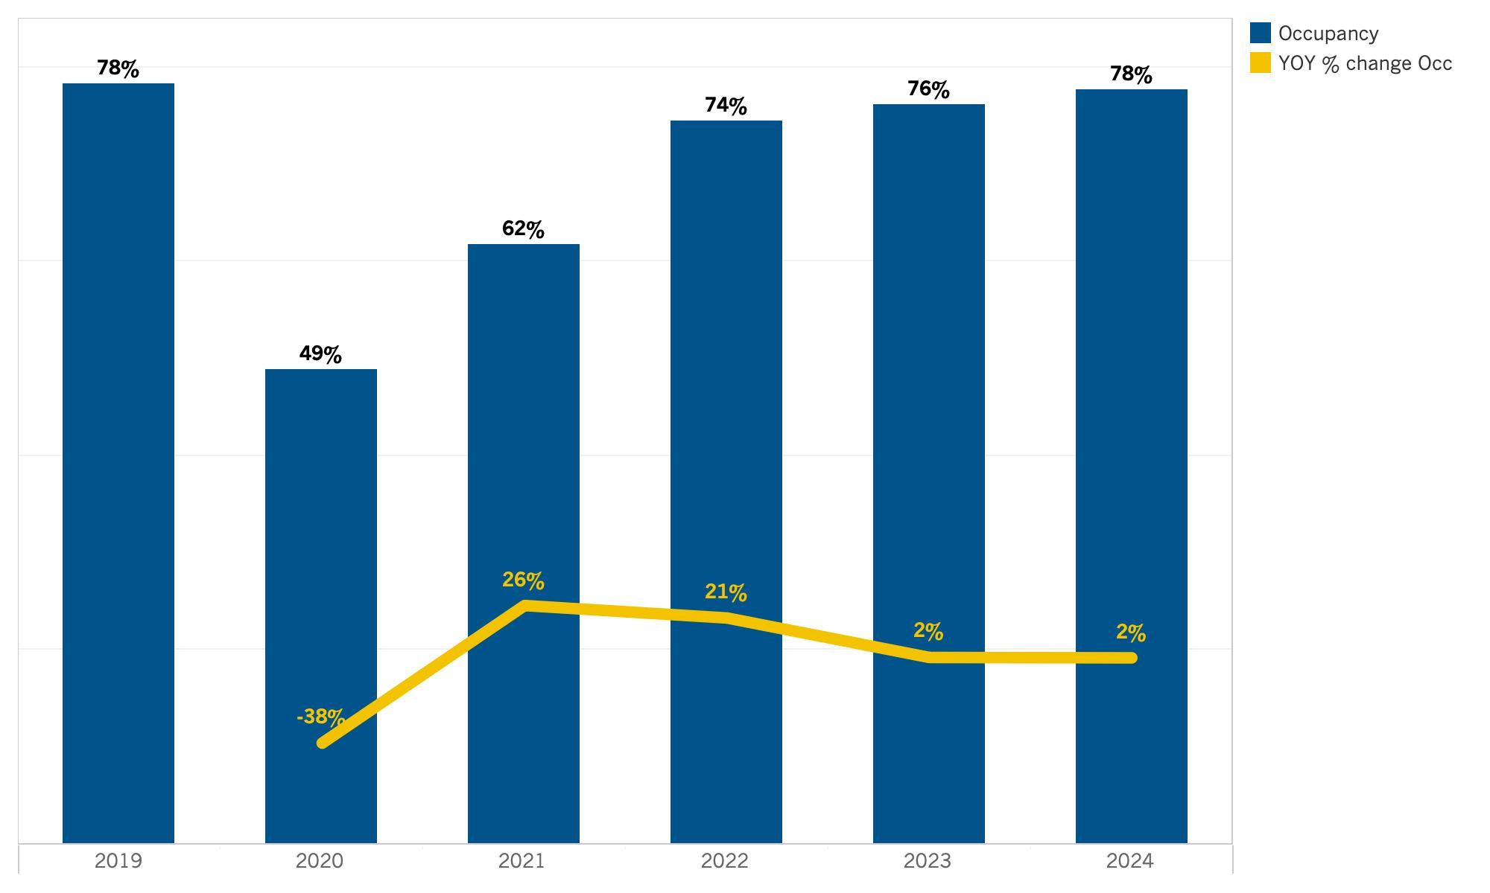
San Diego County: Occupancy
Source: Tourism Economics

Slide 81
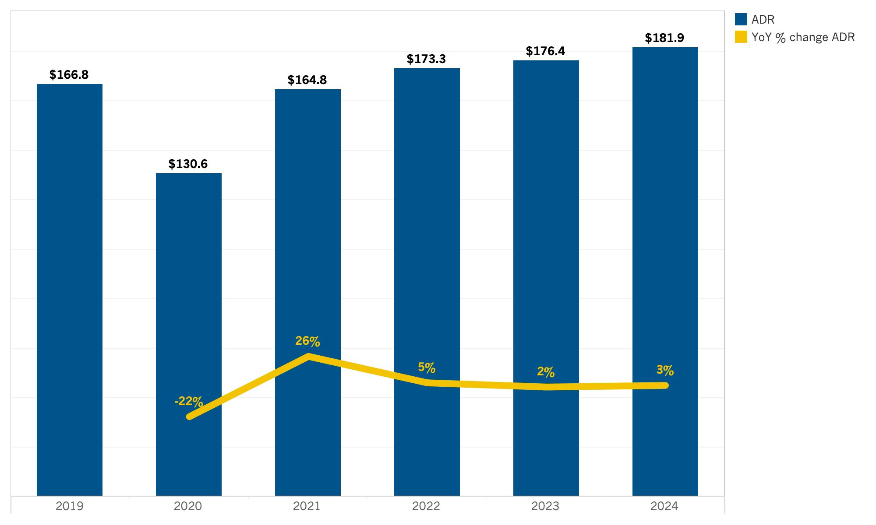
San Diego County: ADR
Source: Tourism Economics

Slide 82
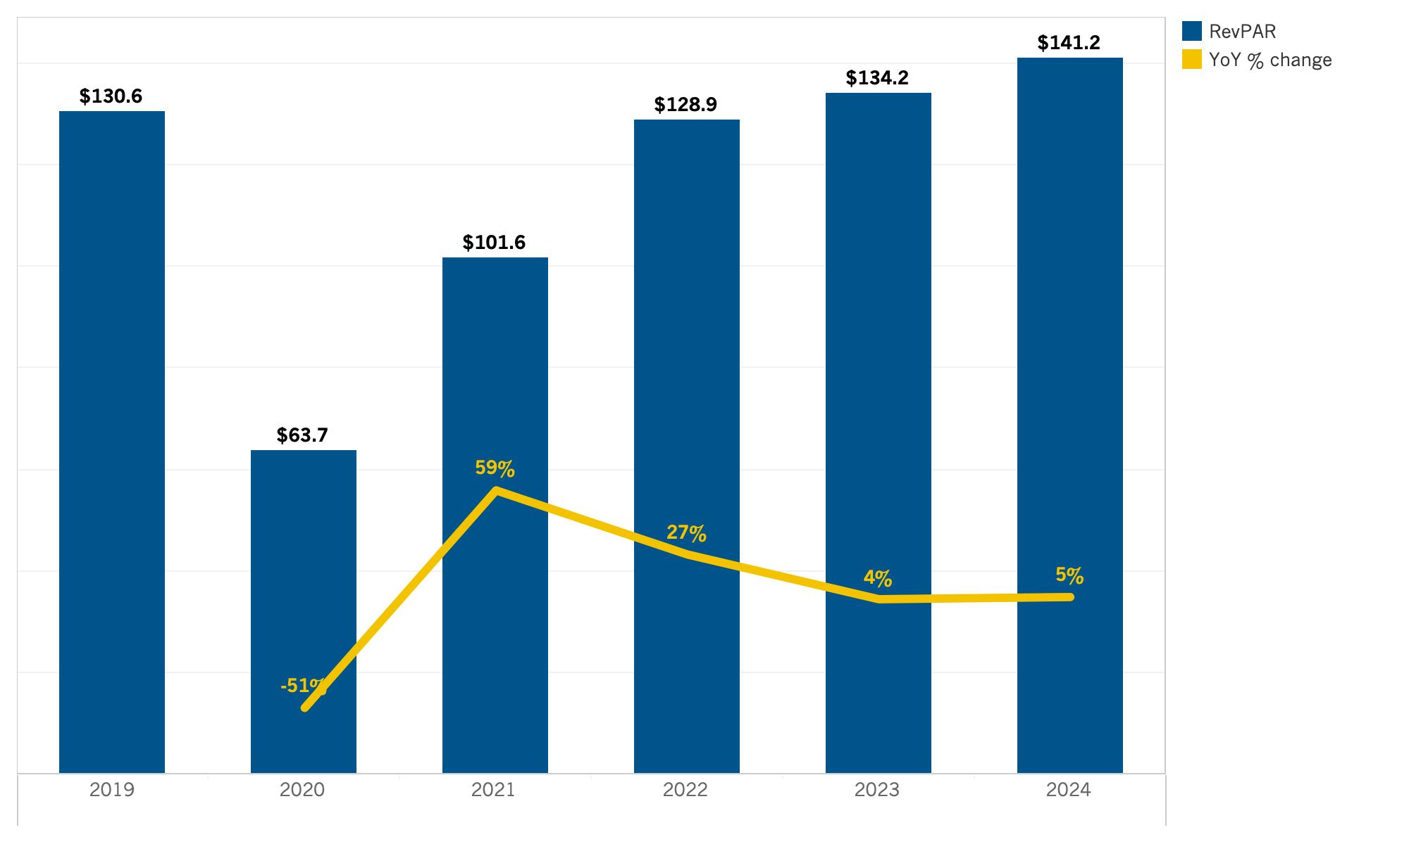
San Diego County: RevPAR
Source: Tourism Economics

Slide 83
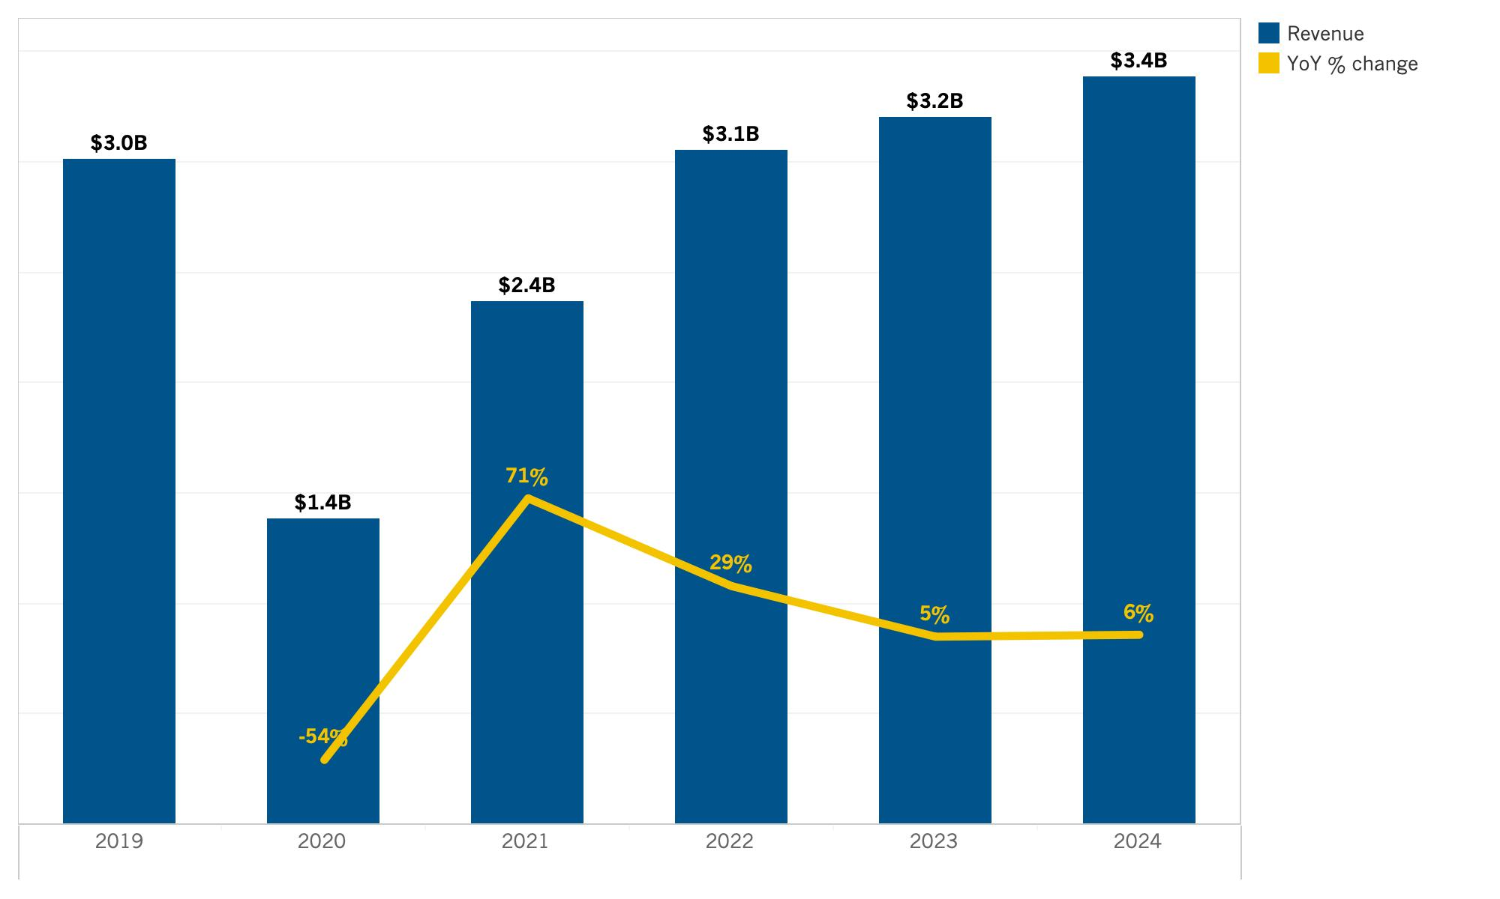
San Diego County: Room Revenue
Source: Tourism Economics

Slide 84
Lodging Forecast
(San Francisco Bay Area)

Slide 85
SUMMARY TABLE
Annual forecast: San Francisco Bay Area

Slide 86
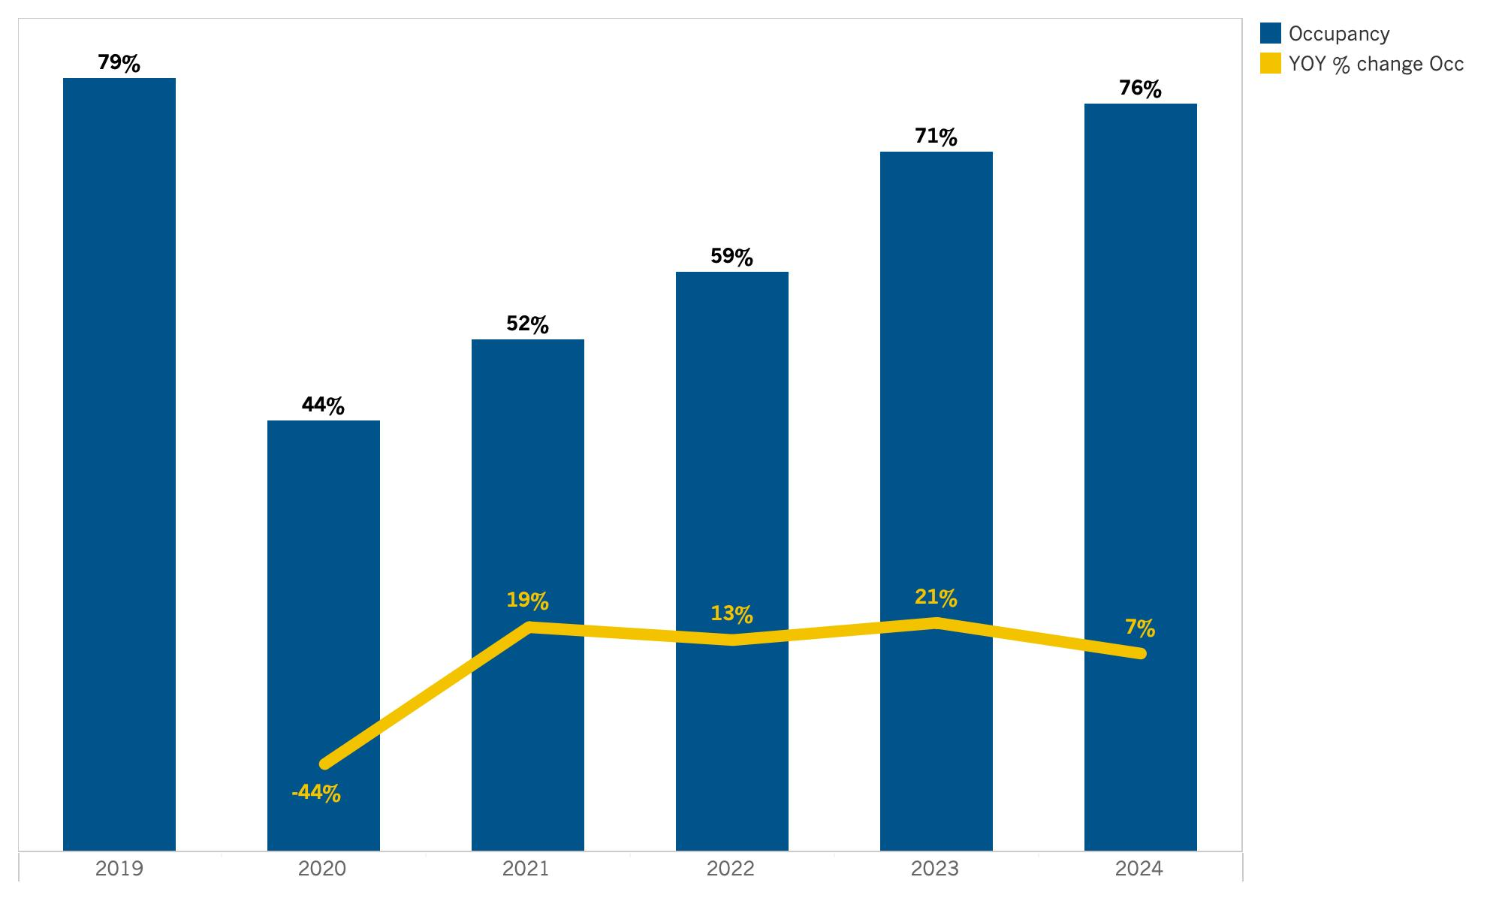
San Francisco Bay Area: Occupancy
Source: Tourism Economics

Slide 87
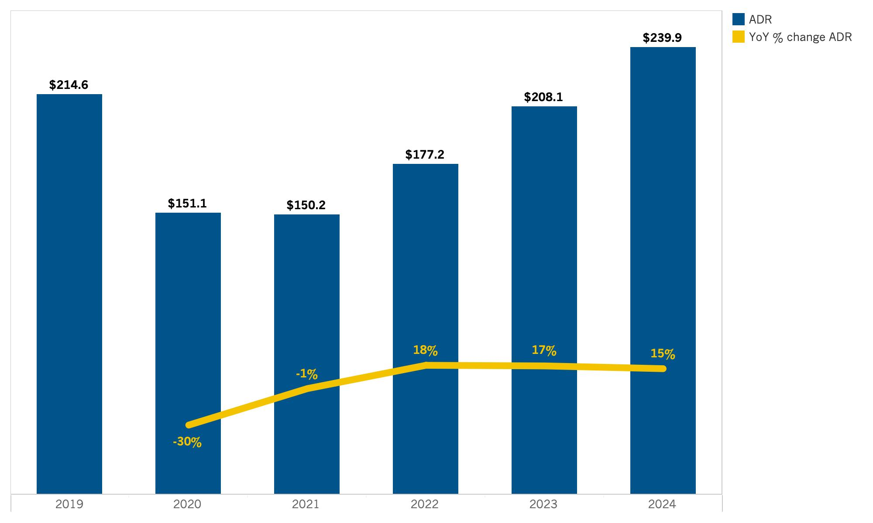
San Francisco Bay Area: ADR
Source: Tourism Economics

Slide 88
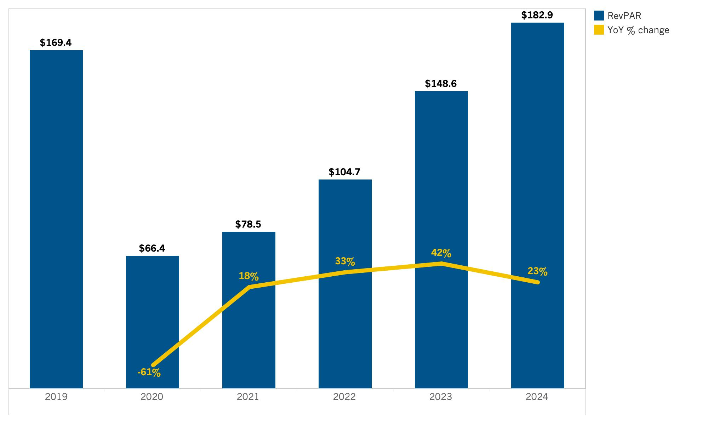
San Francisco Bay Area: RevPAR
Source: Tourism Economics

Slide 89

San Francisco Bay Area: Room Revenue
Source: Tourism Economics

Slide 90
About Tourism Economics
Tourism Economics is an Oxford Economics company with a singular objective: combine an understanding of tourism dynamics with rigorous economics in order to answer the most important questions facing destinations, developers, and strategic planners. By combining quantitative methods with industry knowledge, Tourism economics designs custom market strategies, destination recovery plans, tourism forecasting models, tourism policy analysis and economic impact studies.
With over four decades of experience of our principal consultants, it is our passion to work as partners with our clients to achieve a destination's full potential.
Oxford Economics is one of the world's leading providers of economic analysis, forecasts and consulting advice. Founded in 1981 as a joint venture with Oxford University's business college, Oxford Economics enjoys a reputation for high quality , Quantitative analysis and evidence-based advice. For this, it draws on its own staff of more than 250 professional economics; a dedicated data analysis team; global modeling tools, and a range of partner institutions in Europe, the US and in the United Nations Project Link. Oxford economics has offices in London, Oxford, Dubai, Philadelphia and Belfast.
For more information:
info@tourismeconomics.com

