Slide 1


CALIFORNIA LODGING
FORECAST UPDATE
Prepared for:
Visit California
December 23, 2021
WWW.TOURISMECONOMICS.COM

Slide 2
CONTEXT
Visit California engaged Tourism Economics to prepare a custom forecast of key lodging sector indictors for twelve California regions (consistent with the market as defined by STR). The analysis relies on:
Data provided by Visit California, such as historical guest hotel metrics;
Tourism Economics’ prior research on California’s tourism economy;
STR hotel data through December 11, 2021;
economic forecasts prepared by Oxford Economics, parent company of Tourism Economics; and,
assumptions on the future path of tourism sector recovery.
The health implications of the Omicron variant are still highly uncertain. Given the variant’s apparent greater ability to overcome vaccines and reinfect, it seems likely that the peak of the current Covid wave will surpass the last global peak in August.
Increased uncertainty may prompt more cautious behavior by governments and individuals. Delta waves have already led to renewed restrictions, especially in Europe. Many governments are yet to act beyond tightening foreign travel rules, and the UK won’t be the only place to adopt a Plan B to tackle rising case numbers.
California’s lodging sector has shown stronger-than-anticipated year-to-date performance. As a result, the current near-term forecast is stronger than our previous forecast in September. For now, we do not see the need to downgrade our 2022 forecast, but a clearer picture of the balance of risks should emerge over the next few weeks.

Slide 3
NATIONAL ASSUMPTIONS

Slide 4
ECONOMIC OUTLOOK
Strong end to 2021 before growth firms in 2022
Modest shock so far, but big downside risks from Omicron
Economic output
Labor market
Despite the elevated inflation environment, renewed Covid concerns and heightened market volatility, the economy is booming in Q4. Assuming the Omicron variant leads to a moderate pullback in activity over the coming months and some catch-up next spring and summer, we foresee real GDP growth of 4.4% in 2022 after a 5.7% advance in 2021.
Our November baseline assumes that the combination of coronavirus fear, restrictions, and lingering supply constraints lead to cooler consumer spending. Service sector activities including leisure, hospitality, and travel are more severely impacted leading to a 1ppt annualized drag on GDP growth in Q1 2022, but this lost activity will be made up in the spring and summer next year.
The US economy added an uninspiring 210k jobs in November, but the more positive news came from a decline in the unemployment rate to 4.2% and an increase in labor force participation to a post-pandemic high. With employment having recouped around 85% of Covid job losses and wages rising rapidly, we expect to see compensation growth picking up the income baton from fiscal transfers. We foresee the economy addition nearly 4 million jobs in 2022.
We expect business investment growth to moderate through 2022, in line with cooler demand prospects. Still, the need to expand productive capacity and replenish inventories will support strong growth of 4.6% next year.
Consumers
Business sector

Slide 5
VACCINE COMPLETION TIMEFRAME
G20 & Israel - latest
Note: chart shows the timeframe for vaccination of 30% & 70% population at the latest rate for selected countries. This rate will likely change for many countries and the chart does not represent a forecast of when we believe vaccination will be completed, but is an indication of current progress.
Notes:
What does it mean?
70% ‘herd immunity’ – broader reopening.
30% elderly & vulnerable target a key benchmark for restrictions easing.
10 of these countries (UK-Spain) will reach 70% in 2021.
All but two of the remaining ones in 2022.
Some improvement in last week alone – e.g. Albania based on dist rates one week ago projected to vaccinate 70% by 2024, now 2021.
So far, has been slower. Will improve.
By itself – vaccine will not allow a ‘return to normal’ in 2021. Other measure required – this can include improved testing, vaccine passports.
Gov’t co-operation for cross country travel – get something simple to allow that to happen.

Slide 6
US: COVID-19 HOSPITALIZATIONS AND DEATHS
Deaths and hospitalizations have seen an uptick recently

Slide 7
US: COVID-19 VACCINATION PROGRESS
Vaccinations have remained above 1 million per day

Slide 8
US: SHARE OF ADULT POPULATION WITH AT LEAST ONE DOSE, BY STATE
Uptake has improved but Omicron risks another virus wave

Slide 9
US: STATE RECOVERY TRACKER
Regional recoveries continue to progress in late 2021

Slide 10
US GDP GROWTH
Growth will remain historically strong in 2022

Slide 11
US NON-FARM PAYROLL EMPLOYMENT
An uninspiring jobs report in November
Still significant 3.9mn jobs shortfall relative to pre-Covid

Slide 12
US: STRONGEST JOB CREATION IN HISTORY
The economy will add 3.7 million jobs in 2022
Assuming the Omicron variant doesn’t lead to a severe reversal in the health
situation, we expect average monthly jobs gains around 350k in 2022 with
employment reaching its pre-Covid level in the second half of the year.

Slide 13
US: EMPLOYMENT RECOVERY PATHS
A gradual employment recovery will take another year

Slide 14
US OUTLOOK TABLE
Five-year forecast

Slide 15
HOTEL PERFORMANCE
SUMMARY
Room demand
In November, room demand in California stood at 91% of the level observed in November 2019. YTD room demand increased 28.7% in California compared to 36.6% increase in the US.
Occupancy
After reaching highest of the year occupancy in July (74%), California’s occupancy dropped to 63% in November; still an encouraging result compared to 45% occupancy in November 2019.
ADR & RevPAR
ADR recovered to $163 in November 2021 compared to $118 in November 2020 and $166 in November 2019.
RevPAR stood at $103 in November 2021 compared to $53 in November 2020 and $118 in November 2019.
Source: STR

Slide 16
CALIFORNIA FORECAST

Slide 17
SUMMARY TABLE
Annual forecast: California

Slide 18
SUMMARY TABLE
Annual forecast: California gateway regions

Slide 19
SUMMARY TABLE
Annual forecast: California non-gateway regions

Slide 20
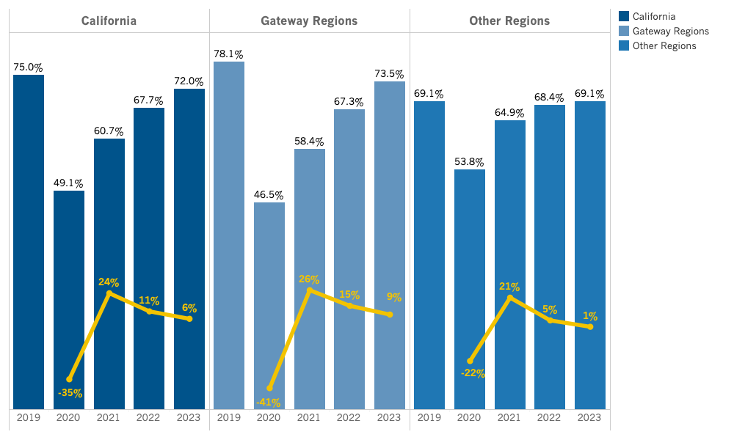
California Summary: Occupancy
Source: Tourism Economics

Slide 21
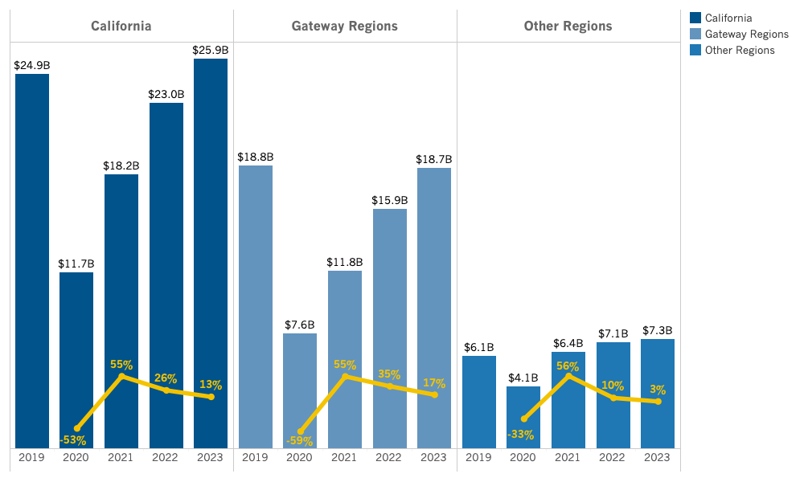
California Summary: Revenue
Source: Tourism Economics

Slide 22
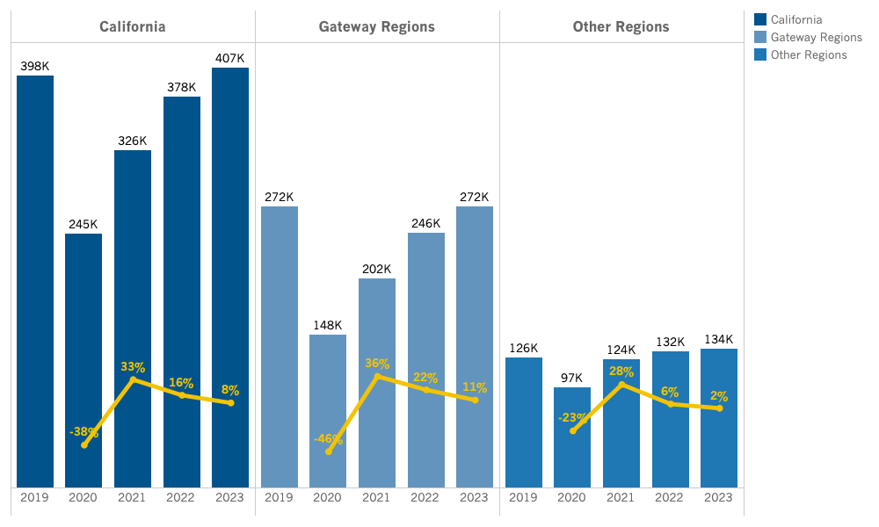
California Summary: Room Demand (Daily)
Source: Tourism Economics

Slide 23
CALIFORNIA REGIONAL FORECAST
Central Coast
Central Valley
Deserts
Gold Country
High Sierra
Inland Empire
Los Angeles County
North Coast
Orange County
San Diego County
San Francisco Bay Area
Shasta Cascade

Slide 24
Lodging Forecast
(Central Coast)

Slide 25
SUMMARY TABLE
Annual forecast: Central Coast

Slide 26
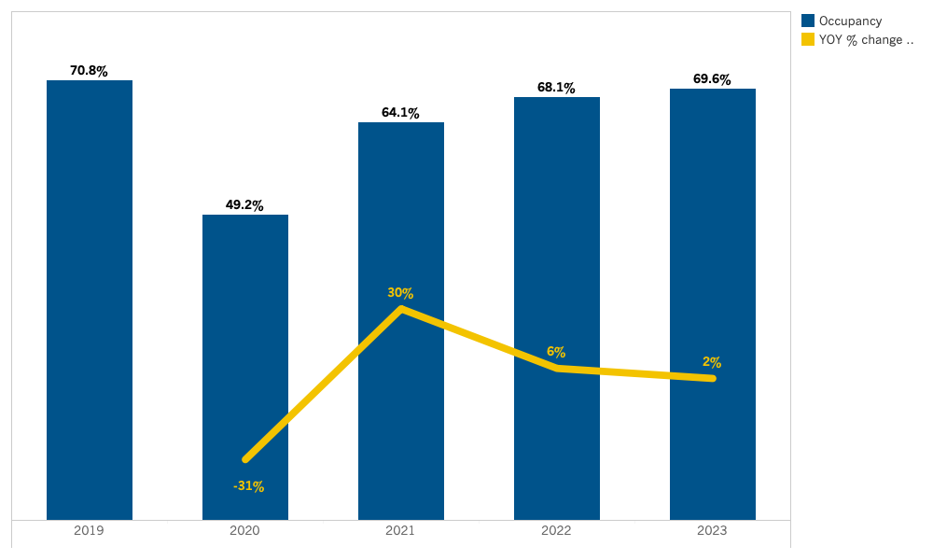
Central Coast: Occupancy
Source: Tourism Economics

Slide 27
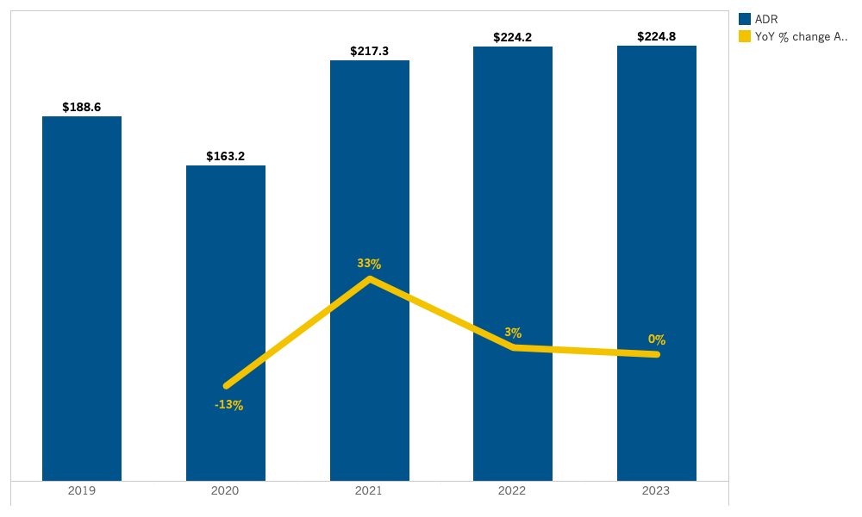
Central Coast: ADR
Source: Tourism Economics

Slide 28
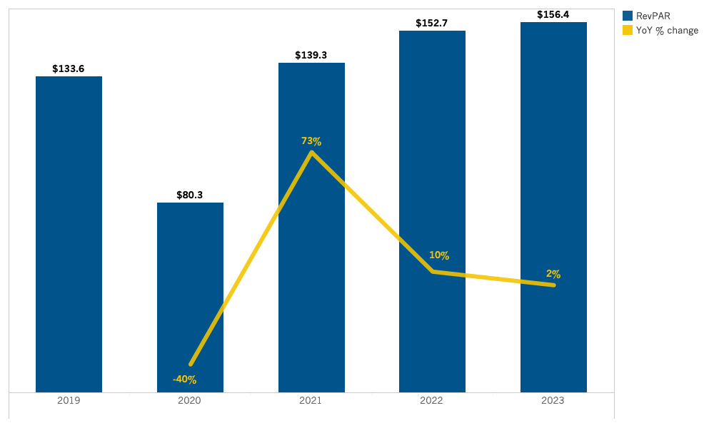
Central Coast: RevPAR
Source: Tourism Economics

Slide 29
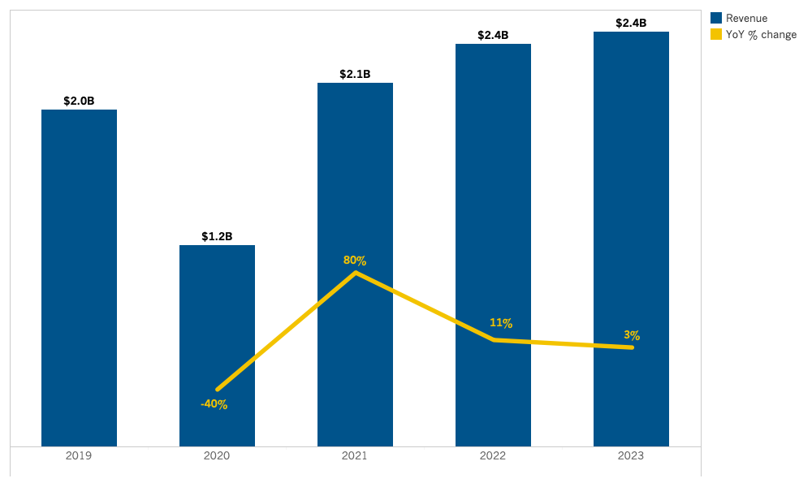
Central Coast: Room Revenue
Source: Tourism Economics

Slide 30
Lodging Forecast
(Central Valley)

Slide 31
SUMMARY TABLE
Annual forecast: Central Valley

Slide 32
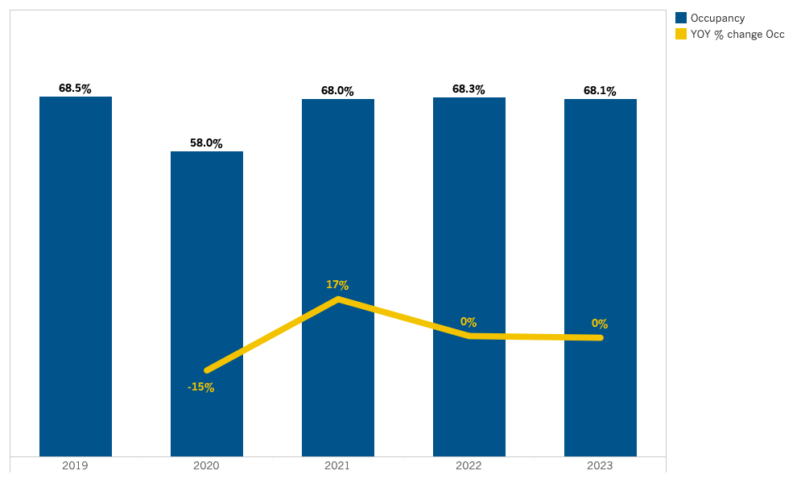
Central Valley: Occupancy
Source: Tourism Economics

Slide 33
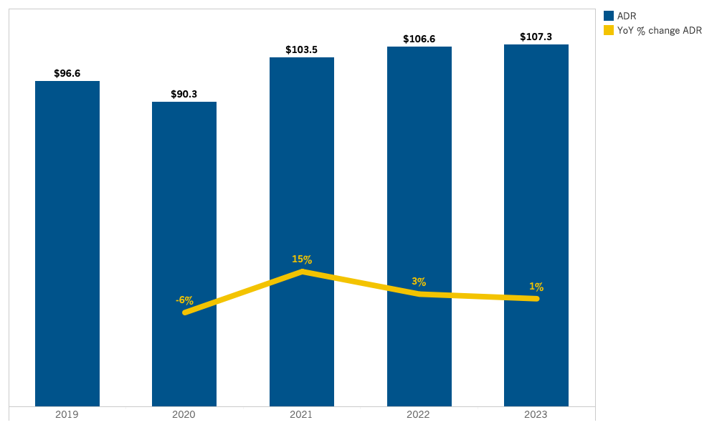
Central Valley: ADR
Source: Tourism Economics

Slide 34
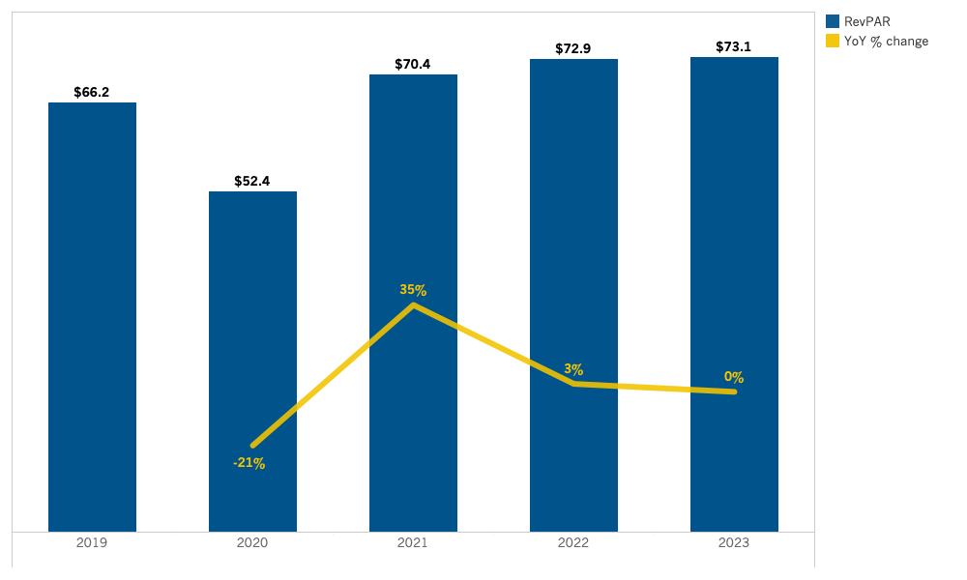
Central Valley: RevPAR
Source: Tourism Economics

Slide 35
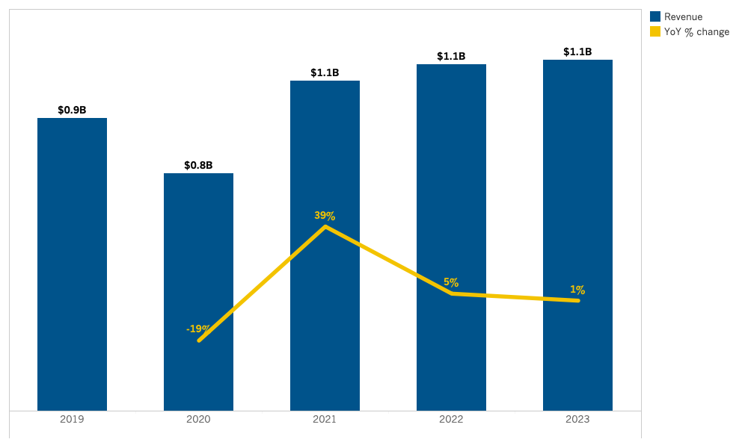
Central Valley: Room Revenue
Source: Tourism Economics

Slide 36
Lodging Forecast
(Deserts)

Slide 37
SUMMARY TABLE
Annual forecast: Deserts

Slide 38
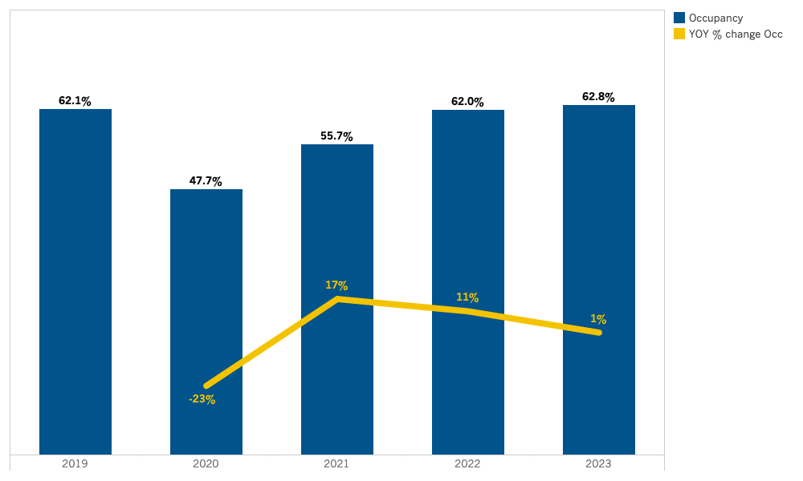
Deserts: Occupancy
Source: Tourism Economics

Slide 39
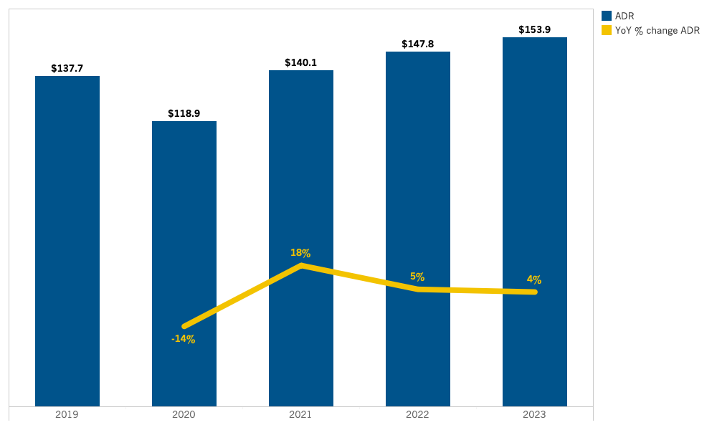
Deserts: ADR
Source: Tourism Economics

Slide 40
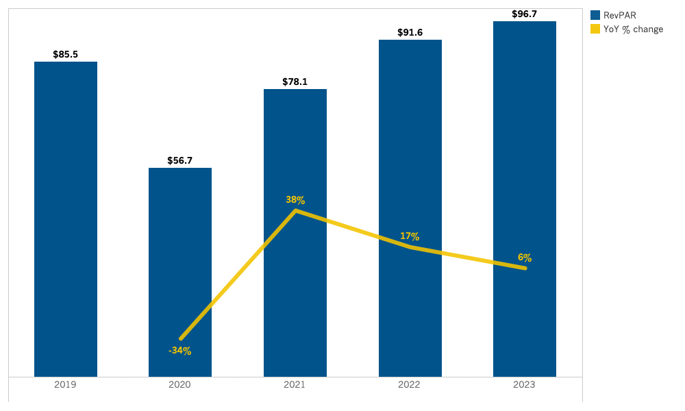
Deserts: RevPAR
Source: Tourism Economics

Slide 41
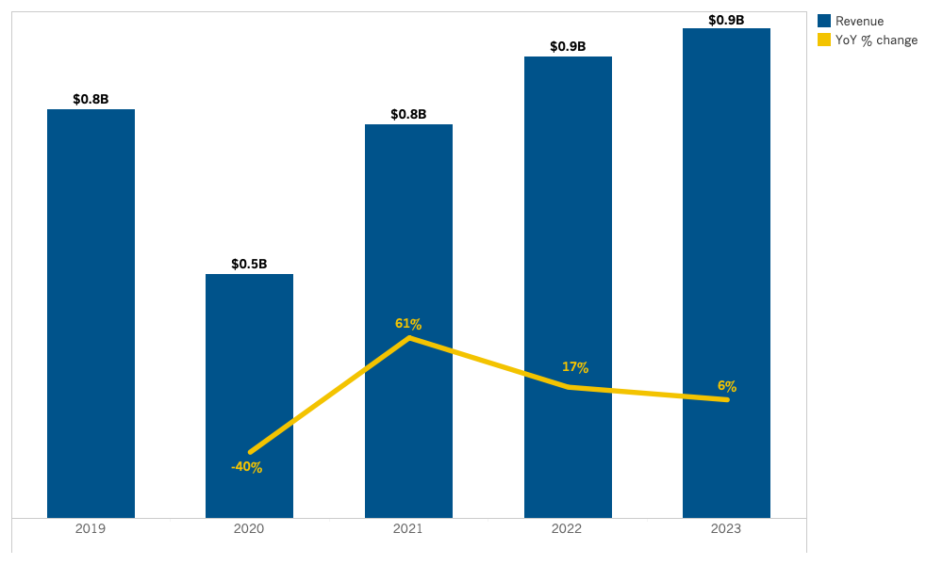
Deserts: Room Revenue
Source: Tourism Economics

Slide 42
Lodging Forecast
(Gold Country)

Slide 43
SUMMARY TABLE
Annual forecast: Gold Country

Slide 44
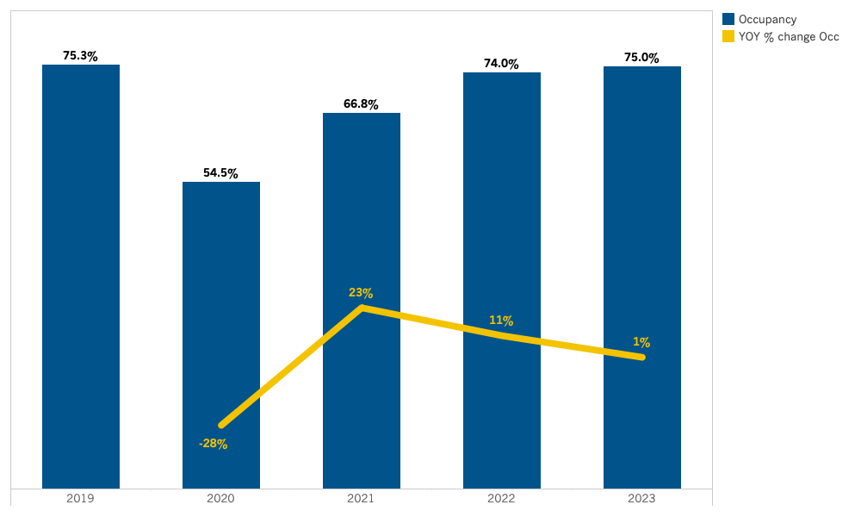
Gold Country: Occupancy
Source: Tourism Economics

Slide 45
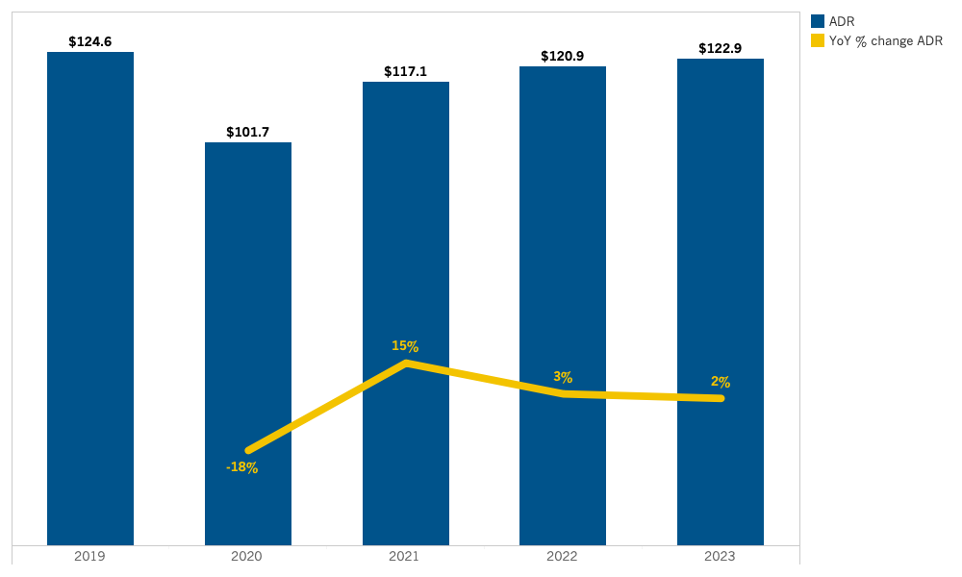
Gold Country: ADR
Source: Tourism Economics

Slide 46
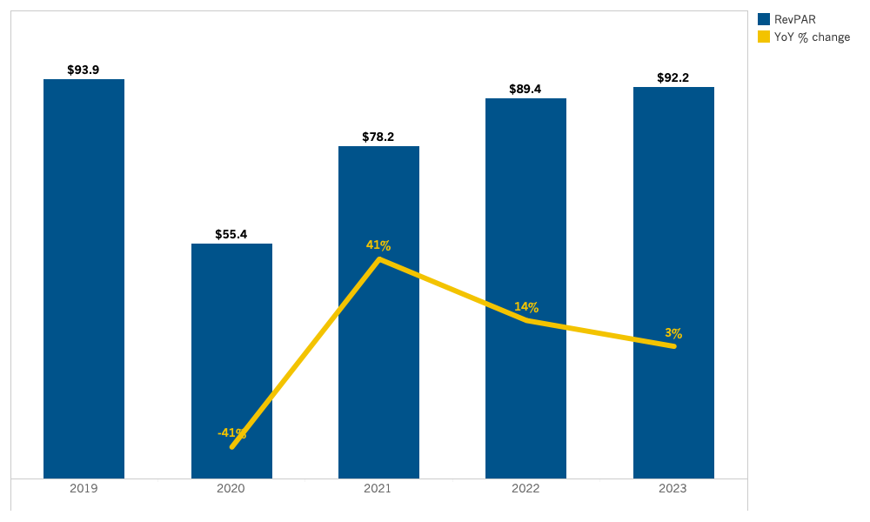
Gold Country: RevPAR
Source: Tourism Economics

Slide 47
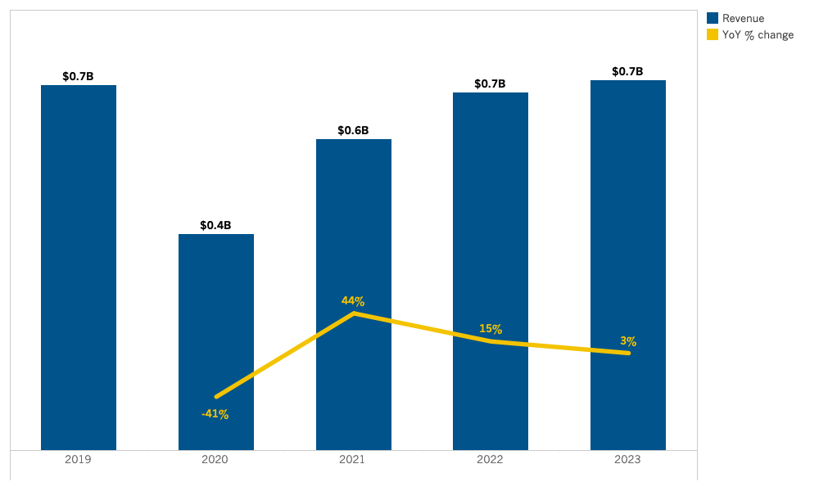
Gold Country: Room Revenue
Source: Tourism Economics

Slide 48
Lodging Forecast
(High Sierra)

Slide 49
SUMMARY TABLE
Annual forecast: High Sierra

Slide 50
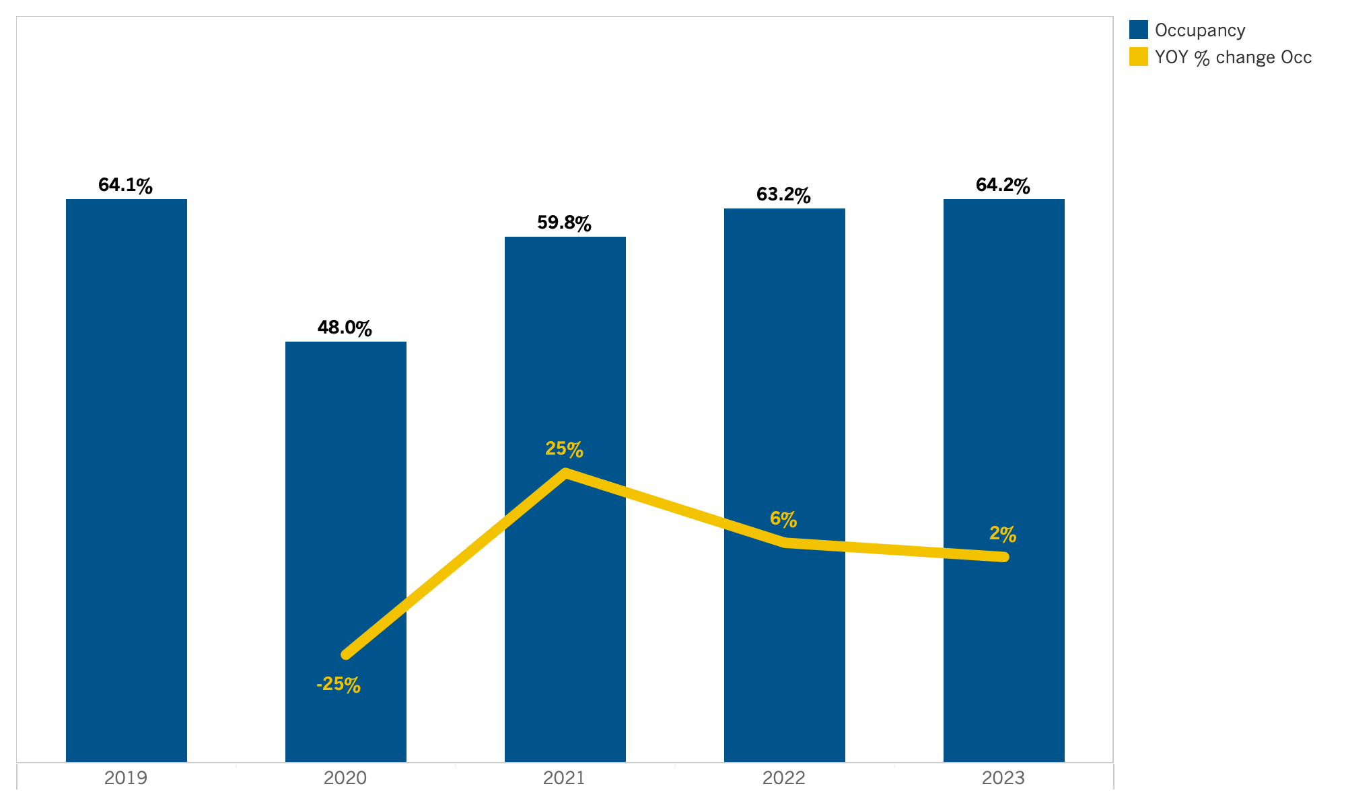
High Sierra: Occupancy
Source: Tourism Economics

Slide 51
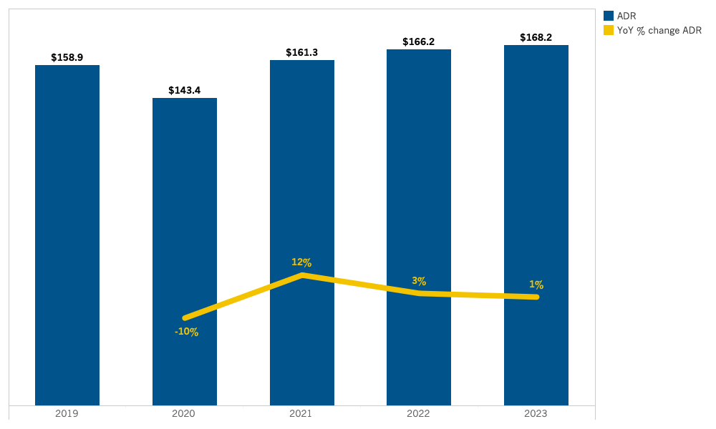
High Sierra: ADR
Source: Tourism Economics

Slide 52
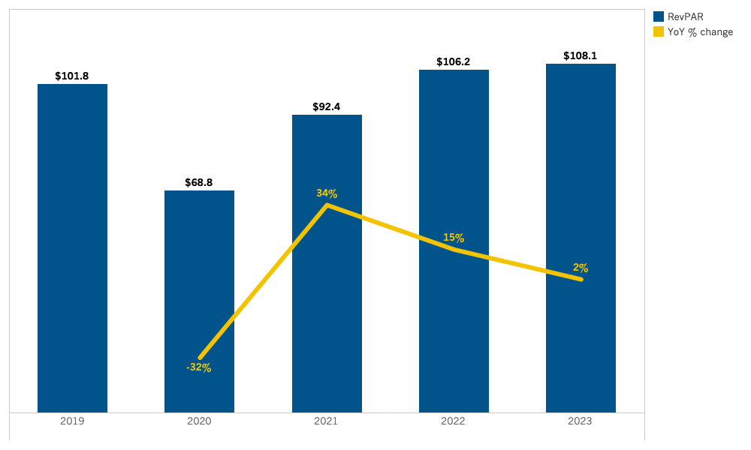
High Sierra: RevPAR
Source: Tourism Economics

Slide 53
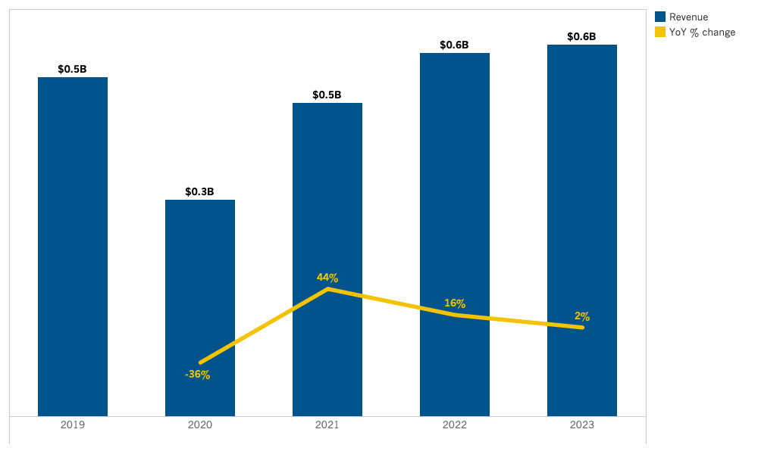
High Sierra: Room Revenue
Source: Tourism Economics

Slide 54
Lodging Forecast
(Inland Empire)

Slide 55
SUMMARY TABLE
Annual forecast: Inland Empire

Slide 56
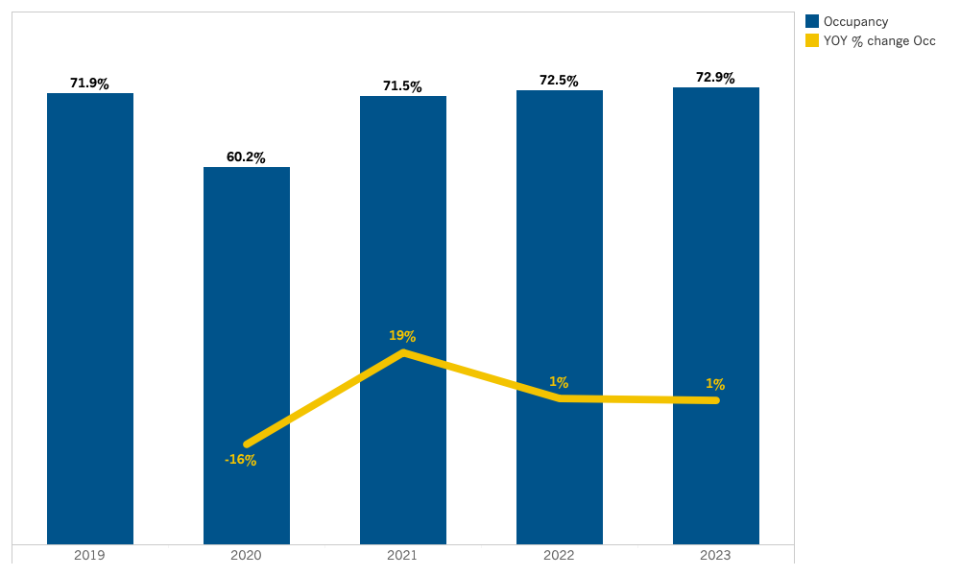
Inland Empire: Occupancy
Source: Tourism Economics

Slide 57
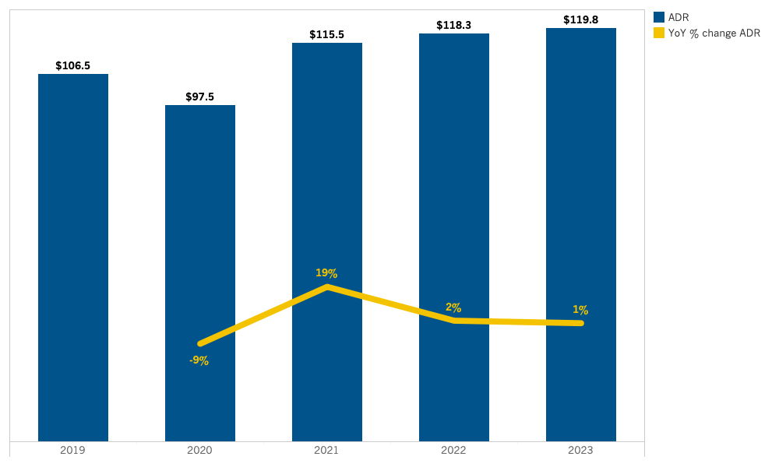
Inland Empire: ADR
Source: Tourism Economics

Slide 58
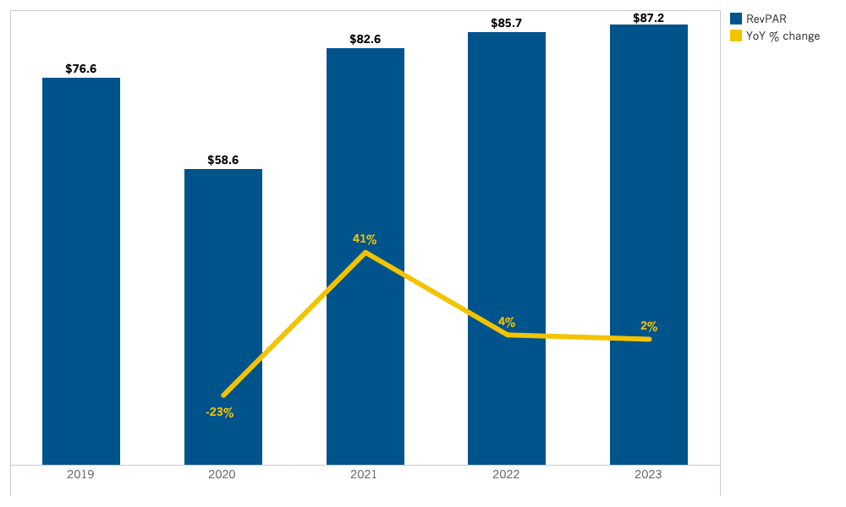
Inland Empire: RevPAR
Source: Tourism Economics

Slide 59
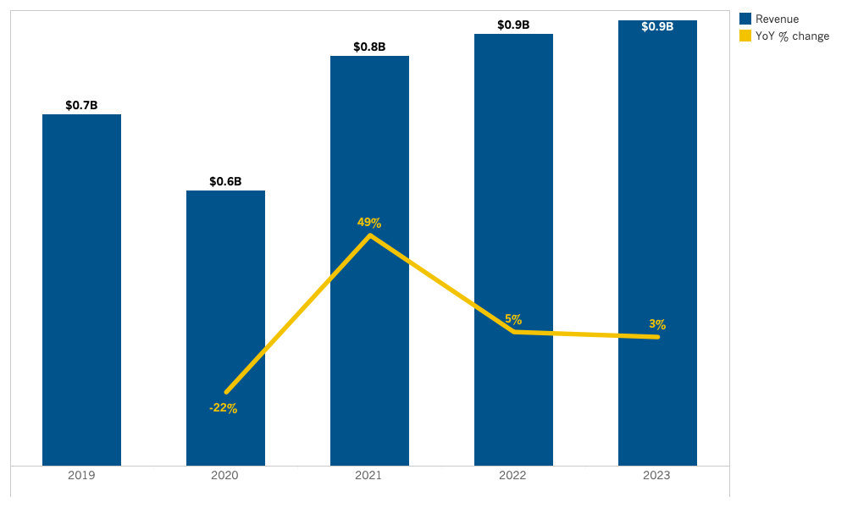
Inland Empire: Room Revenue
Source: Tourism Economics

Slide 60
Lodging Forecast
(Los Angeles County)

Slide 61
SUMMARY TABLE
Annual forecast: Los Angeles County

Slide 62
Los Angeles County: Occupancy
Source: Tourism Economics

Slide 63
Los Angeles County: ADR
Source: Tourism Economics

Slide 64
Los Angeles County: RevPAR
Source: Tourism Economics

Slide 65
Los Angeles County: Room Revenue
Source: Tourism Economics

Slide 66
Lodging Forecast
(North Coast)

Slide 67
SUMMARY TABLE
Annual forecast: North Coast

Slide 68
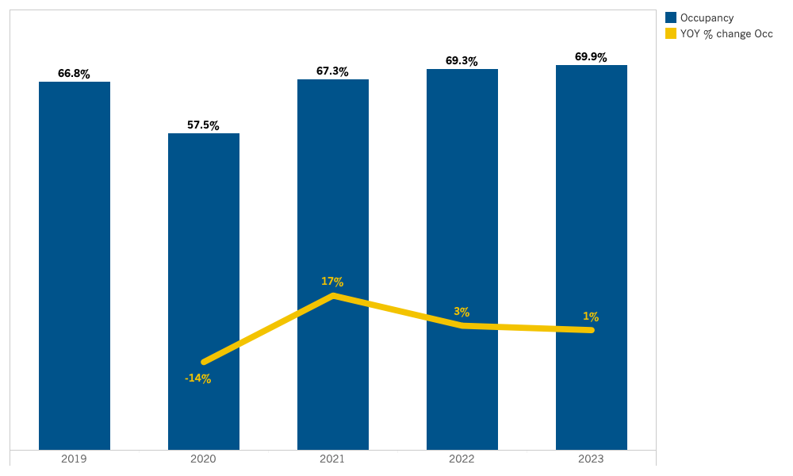
North Coast: Occupancy
Source: Tourism Economics

Slide 69
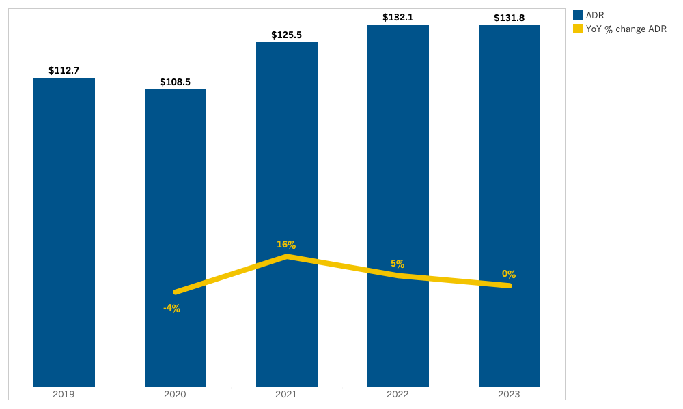
North Coast: ADR
Source: Tourism Economics

Slide 70
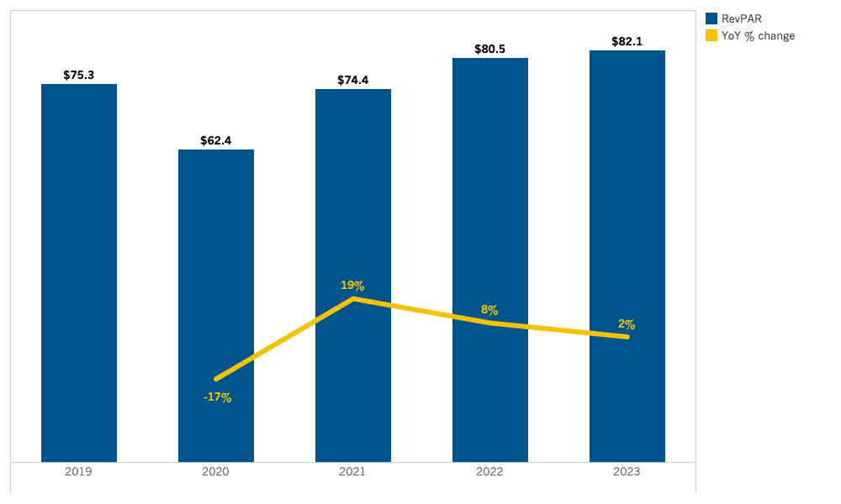
North Coast: RevPAR
Source: Tourism Economics

Slide 71
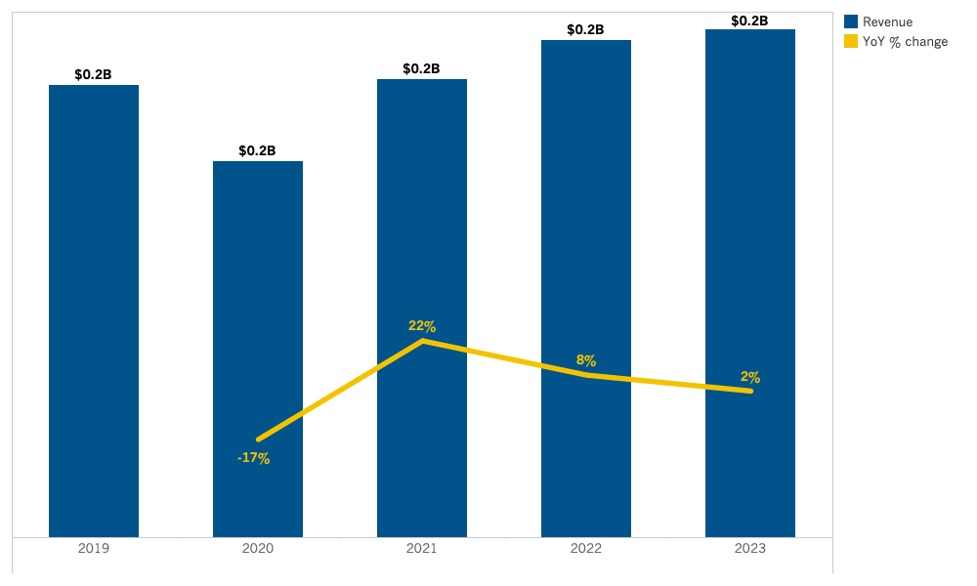
North Coast: Room Revenue
Source: Tourism Economics

Slide 72
Lodging Forecast
(Orange County)

Slide 73
SUMMARY TABLE
Annual forecast: Orange County

Slide 74
Orange County: Occupancy
Source: Tourism Economics

Slide 75
Orange County: ADR
Source: Tourism Economics

Slide 76
Orange County: RevPAR
Source: Tourism Economics

Slide 77
Orange County: Room Revenue
Source: Tourism Economics

Slide 78
Lodging Forecast
(San Diego County)

Slide 79
SUMMARY TABLE
Annual forecast: San Diego County

Slide 80
San Diego County: Occupancy
Source: Tourism Economics

Slide 81
San Diego County: ADR
Source: Tourism Economics

Slide 82
San Diego County: RevPAR
Source: Tourism Economics

Slide 83
San Diego County: Room Revenue
Source: Tourism Economics

Slide 84
Lodging Forecast
(San Francisco Bay Area)

Slide 85
SUMMARY TABLE
Annual forecast: San Francisco Bay Area

Slide 86
San Francisco Bay Area: Occupancy
Source: Tourism Economics

Slide 87
San Francisco Bay Area: ADR
Source: Tourism Economics

Slide 88
San Francisco Bay Area: RevPAR
Source: Tourism Economics

Slide 89
San Francisco Bay Area: Room Revenue
Source: Tourism Economics

Slide 90
Lodging Forecast
(Shasta Cascade)

Slide 91
SUMMARY TABLE
Annual forecast: Shasta Cascade

Slide 92
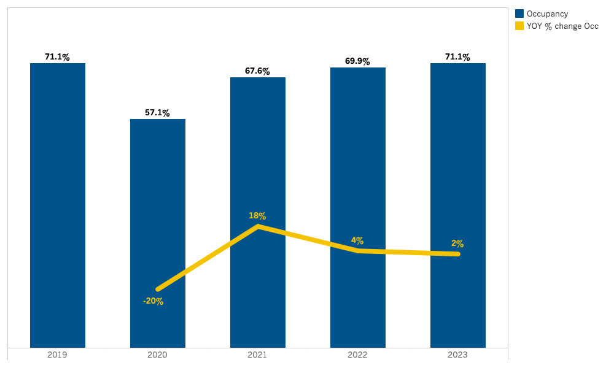
Shasta Cascade: Occupancy
Source: Tourism Economics

Slide 93
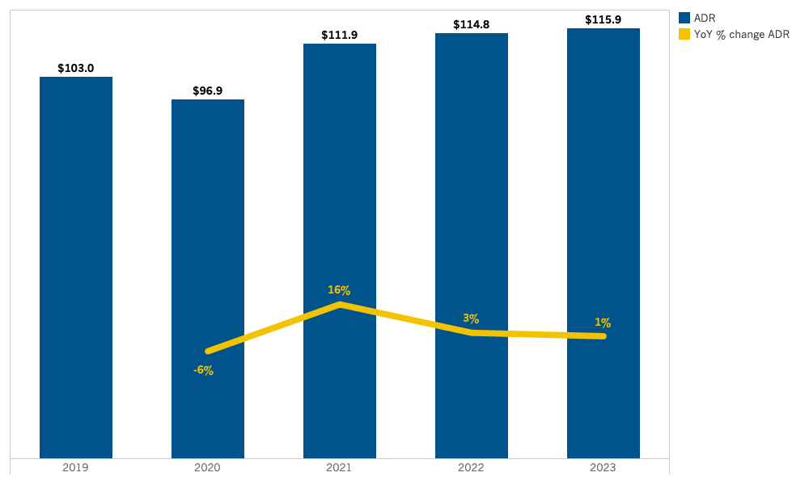
Shasta Cascade: ADR
Source: Tourism Economics

Slide 94
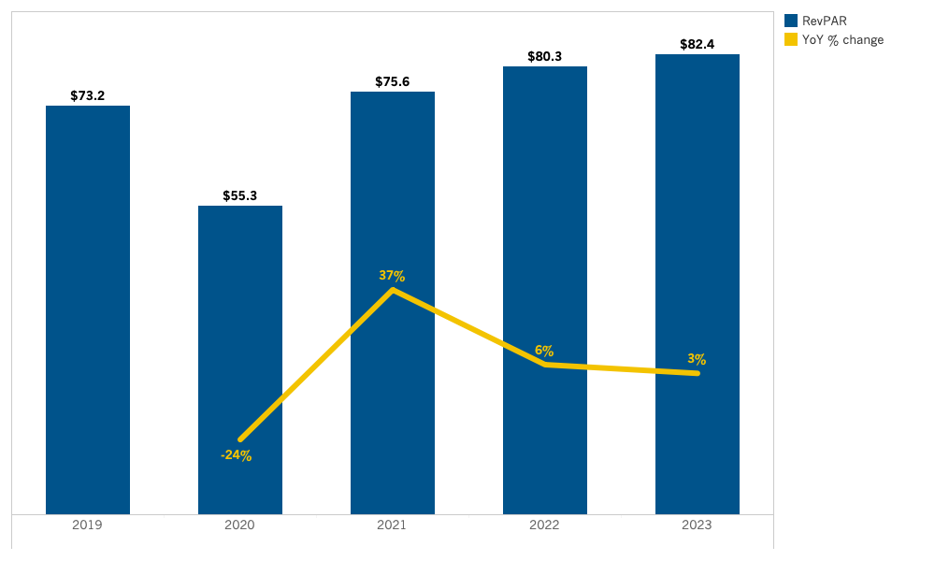
Shasta Cascade: RevPAR
Source: Tourism Economics

Slide 95
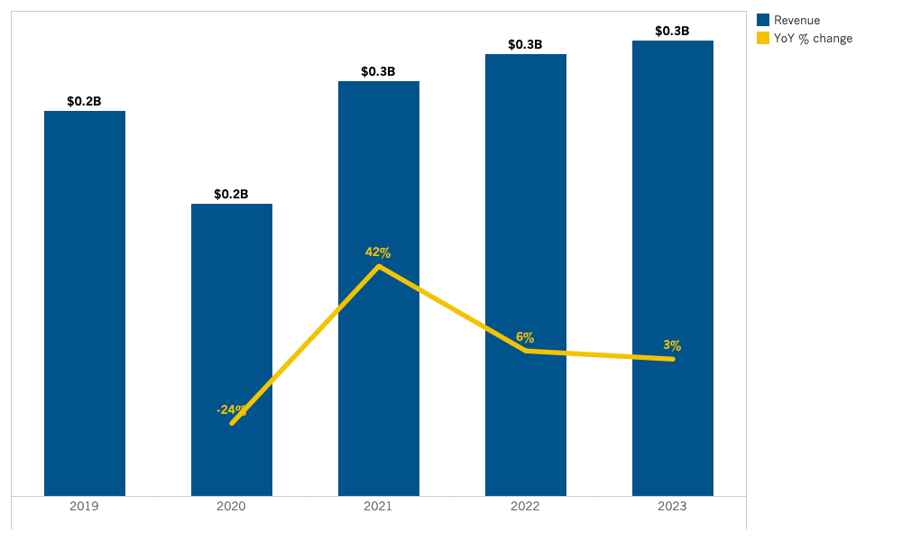
Shasta Cascade: Room Revenue
Source: Tourism Economics

Slide 96
About Tourism Economics
Tourism Economics is an Oxford Economics company with a singular objective: combine an understanding of tourism dynamics with rigorous economics in order to answer the most important questions facing destinations, developers, and strategic planners. By combining quantitative methods with industry knowledge, Tourism economics designs custom market strategies, destination recovery plans, tourism forecasting models, tourism policy analysis and economic impact studies.
With over four decades of experience of our principal consultants, it is our passion to work as partners with our clients to achieve a destination's full potential.
Oxford Economics is one of the world's leading providers of economic analysis, forecasts and consulting advice. Founded in 1981 as a joint venture with Oxford University's business college, Oxford Economics enjoys a reputation for high quality , Quantitative analysis and evidence-based advice. For this, it draws on its own staff of more than 250 professional economics; a dedicated data analysis team; global modeling tools, and a range of partner institutions in Europe, the US and in the United Nations Project Link. Oxford economics has offices in London, Oxford, Dubai, Philadelphia and Belfast.
For more information:
info@tourismeconomics.com

