Slide 1



California’s Visitor Economy
Travel Forecast & Key Drivers
June 2024
Prepared for:
Prepared for:
Prepared for:

Slide 2

TABLE OF
CONTENTS
1
2
3
4
Introduction
Key findings
Forecast assumptions and drivers
Forecast results
1
2
3
4
5
6
7
8
9

Slide 3

Introduction
1

Slide 4
Introduction
Visit California engaged Tourism Economics, an Oxford Economics company, to prepare a 5-year forecast of key visitation and spending indicators for the state of California. The analysis draws on the following data sources:
Data provided by Visit California, such as historical guest hotel metrics
Tourism Economics’ prior research on California’s tourism economy and the most recent lodging forecast for California and its twelve regions (May 2024)
STR hotel data through April 2024
BTS, SIAT, FIA, POE, OAG, California air traffic reports through Q1 2024
Tourism Economics’ proprietary forecast databases, Global Travel Service and Global City Travel
NTTO forecasts of international arrivals to U.S.
Economic forecasts prepared by Oxford Economics
Assumptions on the future path of tourism sector recovery.
Travel exhibited continued signs of resilience and recovery in 2023 but the industry faces a slowing economy and weakening household finances in 2024. However, we believe travel growth will prevail through these challenges.
California visitor volume rose 2% in 2023 and we expect a similar pace of growth in 2024. After welcoming nearly 264 million visitors in 2023, California is expected to add more than 4 million visitors in 2024. Visitor volume in 2024 is projected to reach 94% of 2019’s pre-pandemic benchmark, with full recovery projected in 2027.
Modest growth of about 1% is forecast in 2024 domestic visits, led by 2% growth in domestic business visits due to the on-going recovery in corporate travel and group meetings. Consumer spending is expected to slow over the rest of the year, but any slowdown is likely to be gradual due to solid household balance sheets and a cooling but healthy labor market. While household balance sheets are strong, in aggregate, there are signs that two years of high inflation and interest rates are weighing on some household budgets. Credit card debt has grown significantly, and the delinquency rate on that debt is rising, particularly among younger and lower income households.
International arrivals are forecast to rise 20% in 2024, led by strong growth in arrivals from China, Japan, and Australia. India and Canada reached 2019 levels in 2023, and countries forecast to surpass 2019 benchmarks in 2024 include Japan, South Korea, and Mexico. Countries projected to reach full recovery in 2025 include China, Australia, and the United Kingdom.

Slide 5
Key findings
2

Slide 6
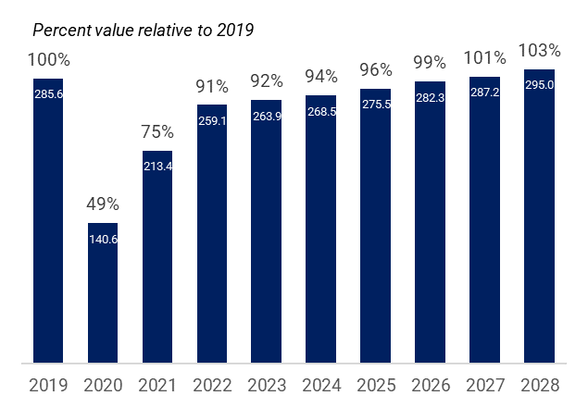
Key findings
Total visitor volume
Visits to California increased 2% in 2023 and surpassed 260 million visitors for the first time since the pandemic. Visitor volume is projected to rise another 2% in 2024, representing nearly 5 million additional visitors.
Visitor volume recovery
Visitor volume is forecast to total 287 million in 2027, 101% of 2019 visitation, and reach 295 million visitors in 2028.
Total California visitor volume
(Millions)
Source: STR; Tourism Economics

Slide 7
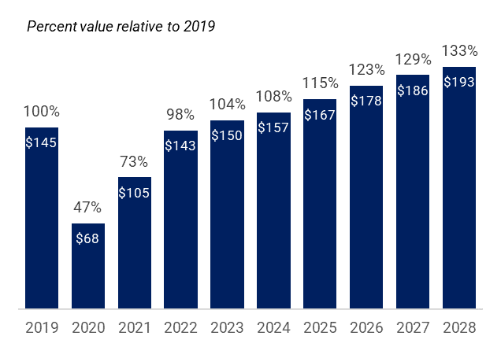
Key findings
Total visitor spending
Direct tourism spending in California advanced 6% in 2023 and surpassed $150 billion. Growth is expected to slow modestly in 2024, to 4%, adding an additional $6 billion in direct tourism spending to California’s economy. By the end of the forecast horizon in 2028, direct tourism spending is expected to surpass $190 billion.
Total visitor spending recovery
Visitor spending fully recovered in 2023 and exceeded 2019 levels by 4%. By the end of 2028 visitor spending is expected to exceed 2019 levels by more than 30%.
Total visitor spending in California
($ billions)
Source: Dean Runyan; Tourism Economics

Slide 8
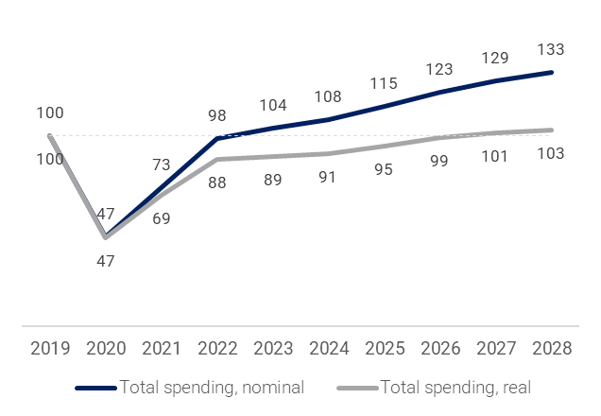
Key findings
Inflationary pressures are overstating real increase in spending
Expressed in real terms, direct visitor spending tallied $129 billion in 2023 compared to $150 billion in nominal terms. Inflation is contributing significantly to the growth of visitor spending, putting it on a trajectory to reach $193 billion by 2028. In real terms, by 2028, visitor spending is expected to tally $149 billion.
Real visitor spending recovery
While nominal visitor spending fully recovered in 2023, visitor spending expressed in real terms is not expected to fully recover until 2027. By 2028, real visitor spending will stand 3% above 2019 (compared to 33% in nominal terms).
Total visitor spending in California
Percent relative to 2019
Source: Dean Runyan; Tourism Economics

Slide 9
Forecast assumptions and drivers
3

Slide 10
World Economic Prospects Monthly
Oxford Economics Macroeconomic Outlook, May 2024
Economic growth withstands inflation and tight monetary policy
We still anticipate a steady but unspectacular recovery in global economic activity this year. Our world GDP growth forecasts are little changed at 2.6% in 2024 and 2.8% in 2025. While recent inflation data have given some policymakers pause for thought, we still expect the European Central Bank (ECB) and Bank of England to cut policy rates in June, while the Federal Reserve now looks likely to follow in September.
Recent economic data have not significantly altered our baseline view for growth prospects. Although the US economy grew a little more slowly in Q1 than we had anticipated, the big picture remains that the US is in the midst of a soft economic landing.
In the absence of a substantial downside growth surprise, inflation and labor market developments remain key to when and how quickly advanced economy central banks lower policy rates. The Fed can take heart from the recent labor data, which suggest the risks of a renewed pick-up in wage growth are easing.
But this only partially counters the concerns raised by the upside inflation surprises at the start of the year. Therefore, we expect the Fed to wait until September, rather than June, to cut rates. Both the ECB and the Bank of England can be more confident that underlying inflation pressures will ease further. We expect both will cut rates in June, before the Fed's next move.

Slide 11
US outlook
2024-2025 forecasts

Slide 12
US Economic Outlook
The Federal Reserve's policy pivot will likely be delayed
Economic output
The Federal Reserve’s plan to cut interest rates this year is being delayed because of the underlying strength of the US economy and inflation data that has not instilled confidence within the central bank that inflation is sustainably moving toward its 2% objective. The hard economic data remains solid, with few fissures in the core of the economy. Trend real GDP growth is running above our estimate of the economy's short-term potential of 2%.
Labor market
We continue to believe the unemployment rate will only increase slightly, peaking at 4.1% in the first half of 2025.
The lingering tightness of the labor market suggests there could be a delay in nominal wage growth returning to 3.5% annual growth, a function of 2% inflation and 1.5% productivity growth, that is consistent with the Fed’s inflation target. This represents an upside risk to the anticipated slowing of inflation.
Consumers
Our business cycle indicator shows the US economy hit a rough patch at the start of this year. However, we don't think there are any immediate causes for concern because real final sales to domestic purchasers, the economy's main economic engine, are fine and threats to the expansion do not appear overly threatening. The weakness in the economy in Q1 may be a little hangover after the economy grew rapidly in H2 2023.
We assume that growth in real consumer spending will remain solid, supported by a tight labor market, gains in real disposable income, past increases in household wealth, and low savings. Excess savings, or the additional savings households had relative to pre-pandemic saving patterns, won’t be a factor in spending going forward as these savings have been mostly depleted.
Inflation
The biggest change to our baseline in May was an upward revision to our forecast for inflation in the US. Consumer prices rose more than anticipated in March, and while inflation is expected to moderate, the forecast needed to be tweaked. We now expect the core PCE deflator to rise 2.7% on an average annual basis this year, versus 2.5% in the April baseline. We also raised our projection for the year-on-year gain in the core CPI from 3.3% to 3.6%.
We still believe inflation will moderate in the second half of this year as disinflation in housing kicks in, nominal wage growth slows further, residual seasonality shifts from a support to a drag, and some of the idiosyncratic price increases that occurred earlier this year, including motor vehicle insurance, are not duplicated.

Slide 13
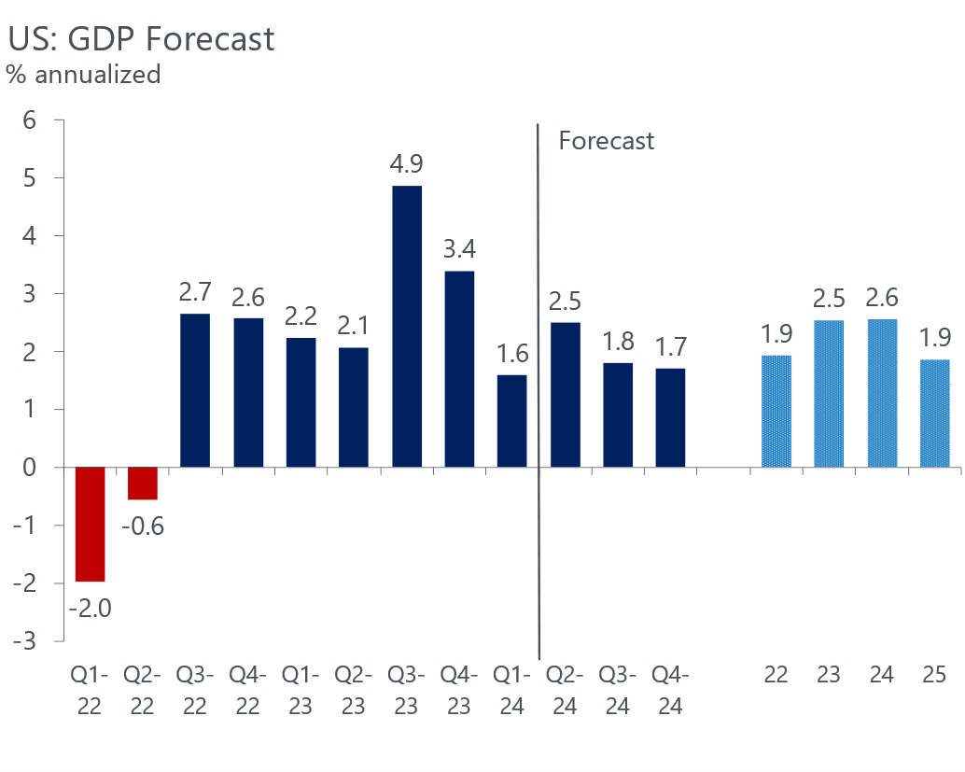
US: GDP Forecast
US macro forecast is benign
Weakness in Q1 was concentrated in volatile components of GDP including inventories and net exports. These drags are not expected to persist and real consumer spending is on a better trajectory in Q2.

Slide 14
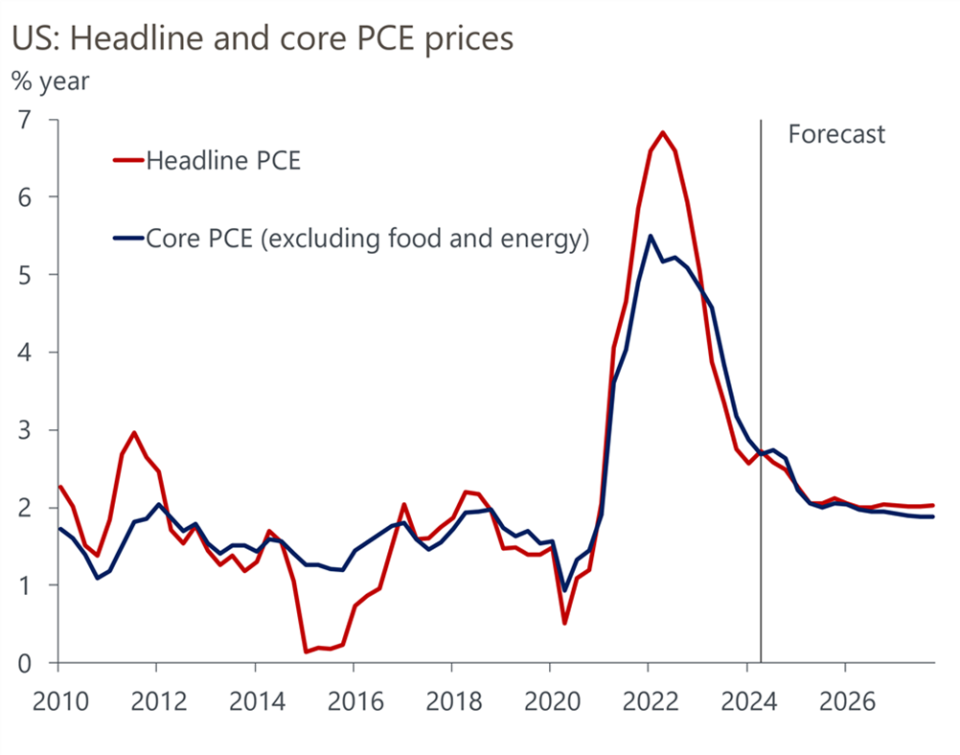
Sticky inflation not expected to last much longer
Persistent inflation in the first quarter delays Fed easing
Inflation is expected to continue slowing but remain above the Federal Reserve’s 2% target through the end of 2024.

Slide 15
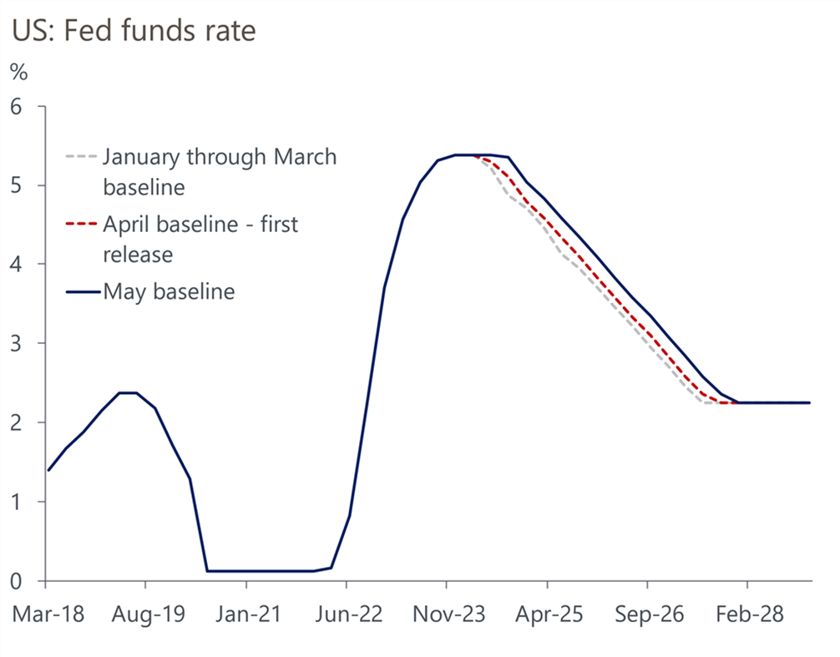
US: Interest Rates
The Federal Reserve is likely to start lowering interest rates in September
We expect the first rate cut by the Federal Open Market Committee to occur in September.
The delay to the first rate cut reduces the cumulative amount of easing this year from 75bps to 50bps and risks are weighted toward fewer or smaller rate cuts.
We believe the Fed will cut rates at every other meeting until the federal funds rate reaches its neutral rate, which we estimate to be 2.25%.

Slide 16
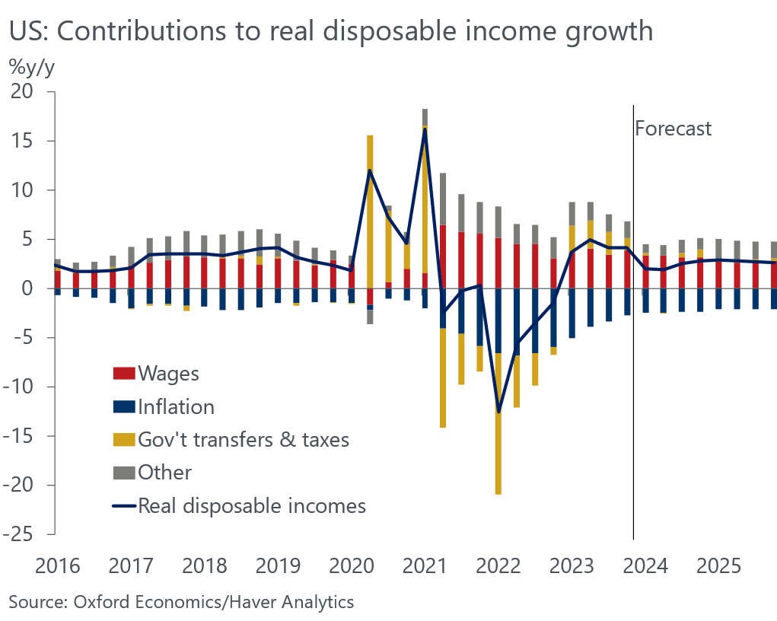
Real incomes are rising
Growth in real disposable income as inflation eases

Slide 17
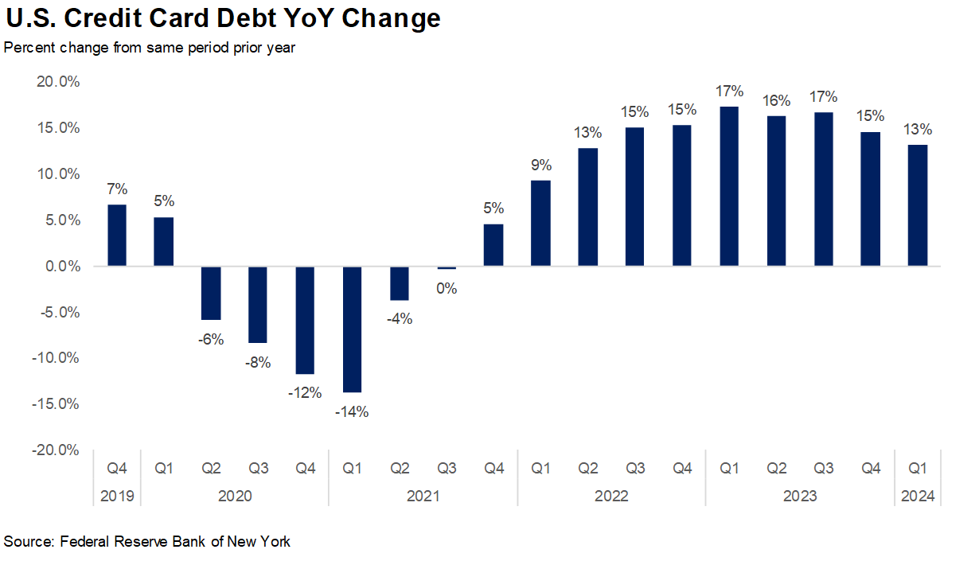
Consumers turning to credit cards to maintain spending
Regressive nature of inflation squeezes middle and lower income household budgets

Slide 18
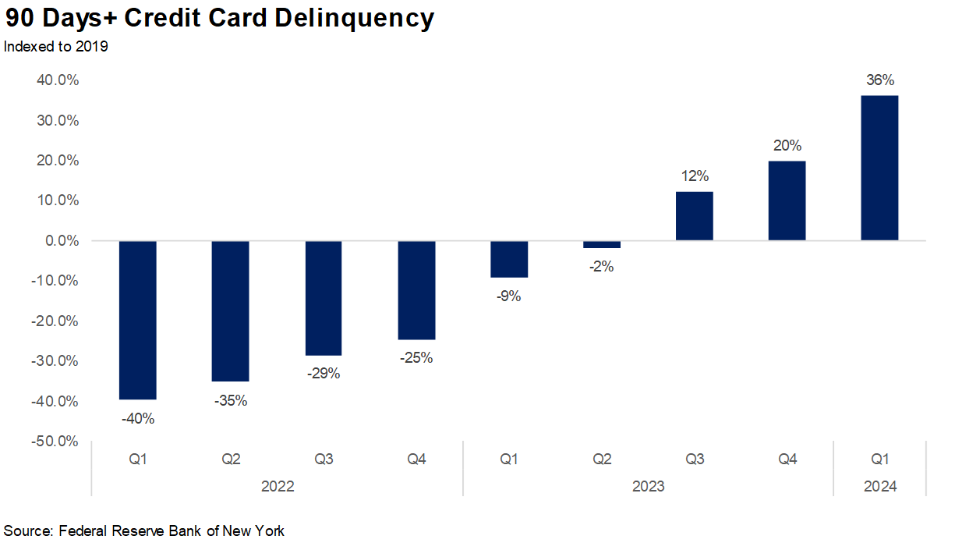
Delinquency rates are rising
Higher credit card debt combined with higher interest rates

Slide 19
Travel Planning Remains Stable

Slide 20
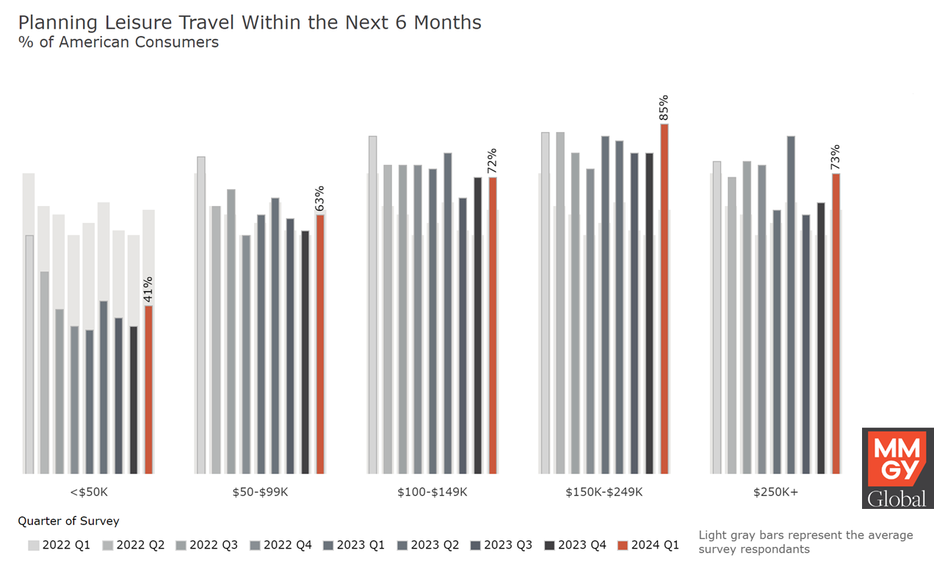
Leisure Travel Plans Rebounded in Q1

Slide 21
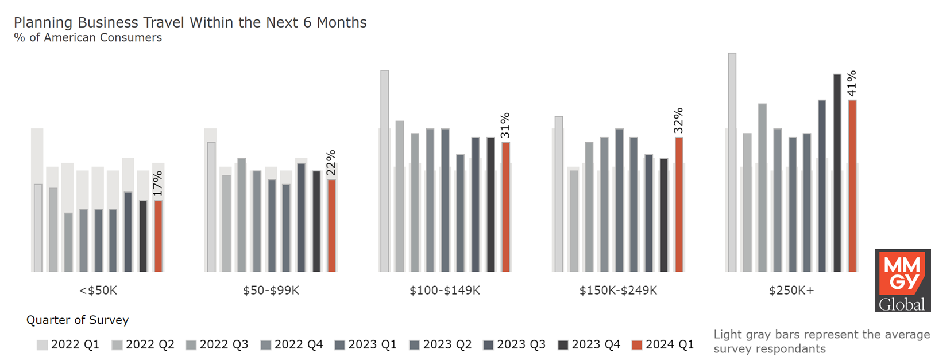

Overall business travel plans rose in Q1

Slide 22
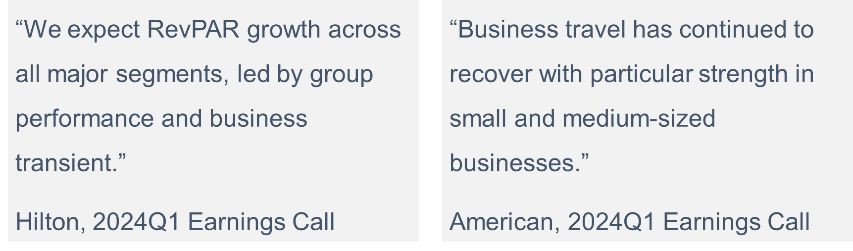
Travel industry looking for growth from business sector

Slide 23
International travel
Outbound recovery is well ahead of inbound
Total outbound trips by U.S. residents surpassed 2019 levels in the fall of 2023.
Inbound arrivals by non-U.S. residents has yet to reach pre-pandemic levels.
Total arrivals in the first quarter of 2024 were 93% of the same period in 2019, while outbound trips by U.S. residents were 108%.

Slide 24
Exchange rates
Units of the local currency per USD remain above 2019 levels
The exchange rate for visitors from Japan and Brazil is significantly higher than in 2019 and is likely contributing to the slow recovery in arrivals.
Arrivals from India have experienced a robust recovery despite a nearly 20% increase in the exchange rate.
A weaker British Pound and Euro have been credited with the surge of U.S travel to Europe in 2022 and 2023, but the exchange rates have eased.

Slide 25
US: Room Demand
Hotel demand is bifurcating along economic lines
The regressive nature of inflation and higher interest rates is contributing to a bifurcation in travel performance.
Hotel demand is trailing prior year levels among Economy and Midscale chains, while demand in Upper Upscale and Luxury chains continues to grow.
On-going growth in cruise passenger volumes and international travel by U.S. citizens also suggest higher-income households are traveling, while the more budget conscious may be cutting back.

Slide 26
US: Room Demand
Room demand gains will be modest in 2024
U.S. demand in 2024 is forecast to be about 1% below 2019.
The recovery in hotel demand is being undermined by:
Strong growth in outbound U.S. travel versus a more measured recovery in international inbound arrivals.
Growth in the cruise industry
Weakness in demand for Economy and Midscale hotels

Slide 27
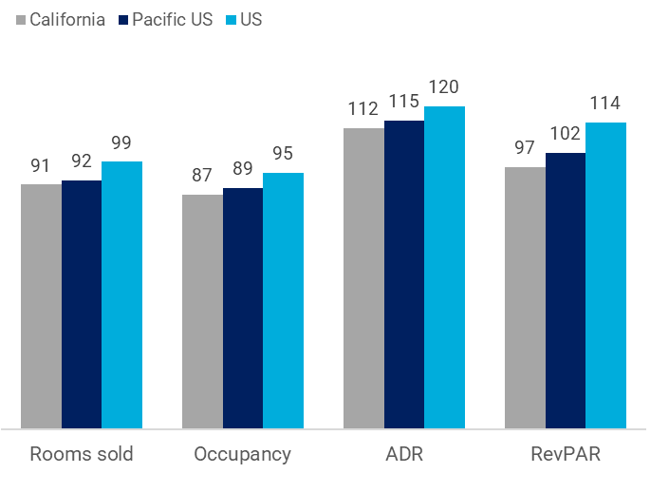
Recent California lodging performance
The recovery in California’s lodging sector continues to trail the overall industry
Room demand
California room demand continues to recover but trails the Pacific region and the US overall. Hotel demand in California, through the first four months of 2024, was 9% below the same period in 2019.
Occupancy
Year to date through April, California’s hotel occupancy was 87% of the same period in 2019. Year to date occupancy stood at 63.7% compared to 73.2% through the first four months of 2019.
ADR & RevPAR
ADR surpassed 2019 in 2023 and was 12% above the 2019 baseline through the first four months of 2024. However, the slow recovery in occupancy rates is constraining the recovery in RevPAR.
Hotel performance through April
YTD April 2024 relative to 2019
Source: CoStar Group

Slide 28
Forecast results
4

Slide 29
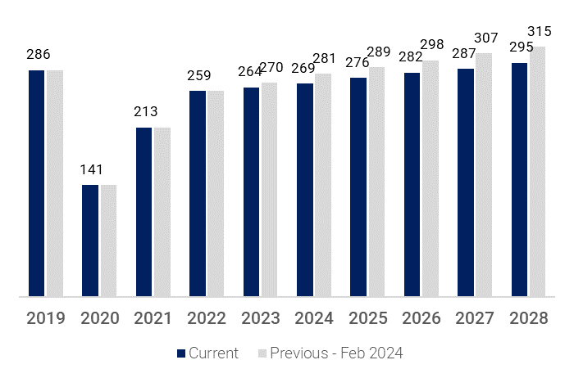
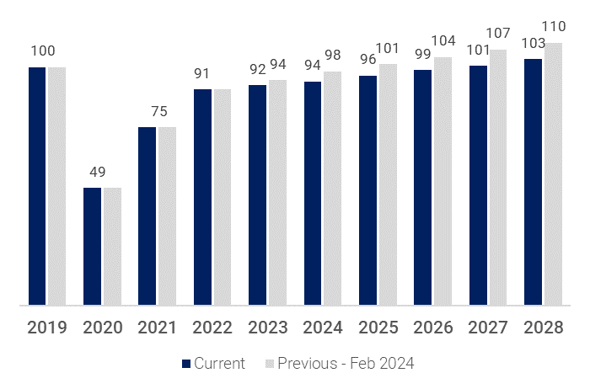
California visitor forecast
Forecast comparison: Current (Jun 2024) vs. previous (Feb 2024)
Total visitors in California
(Millions)
Total visitors in California
(Index, 2019=100)
Source: Tourism Economics
Source: Tourism Economics

Slide 30
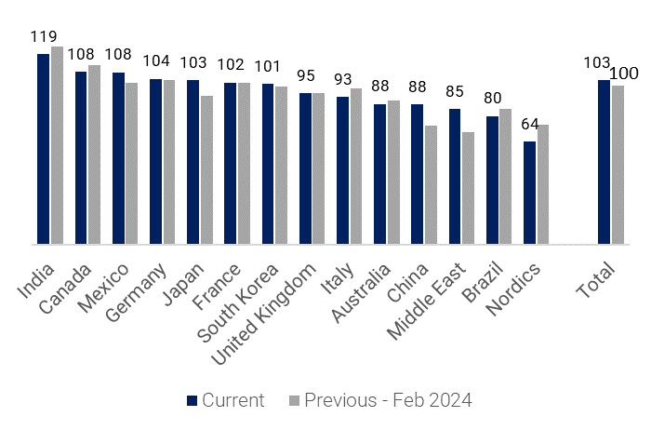
California international visitor forecast
Forecast comparison: Current (Jun 2024) vs. previous (Feb 2023)
The global travel recovery continues in 2024. Many countries that were previously expected to endure recession are now likely to avoid this although economic growth will certainly slow. The travel resilience in North America and Europe is set to continue as consumers prioritize travel and the Asia Pacific recovery will gain momentum.
We have upgraded our 2024 forecast for international arrivals to California to 103% of 2019’s level (from 100% in the February 2024 forecast) on stronger-than-expected Q1 arrivals.
Notable upgrades came from Asia Pacific, with significant increases in the outlook for arrivals from China and Japan. California arrivals from China more than tripled in 2023 and are projected to increase more than 80% in 2024, reaching nearly 90% of 2019 levels.
California’s international arrivals recovery has been led by India. Arrivals from India totaled 119% of the 2019 benchmark in 2023 and are projected to grow another 4% in 2024.
Arrivals from Canada also set a new high in 2023, and 6% growth is forecast for 2024.
Japan, South Korea, Germany, France, and Mexico are projected to surpass 2019 levels in 2024.
Inbound California visits forecast, 2024
(2019 = 100)
Source: Tourism Economics

Slide 31
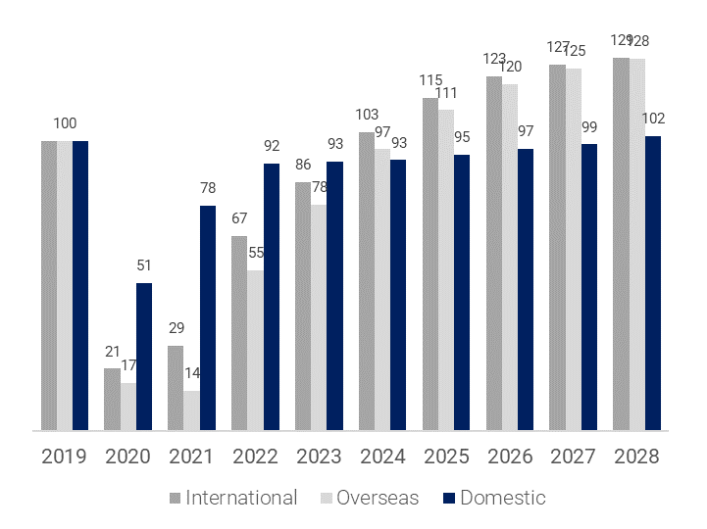
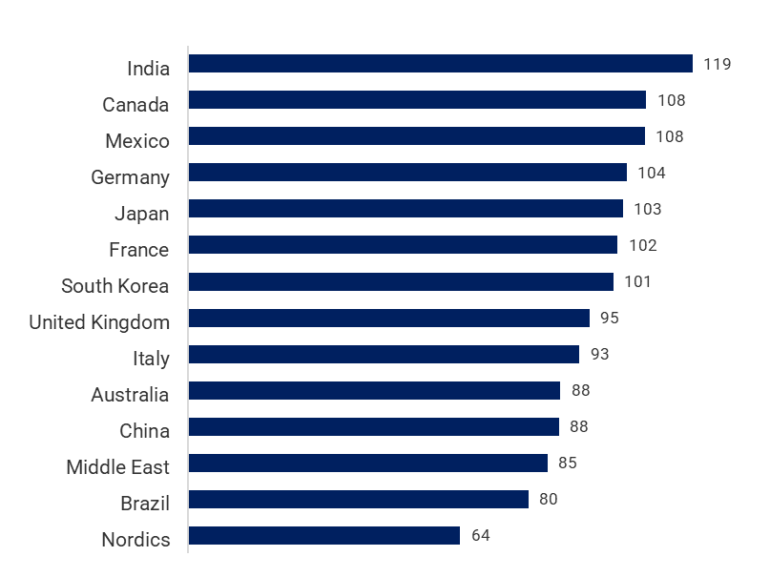
California visitor forecast
Relative to 2019 volume
Total visitors in California
(2019 = 100)
California international visitors in 2024
(2019 = 100)
Source: Tourism Economics
Source: Tourism Economics

Slide 32
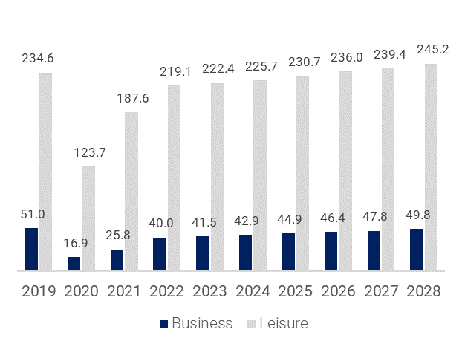
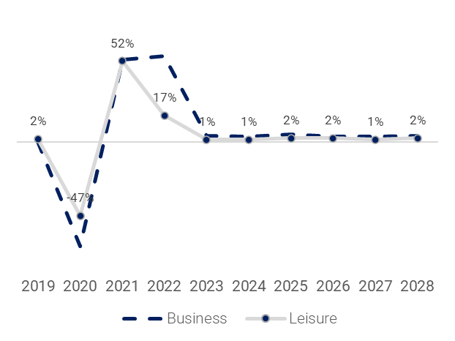
California visitor forecast
Business vs. leisure
Business vs. leisure visitors in California
(Millions)
Percentage change in business vs. leisure visitors to California
(Year-on-year % change)
Source: Tourism Economics
Source: Tourism Economics

Slide 33
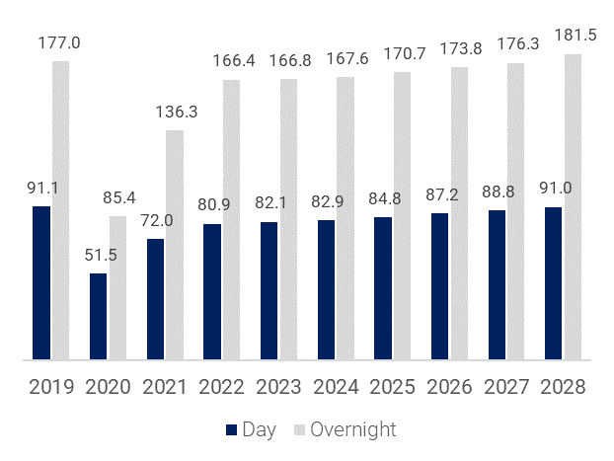
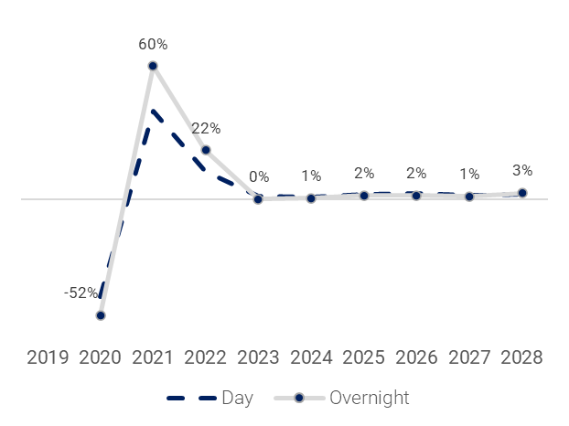
Domestic visitors to California
Day vs. overnight
Domestic day vs. overnight visitors in California
(Millions)
Percentage change in domestic day vs. overnight visitors to California
(Year-on-year % change)
Source: Tourism Economics
Source: Tourism Economics

Slide 34
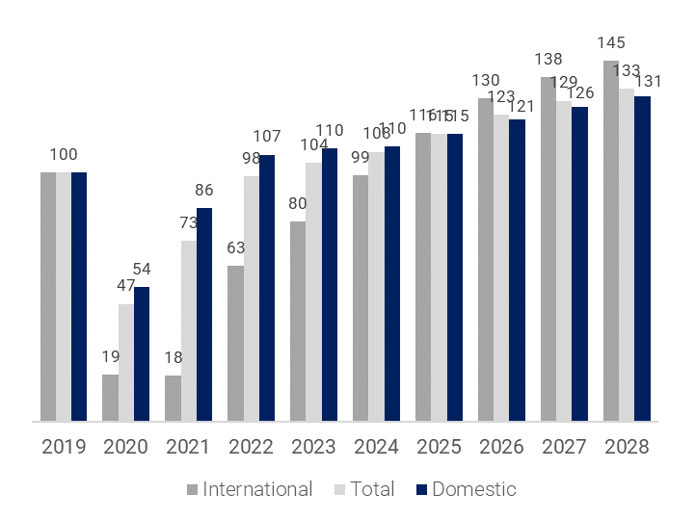
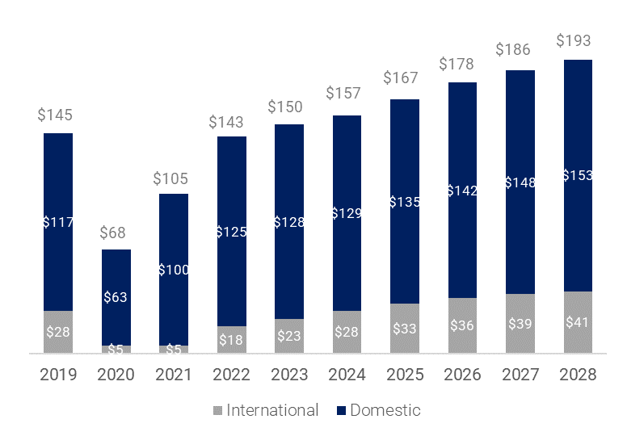
Direct visitor spending in California
Domestic vs. international
Domestic vs. international visitor spending in California
(2019 = 100)
Domestic vs. international visitor spending in California
($ billions)
Source: Dean Runyan; Tourism Economics
Source: Dean Runyan; Tourism Economics

Slide 35
Forecast tables

Slide 36
Forecast tables

Slide 37
Forecast tables

Slide 38
Forecast tables

Slide 39
About Tourism Economics
Tourism Economics is an Oxford Economics company with a singular objective: combine an understanding of the travel sector with proven economic tools to answer the most important questions facing our clients. More than 500 companies, associations, and destination work with Tourism Economics every year as a research partner. We bring decades of experience to every engagement to help our clients make better marketing, investment, and policy decisions. Our team of highly-specialized economists deliver:
  Global travel data-sets with the broadest set of country, city, and state coverage available
  Travel forecasts that are directly linked to the economic and demographic outlook for origins and destinations
  Economic impact analysis that highlights the value of visitors, events, developments, and industry segments
  Policy analysis that informs critical funding, taxation, and travel facilitation decisions
  Market assessments that define market allocation and investment decisions
Tourism Economics operates out of regional headquarters in Philadelphia and Oxford, with offices in Belfast, Buenos Aires, Dubai, Frankfurt, and Ontario.
Oxford Economics is one of the world’s foremost independent global advisory firms, providing reports, forecasts and analytical tools on 200 countries, 100 industrial sectors and over 3,000 cities. Our best-of-class global economic and industry models and analytical tools give us an unparalleled ability to forecast external market trends and assess their economic, social and business impact. Headquartered in Oxford, England, with regional centers in London, New York, and Singapore, Oxford Economics has offices across the globe in Belfast, Chicago, Dubai, Miami, Milan, Paris, Philadelphia, San Francisco, and Washington DC, we employ over 500 full-time staff, including 300 professional economists, industry experts and business editors—one of the largest teams of macroeconomists and thought leadership specialists.
For more information:
info@tourismeconomics.com

