Slide 1



California’s Visitor Economy
Travel Forecast & Key Drivers
February 2024
Prepared for:
Prepared for:
Prepared for:

Slide 2

TABLE OF
CONTENTS
1
2
3
4
Introduction
Key findings
Forecast assumptions and drivers
Forecast results
1
2
3
4
5
6
7
8
9

Slide 3

Introduction
1

Slide 4
Introduction
Visit California engaged Tourism Economics, an Oxford Economics company, to prepare a 5-year forecast of key visitation and spending indicators for the state of California. The analysis draws on the following data sources:
Data provided by Visit California, such as historical guest hotel metrics
Tourism Economics’ prior research on California’s tourism economy and the most recent lodging forecast for California and its twelve regions (Jan 2024)
STR hotel data through December 2023
BTS, SIAT, FIA, POE, OAG, California air traffic reports through Q3/Q4 2023
Tourism Economics’ proprietary forecast databases, Global Travel Service and Global City Travel
US Travel forecast, Fall 2023 forecast update vintage
Economic forecasts prepared by Oxford Economics
Assumptions on the future path of tourism sector recovery.
After a solid 4% growth in visitor volume in 2023, we expect California visitor volume to grow another 4% and come closer to a full recovery in 2024 despite wider economic uncertainty. Recessions that had been forecast for late 2023 will be narrowly avoided in many countries. However, the lagged effects of monetary policy tightening will be felt more fully in 2024 with economic growth set to slow, particularly in the US.
All indicators point to consumers continuing to prioritize travel spending. As we move into a more advanced stage of travel recovery, the pace of growth will slow from recent years edging closer to ‘normal’ growth trends. Asia is the main exception to this narrative with travel restrictions being lifted much later, current demand level further behind other regions, and capacity still being restored. As such, a more robust recovery pace from Asia is anticipated in 2024.
Generally, there appear to be strong expectations for travel in 2024. We expect higher occupancy rates in California and greater visitor numbers despite the anticipated economic weakness. After welcoming close to 270 million visitors in 2023, California is expected to add another 10 million visitors in 2024. The full recovery milestone is expected in 2025. Domestic and transborder travel from Canada and Mexico will contribute to this result, while overseas arrivals will need an additional year before fully recovering in 2025.

Slide 5
Key findings
2

Slide 6
Key findings
Total visitor volume
Visits to California increased 4% in 2023 nearing 270 million visitors. We expect California to grow 4% and welcome an additional 10 million visitors in 2024.
Visitor volume recovery
Visitor volume is expected to recover to 100% of 2019 visitation levels in 2025 and 10% above 2019 visitation levels by the end of 2028.
Total California visitor volume
(Millions)
Source: STR; Tourism Economics

Slide 7
Key findings
Total visitor spending
Our preliminary estimates suggest direct tourism spending in California advanced 6% in 2023 totaling $149 billion. Growth is expected to average 7% this year adding an additional $11 billion in direct tourism spending to California’s economy. By the end of the forecast horizon in 2028, direct tourism spending is expected to reach $191 billion.
Total visitor spending recovery
Visitor spending fully recovered in 2023 and surpassed 2019 levels by 3%. By the end of 2028 visitor spending is expected to exceed 2019 levels by 32%.
Total visitor spending in California
($ billions)
Source: Dean Runyan; Tourism Economics

Slide 8
Key findings
Inflationary pressures are overstating real increase in spending
Expressed in real terms, direct visitor spending tallied $128 billion in 2023 compared to $149 billion in nominal terms. Inflation is contributing significantly to the growth of visitor spending putting it on a trajectory to reach $191 billion by 2028. In real terms, by 2028, visitor spending is expected to tally $148 billion.
Real visitor spending recovery
While nominal visitor spending fully recovered in 2023, visitor spending expressed in real terms is not expected to fully recover until 2027. By 2028, real visitor spending will stand 2% above 2019 (compared to 32% in nominal terms).
Total visitor spending in California
Percent relative to 2019
Source: Dean Runyan; Tourism Economics

Slide 9
Historical revisions in international arrivals
2012-2022
The data for international overseas arrivals is sourced from the Survey of International Air Travelers (SIAT) published by NTTO.
This forecast update includes historical revisions for international arrivals from overseas markets in 2012-2022.
Current arrivals from China are estimated at ~1.0 million compared to the previous estimate of ~1.5 million.
Corresponding revisions in visitor spending from each origin market were made based on prior estimates of average spend per visitor.
Visitor arrivals estimates to California
2019

Slide 10
Forecast assumptions and drivers
3

Slide 11
World Economic Prospects Monthly
Oxford Economics Macroeconomic Outlook, January 2024
Global outlook boosted by US GDP upgrade
Evidence of a soft landing in the US is building and weakening inflation prospects around the world should allow central banks to start cutting interest rates in H1 2024. But global GDP growth still looks set to be subdued, even by the standards of the 2010s, and we think that the pace of policy rate cuts by the US Federal Reserve this year will be less than markets envisage.
We've raised our 2024 world GDP growth forecast to 2.3% from 2.1% a month ago, slightly weaker than last year's estimated 2.7% gain. The key driver of the revision was the US, where we now envisage a more gradual slowdown to sub-trend growth over the course of 2024. We've therefore upgraded our forecast for US GDP growth in 2024 to 2% from 1.2%.
The other key development over the past month has been the downward revision to our global inflation forecasts. A swathe of weaker-than-expected inflation data towards the end of 2023 and a reduction in our oil price forecast – we now expect the Brent oil price will remain around US$75 per barrel this year – are the main drivers.
We expect world CPI inflation to average 4.1% this year, still above the 2.5%-3% average range in the late 2010s, but considerably lower than last year's 6% increase. The path for inflation remains uncertain and there are still plenty of potential shocks that could slow the normalisation, including the recent Red Sea shipping attacks. Even so the risk around our forecast are becoming more evenly balanced.

Slide 12
US outlook
Five-year forecast

Slide 13
US Economic Outlook
New year ushers in reasons for cautious optimism
Economic output
We upgraded our baseline forecast for the US to reflect the underlying strength of the labor market, a quicker moderation in inflation, looser financial market conditions, and signs that the Federal Reserve is set to pivot sooner than we anticipated.
The most significant changes to our January forecast are an upward revision to our projection for real GDP growth this year, a lower peak in the unemployment rate, and an earlier rate cut by the Fed. We forecast real GDP will grow by 2% in 2024, following an estimated 2.5% expansion in 2023.
Labor market
The breadth of job growth has narrowed but this is not an immediate cause for concern. Job openings are still above those seen in 2019 in almost every industry, suggesting labor demand has not fallen off a cliff. A possible reason for the narrowing of hiring in a few industries, including healthcare, leisure/hospitality, and government, is that the affected sectors had elevated output per worker. This resulted in a larger-than-average increase in wages and that helped ease labor supply constraints, making hiring easier.
We expect the unemployment rate will now peak this year at 4.25%, compared with the 4.5% in the December baseline but up from its current 3.7%.
Consumers
We estimate GDP in Q4 2023 was above 2% at an annualized rate, and the jumping-off point for real consumer spending for Q1 is favorable because of the increase in December vehicle sales.
Spending should get a boost from lower retail gasoline prices, as they have fallen by $0.76 per gallon since late September, which should boost consumption by roughly $1 trillion over the course of 2024. Another support for consumer spending is the faster anticipated growth in real disposable income.
With inflation moderating quicker than we anticipated, real disposable income should increase at a solid clip this year, which should help prop up consumption.
Inflation
Our new baseline forecast factors in the recently released revisions to the core PCE deflator, but we think inflation will flirt with the Fed's 2% target by midyear. Therefore, we expect the first rate cut by the Federal Open Market Committee to occur in May, rather than September.
Core goods prices continue to outright decline. Risks to our forecast that goods prices will be a drag on inflation this year are weighted toward the upside because of supply-chain stress stemming from geopolitical tensions, which could push freight costs higher and increase delivery times.

Slide 14
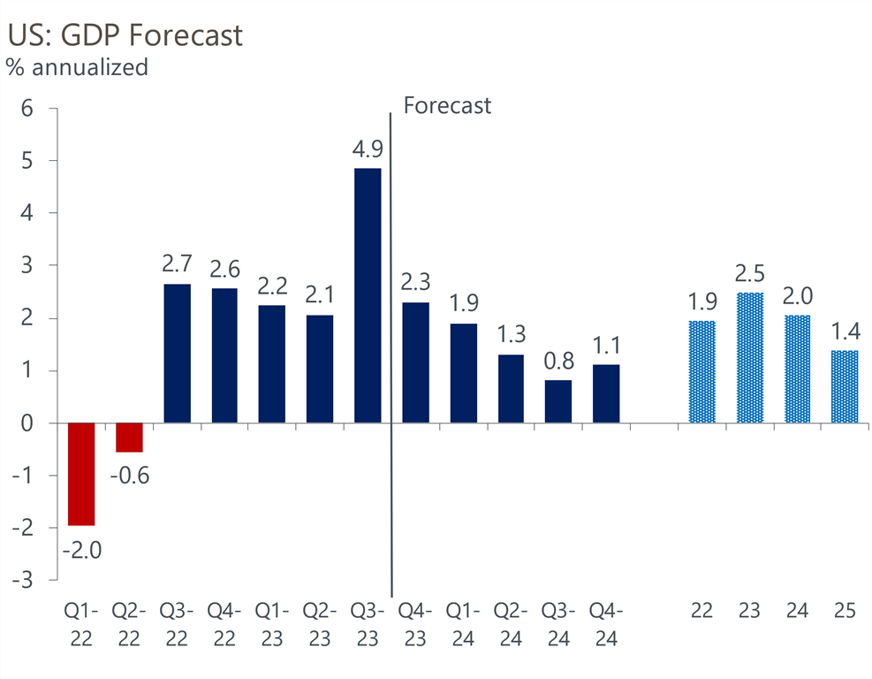
US: GDP Forecast
GDP set to slow as we move through 2024
Risks to are forecast are balanced.
Upside:
Easing financial market conditions
More significant disinflation in core services
Downside:
Significant weakness in the supply side of the economy
Fiscal policy uncertainty weighing more heavily than anticipated on real business investment

Slide 15
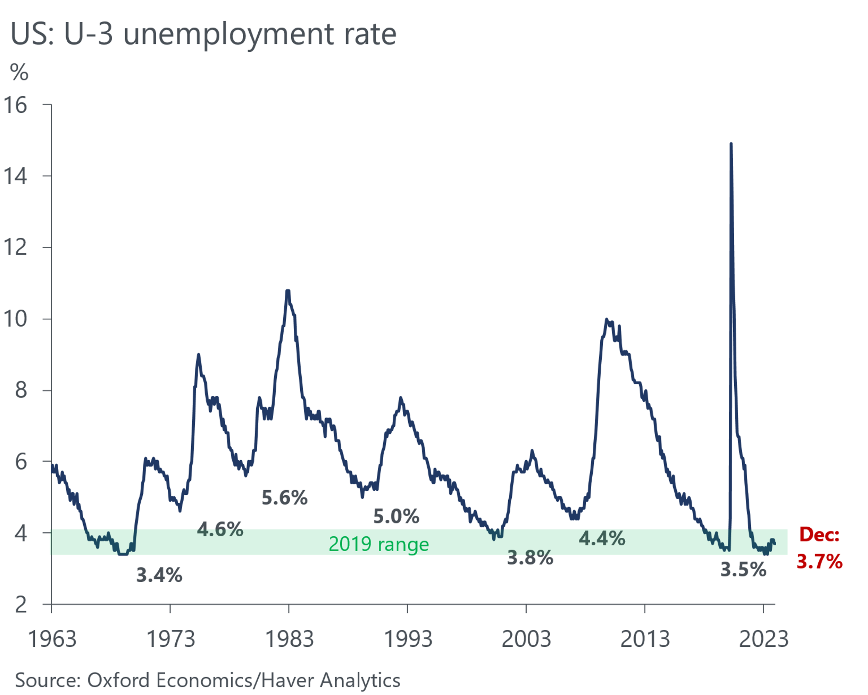
US: Labor Market
Unemployment remains historically low
We expect the unemployment rate will peak this year at 4.25% from its current 3.7%.

Slide 16
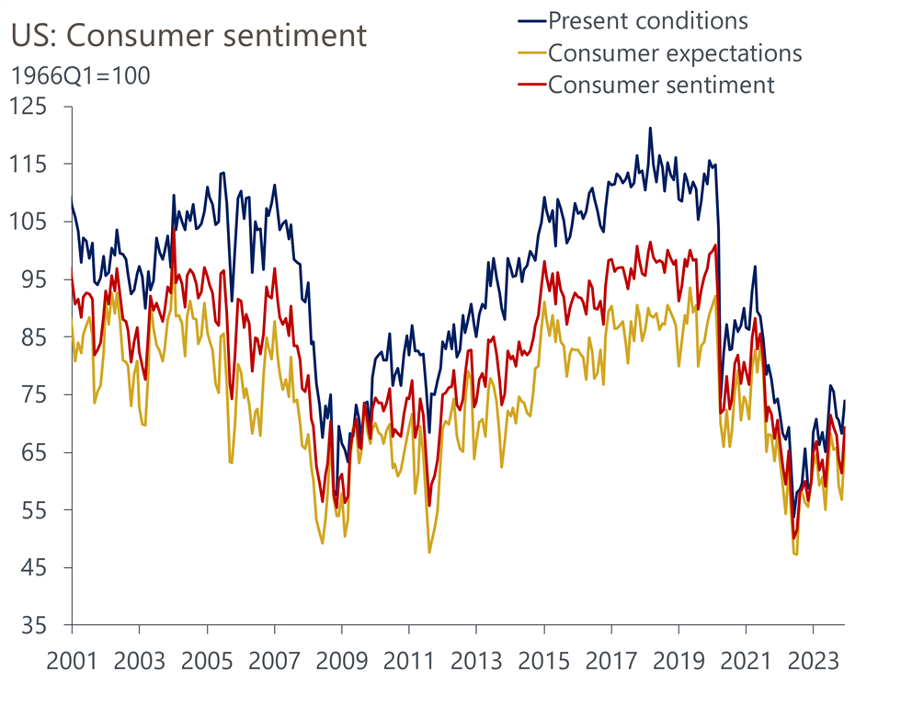
US: Consumer Sentiment
Consumers are feeling uneasy
Consumer sentiment saw a strong rise in January reflecting recent declines in inflation, lower gasoline prices, and the rebound in the stock market.
Confidence alone is not a good indicator of where consumer spending is heading, but improved sentiment does reduce the risk that consumers increase their saving drastically this year, which is a key risk to our more upbeat outlook on consumer spending and GDP growth.

Slide 17
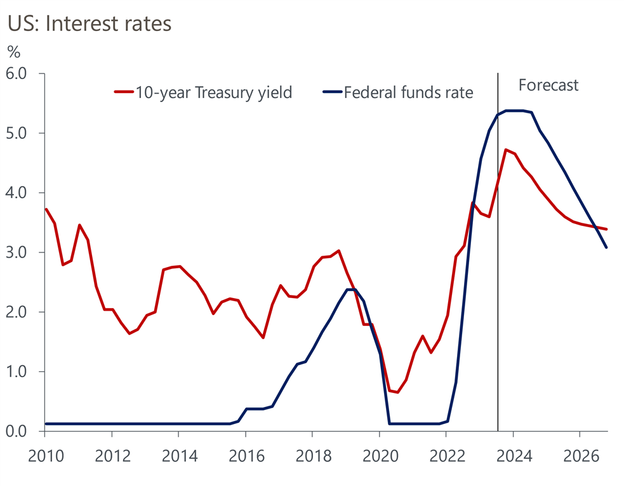
US: Interest Rates
Higher interest rates are leaving their mark
We expect the first rate cut by the Federal Open Market Committee to occur in May.
The Fed is expected to cut rates by 25bps at every other meeting until reaching the neutral rate, which we estimate at 2.25%.

Slide 18
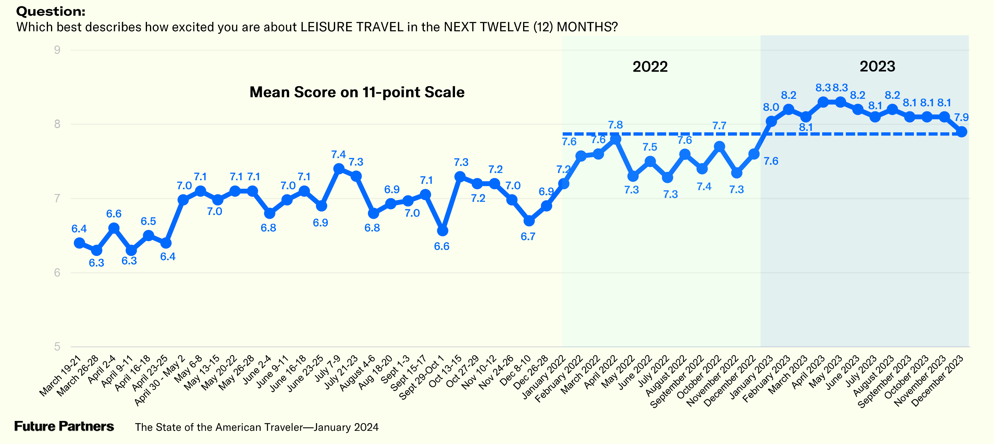
Excitement for travel has waned slightly but remains high

Slide 19
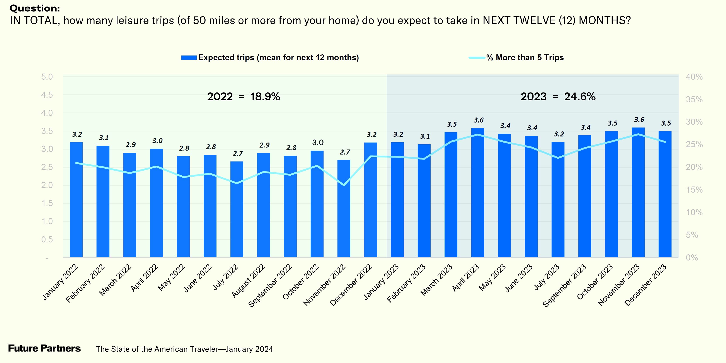
Travel expectations remain higher than last year

Slide 20
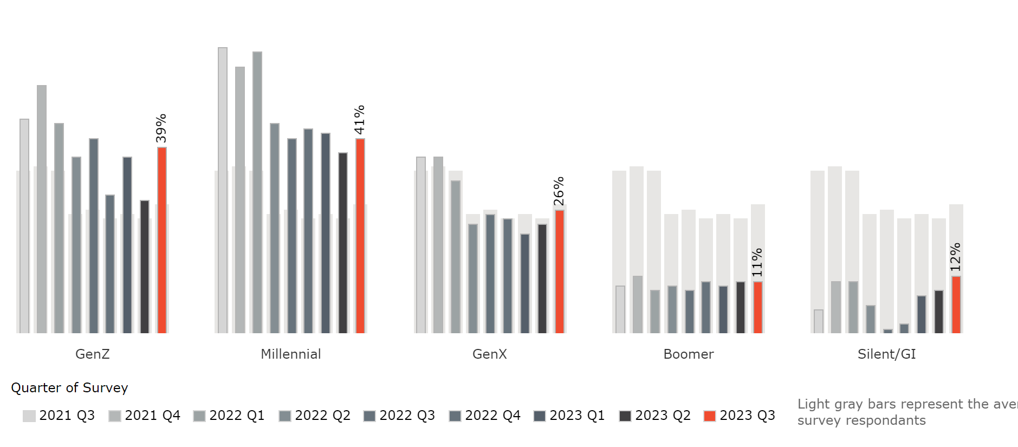

Business travel plans are strengthening
“Group business continues to improve. Total group revenue pace is now 6.7% ahead of the same time 2019, up from 4.2% as of the second quarter … The group booking window continues to extend, and we are pleased with the base we have on the books for next year​.”
Host, 2023Q3 earnings call

Slide 21
International travel
Outbound recovery is well ahead of inbound

Slide 22

International travel
Travel intentions now match pre-pandemic
Base: Respondents who are likely to take an international holiday in the next 12 months
Q. In the NEXT 12 MONTHS, what country or countries will you visit on your international holiday(s)? - % United States
Source: Brand USA/Big Village’s Caravan Omnibus Study

Slide 23
US: Room Demand
Room demand gains will be modest in 2024

Slide 24
Recent California lodging performance
California lodging sector continued to trail the US in 2023
Room demand
California room demand continued to recover in 2023. Hotel demand concluded the year 5% below the 2019 level.
Occupancy
California occupancy recovered to 89% relative to 2019. Average 2023 occupancy stood at 67.1% compared to 75.1% in 2019.
ADR & RevPAR
ADR in 2023 surpassed 2019 by 11%, reaching $190 compared to $172 in 2019.
Hotel performance through August
YTD December 2023 relative to 2019
Source: STR

Slide 25
Forecast results
4

Slide 26
California visitor forecast
Forecast comparison: Current (Jan 2024) vs. previous (Sep 2023)
Total visitors in California
(Millions)
Total visitors in California
(Index, 2019=100)
Source: Tourism Economics
Source: Tourism Economics

Slide 27
California international visitor forecast
Forecast comparison: Current (Jan 2024) vs. previous (Sep 2023)
Global travel recovery will continue in 2024 despite a slower economic backdrop. Many countries that were previously expected to endure recession are now likely to avoid this although economic growth will certainly slow. The travel resilience in North America and Europe is set to continue as consumers continue to prioritize travel while Asia Pacific recovery will gain momentum.
We have upgraded our 2023 forecast for international arrivals to California to 87% of 2019 level (from 82% in September 2023 forecast) on stronger-than-expected Q3 arrivals. Canada and India are leading the recovery and are expected to fully recover this year.
Most notable upgrades came from Asia Pacific, which showed more robust recovery in Q3 than we anticipated. We expect further pick up in the recovery pace as capacity constraints in China ease and visa processes and perceptions of safety continue to improve, which have become key factors in Chinese travel decisions. Outbound trips from China are expected to roughly double in 2024 but will remain around 20% below 2019 levels.
Higher costs stemming from inflation, staff shortages and fuel prices have translated to higher travel prices for consumers, as post-pandemic balance sheets have reduced the ability for airlines and hotels to absorb costs. Combined with a weaker economic backdrop this will limit travel demand, especially in Advanced Economies. The recovery will not be derailed as consumers have demonstrated some tolerance towards higher prices.
Generally, there appear to be strong expectations for travel in 2024. We expect higher occupancy rates in California and greater visitor numbers despite the anticipated economic weakness.
Inbound California visits forecast, 2023
(2019 = 100)
Source: Tourism Economics

Slide 28
California visitor forecast
Relative to 2019 volume
Total visitors in California
(2019 = 100)
California international visitors in 2023
(2019 = 100)
Source: Tourism Economics
Source: Tourism Economics

Slide 29
California visitor forecast
Business vs. leisure
Business vs. leisure visitors in California
(Millions)
Percentage change in business vs. leisure visitors to California
(Year-on-year % change)
Source: Tourism Economics
Source: Tourism Economics

Slide 30
Domestic visitors to California
Day vs. overnight
Domestic day vs. overnight visitors in California
(Millions)
Percentage change in domestic day vs. overnight visitors to California
(Year-on-year % change)
Source: Tourism Economics
Source: Tourism Economics

Slide 31
Direct visitor spending in California
Domestic vs. international
Domestic vs. international visitor spending in California
(2019 = 100)
Domestic vs. international visitor spending in California
($ billions)
Source: Dean Runyan; Tourism Economics
Source: Dean Runyan; Tourism Economics

Slide 32
Forecast tables

Slide 33
Forecast tables

Slide 34
Forecast tables

Slide 35
Forecast tables

Slide 36
About Tourism Economics
Tourism Economics is an Oxford Economics company with a singular objective: combine an understanding of the travel sector with proven economic tools to answer the most important questions facing our clients. More than 500 companies, associations, and destination work with Tourism Economics every year as a research partner. We bring decades of experience to every engagement to help our clients make better marketing, investment, and policy decisions. Our team of highly-specialized economists deliver:
  Global travel data-sets with the broadest set of country, city, and state coverage available
  Travel forecasts that are directly linked to the economic and demographic outlook for origins and destinations
  Economic impact analysis that highlights the value of visitors, events, developments, and industry segments
  Policy analysis that informs critical funding, taxation, and travel facilitation decisions
  Market assessments that define market allocation and investment decisions
Tourism Economics operates out of regional headquarters in Philadelphia and Oxford, with offices in Belfast, Buenos Aires, Dubai, Frankfurt, and Ontario.
Oxford Economics is one of the world’s foremost independent global advisory firms, providing reports, forecasts and analytical tools on 200 countries, 100 industrial sectors and over 3,000 cities. Our best-of-class global economic and industry models and analytical tools give us an unparalleled ability to forecast external market trends and assess their economic, social and business impact. Headquartered in Oxford, England, with regional centers in London, New York, and Singapore, Oxford Economics has offices across the globe in Belfast, Chicago, Dubai, Miami, Milan, Paris, Philadelphia, San Francisco, and Washington DC, we employ over 500 full-time staff, including 300 professional economists, industry experts and business editors—one of the largest teams of macroeconomists and thought leadership specialists.
For more information:
info@tourismeconomics.com

